Slide 1
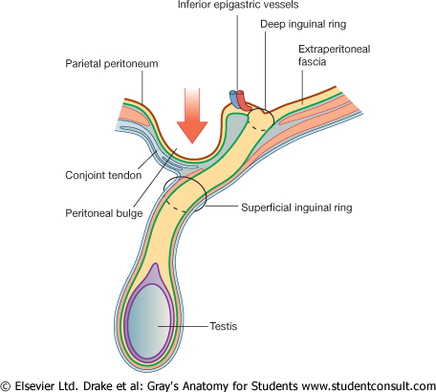
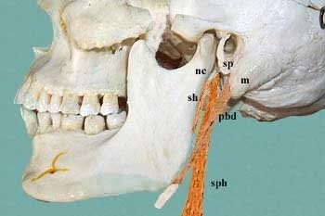
INGUINAL CANAL
Dr. Praveen Kumar Kurrey
MBBS, MS, BCME,BCBR
Professor Anatomy

Slide 2
For Students…………..
This lockdown holidays are not for sleeping,
Its time to show the hidden talent inside you.
Study hard, selective and study for knowledge.
Its time to study by urself, as all of you are talented neet selected ,intelligent students.
We can only help you through ppts but actual study is done from books.
Exam is near, be ready and prepared.
Stay safe and healthy……………
Dr.Praveen Kurrey

Slide 3
Very Important Questions
For University Exam………

Slide 4
LONG QUESTIONS
Inguinal canal ,Mechanism and hernia
Testis, coverings, histology, development and descent of testis with applied
Stomach, blood supply, nerve supply, relations and clinical importance
Relations of second part, histology, development and applied of Duodenum
Appendix, positions, histology, development and clinical
Portal vein , relations and porto-caval anastomosis
Describe Extrahepatic biliary apparatus
Pancreas, relations of head, body, development ,histology and clinical
Kidney, relations of both surface, histology,development and clinical
Diaphragm, openings, development and clinical
Ischiorectal fossa in detail and applied
Superficial and deep perineal pouches
Urinary bladder, relations, histology, development and ligaments
Ovary, relations, histology, development and clinical
Uterus, relations, supports, histology development and clinical
Prostate, relations, histology, development, age changes and clinical
Anal canal, structure, zones, sphincters and clinical piles

Slide 5
Short Notes
Meckels diverticulum
Bed of caecum
Visceral relations of spleen
Capsules of kidney
Normal constrictions of ureter
Suprarenal gland, relations and blood supply
Perineal membrane, structure piercing in male and female
Pudendal canal and pudendal block
Fallopian tube, parts relations and applied
Age changes in Prostate gland
Curvatures of rectum
Hemorrhoides
Branches of internal carotid artery
Levator ani and Psoas major muscle
Pelvic diaphragm
Difference between male and female pelvis
Holdens line
Inguinal ligament
Rectus sheath
Fascia transversaalis
Spermatic cord
Layers of scrotum
Nine quadrants of abdomen
Transpyloric plane
Greater and lesser omentum
Epiploic foramen
Lesser sac
Hepatorenal pouch
Peritoneal reflection over male and female genitalia
Stomach bed
Differnence between jejunum ad ileum mesentry

Slide 6
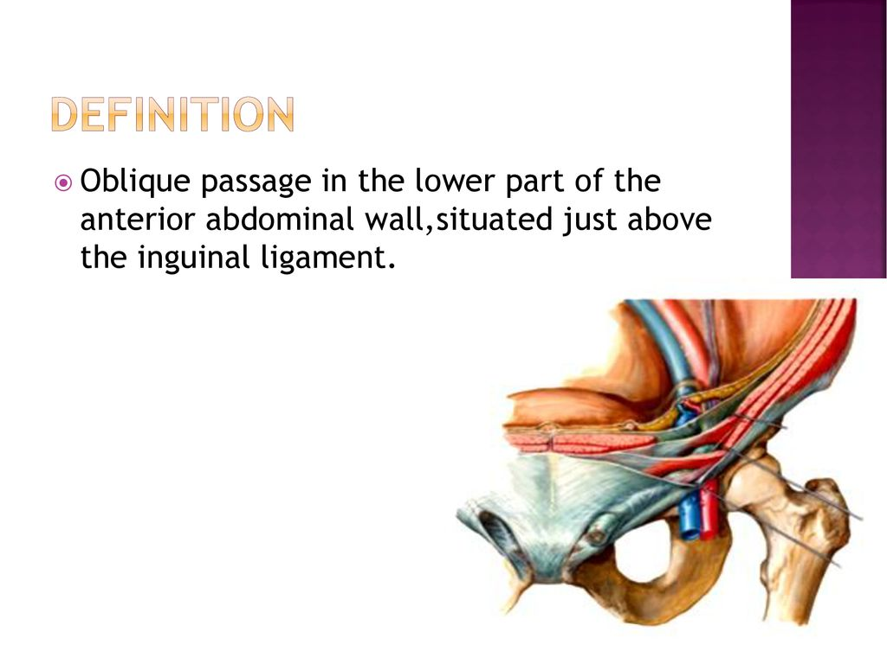

Slide 7
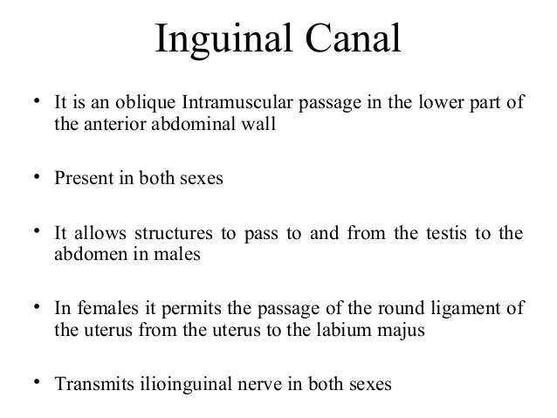

Slide 8
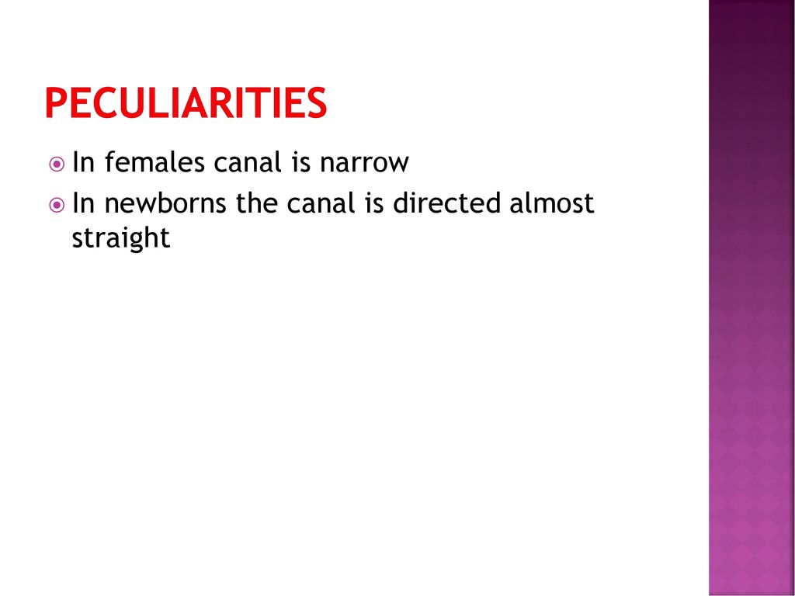

Slide 9
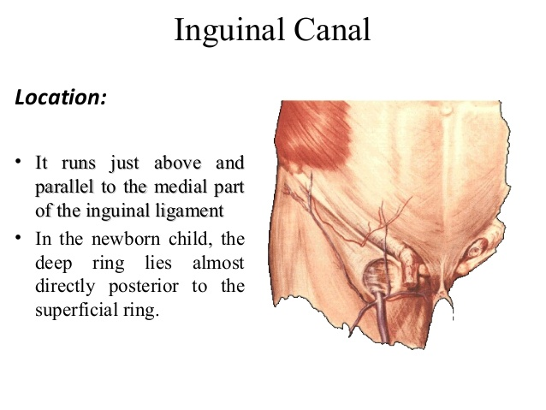

Slide 10
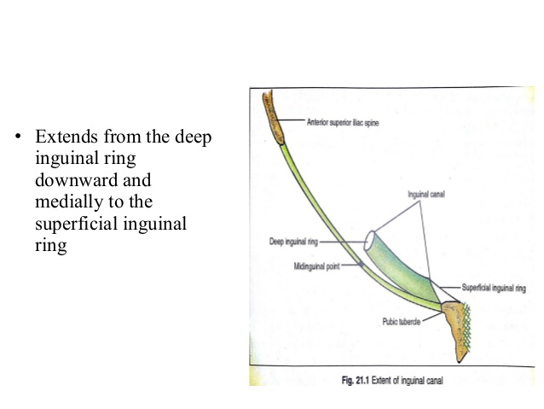

Slide 11
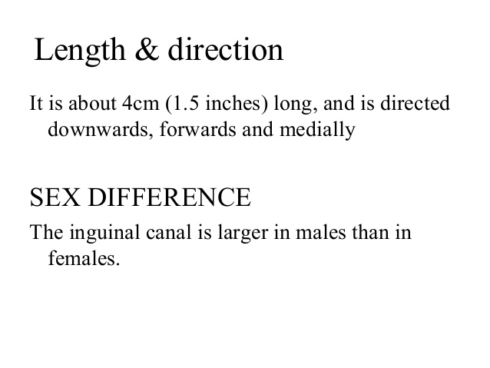

Slide 12
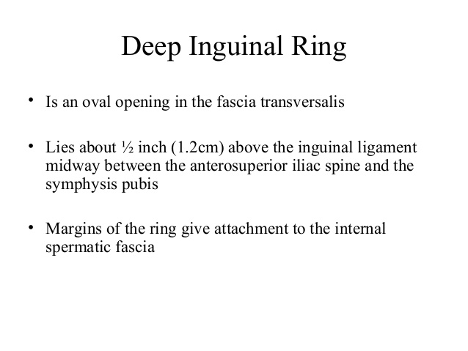

Slide 13
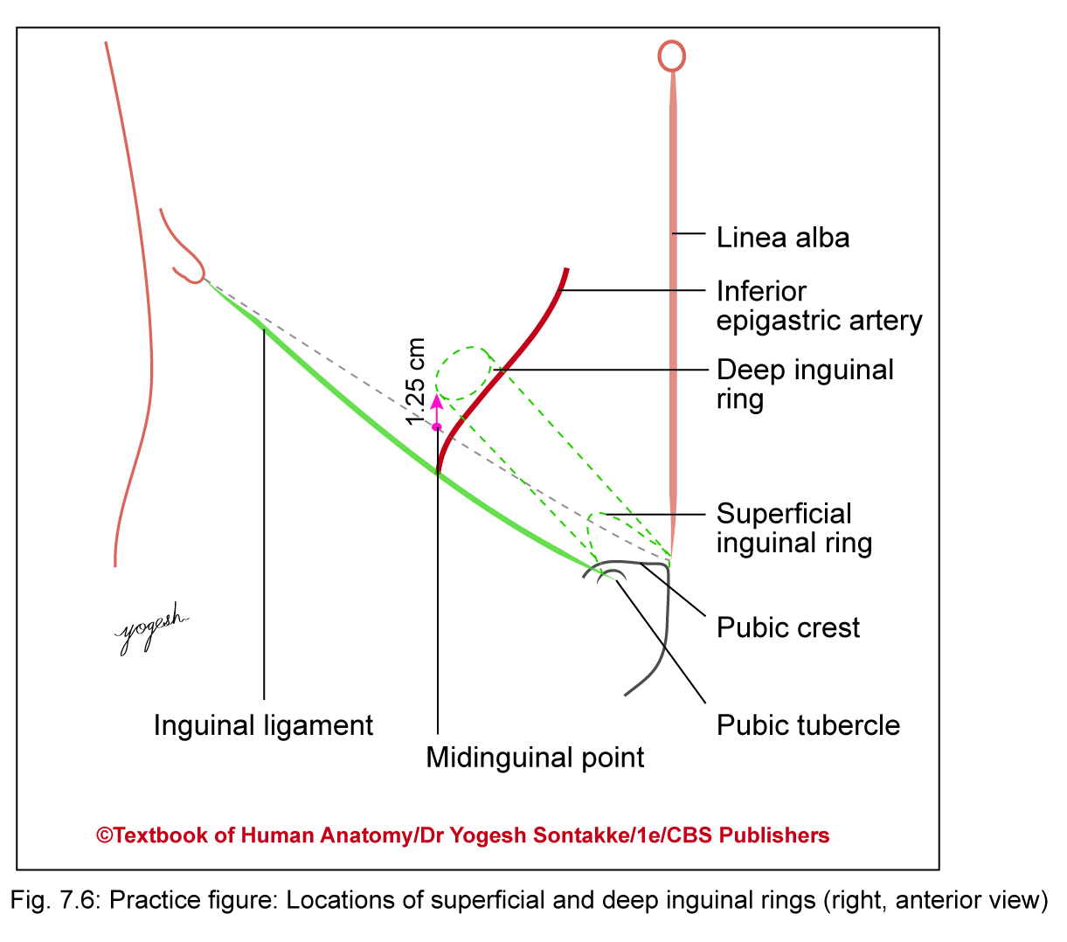
Inguinal rings
Deep inguinal ring
Forms inlet of inguinal canal
Opening in fascia transversalis
Location: Located 1.25 cm above midinguinal point, just lateral to beginning of inferior epigastric artery

Slide 14
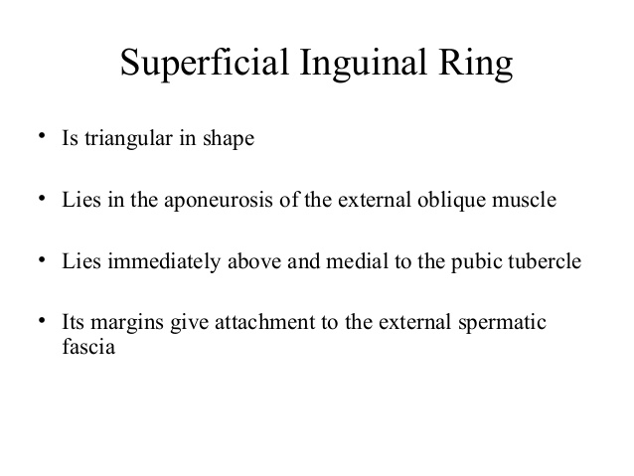

Slide 15
Inguinal rings
Superficial inguinal ring
Boundaries of superficial inguinal ring
Bounded as follows
  Base: Pubic crest
  Apex: Directed upward and laterally and formed by convergence of two crura
  Medially: Superior crus – attached to pubic symphysis
Laterally: Inferior crus – attached to pubic tubercle
Measurements: 2.5 cm long and 1.2 cm broad (at base)

Slide 16
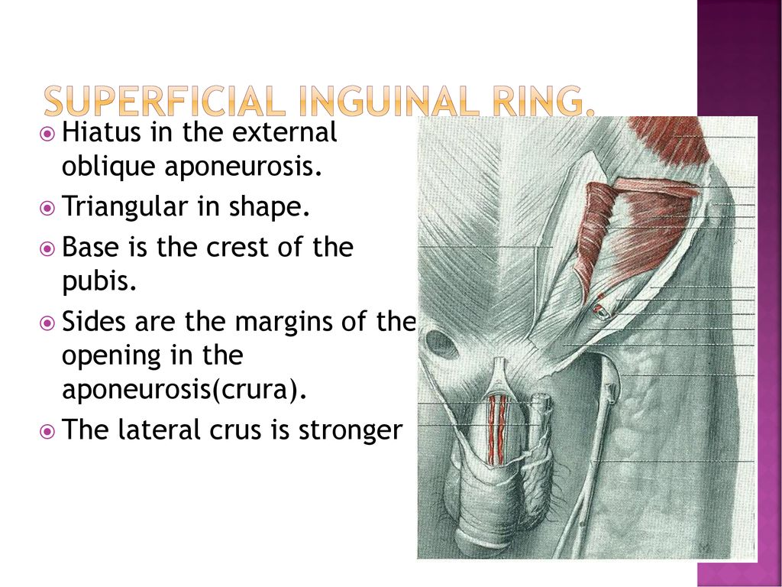

Slide 17
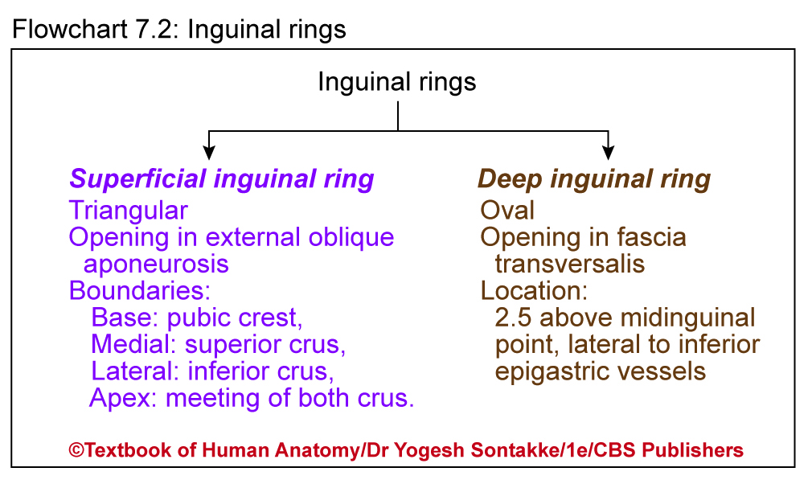

Slide 18
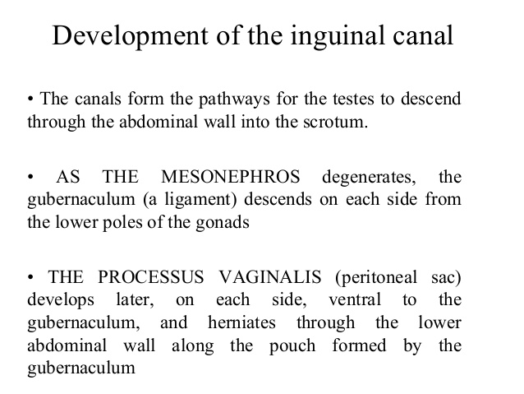

Slide 19
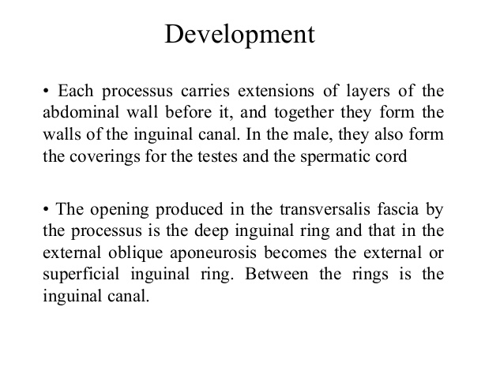

Slide 20
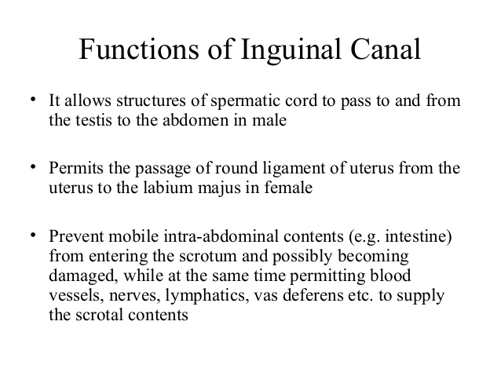

Slide 21
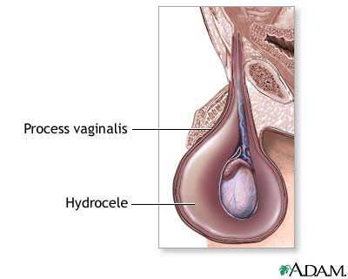

Slide 22
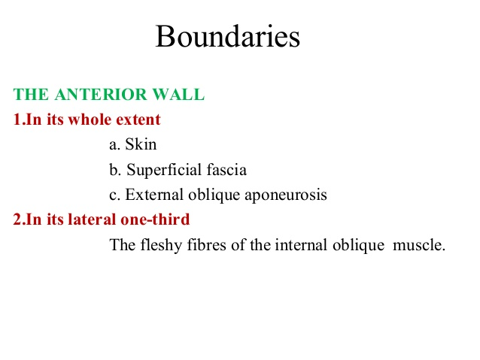

Slide 23
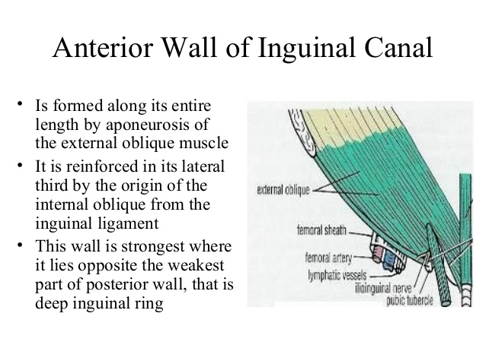

Slide 24
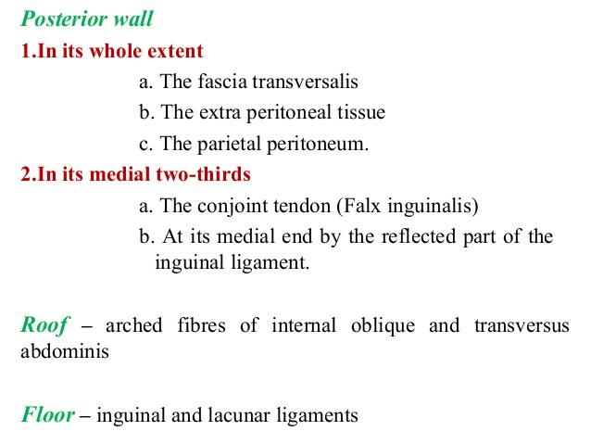

Slide 26
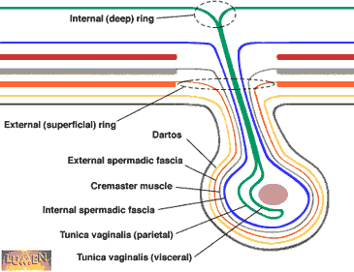

Slide 27
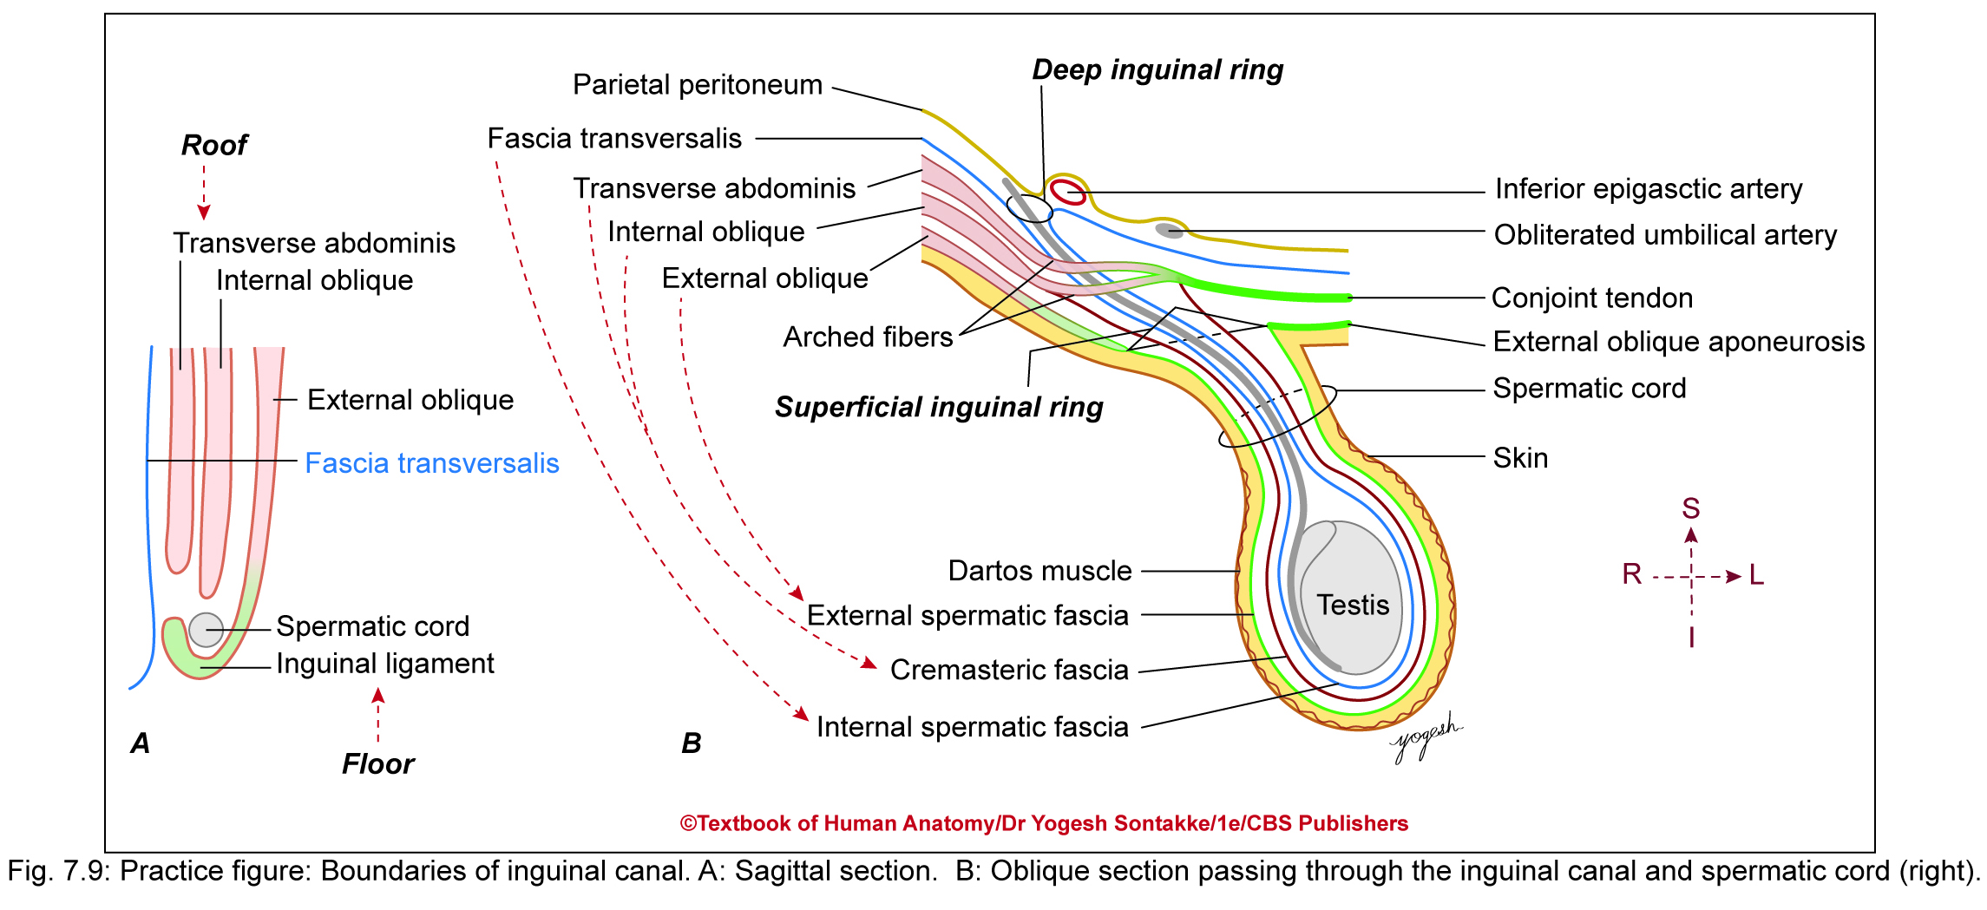

Slide 28
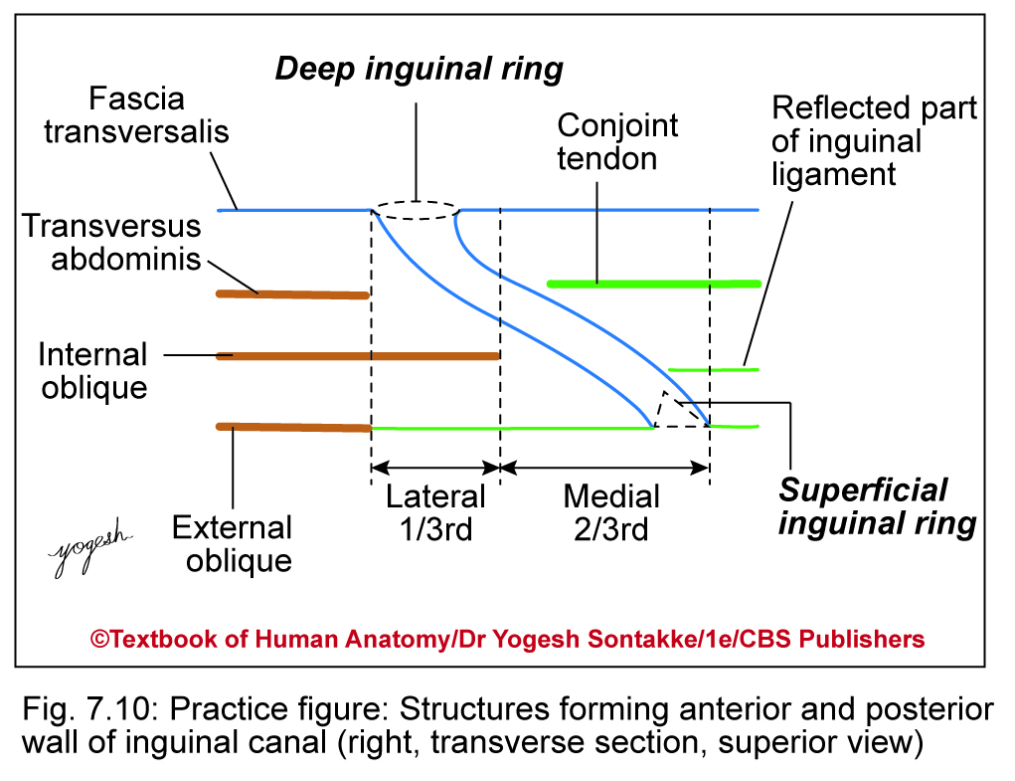

Slide 29
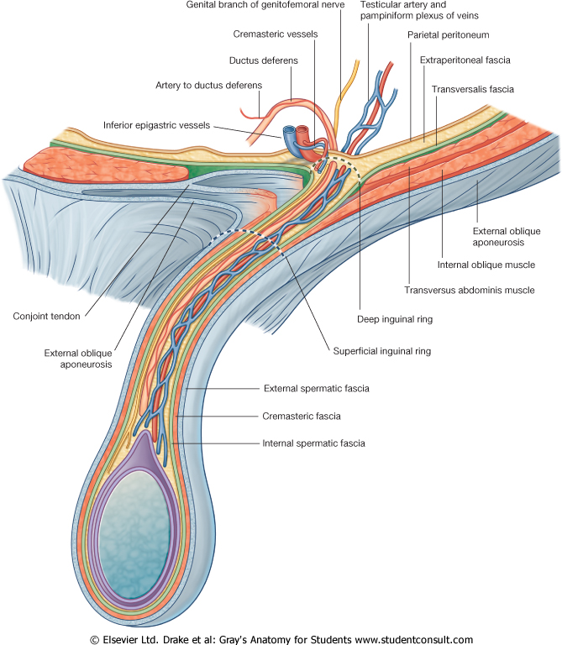

Slide 30
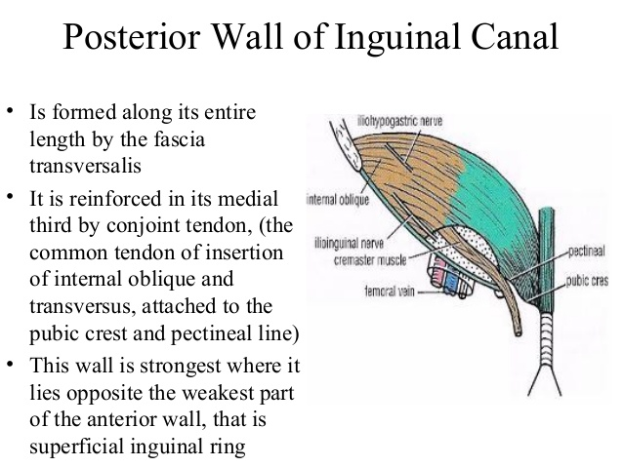

Slide 31
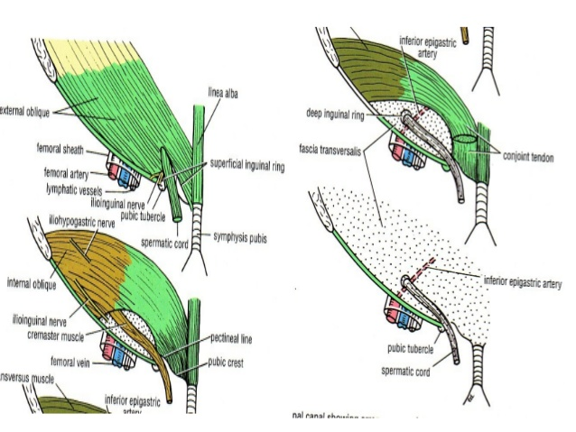

Slide 32
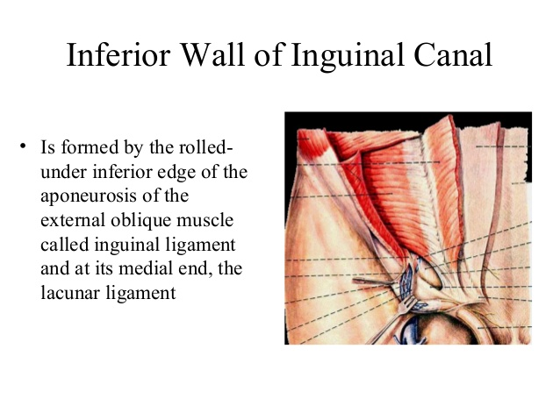
Floor

Slide 33
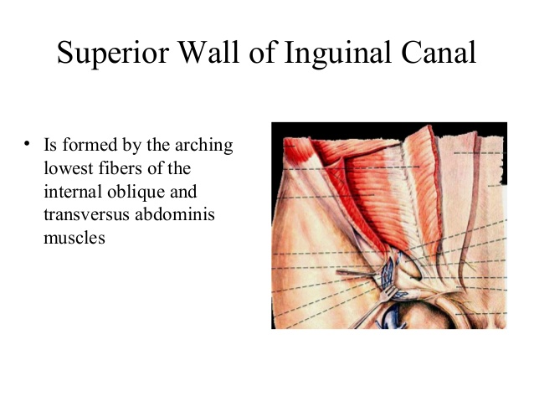
Roof

Slide 34
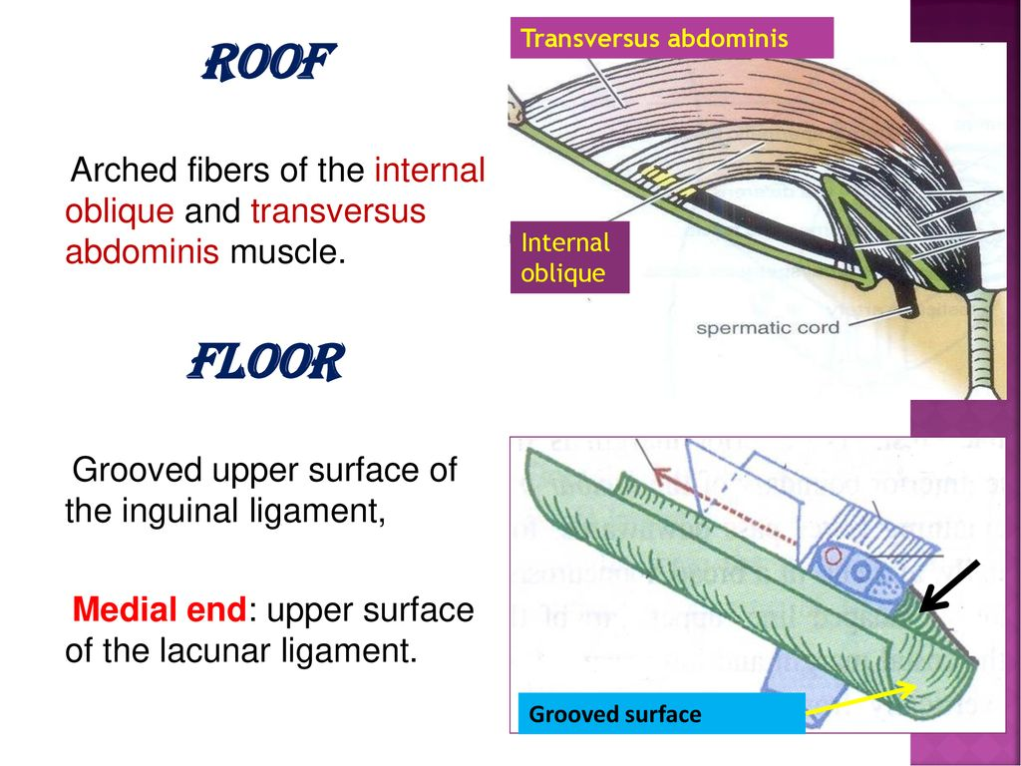

Slide 35
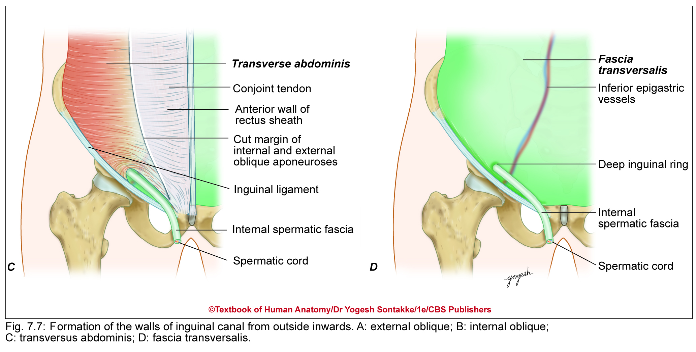

Slide 37
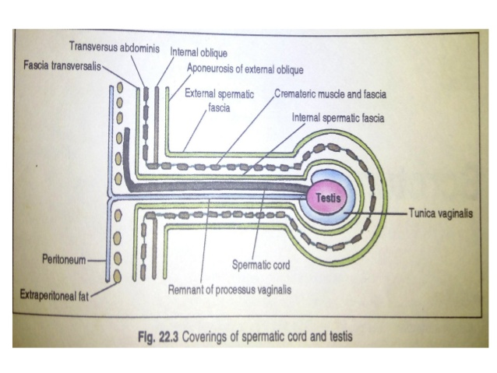

Slide 38
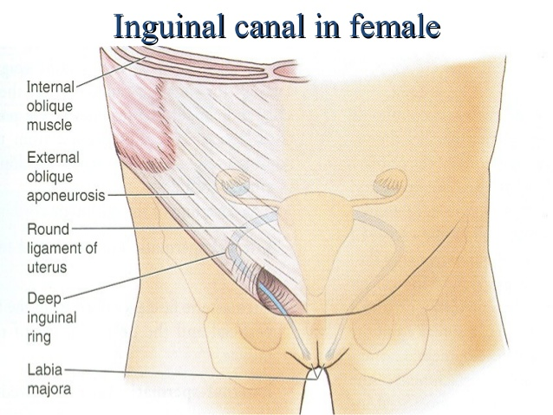

Slide 39
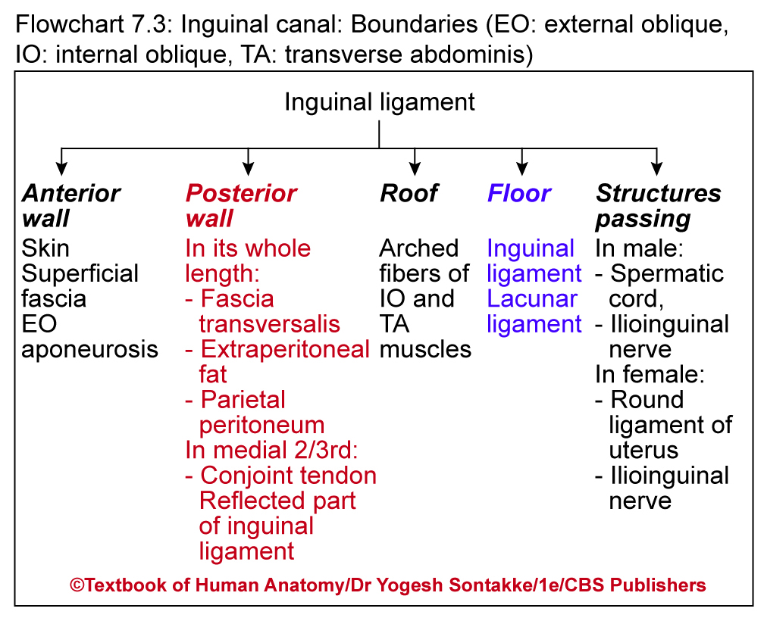

Slide 40
CONTENTS OF INGUINAL CANAL
Structures passing through inguinal canal
  In male: Spermatic cord, ilioinguinal nerve
  In female: Round ligament of uterus and ilioinguinal nerve

Slide 41
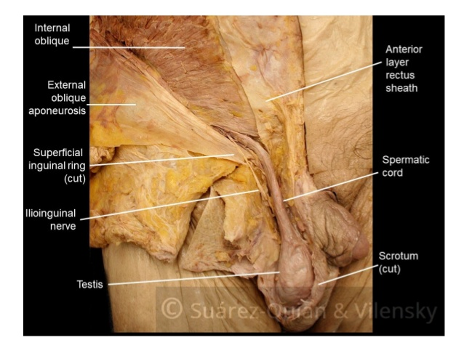

Slide 42
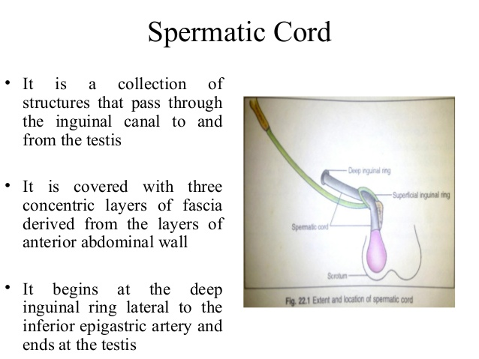

Slide 43
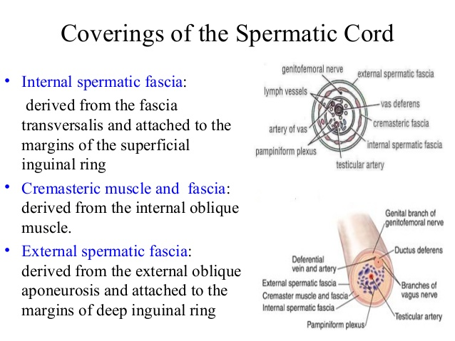

Slide 45
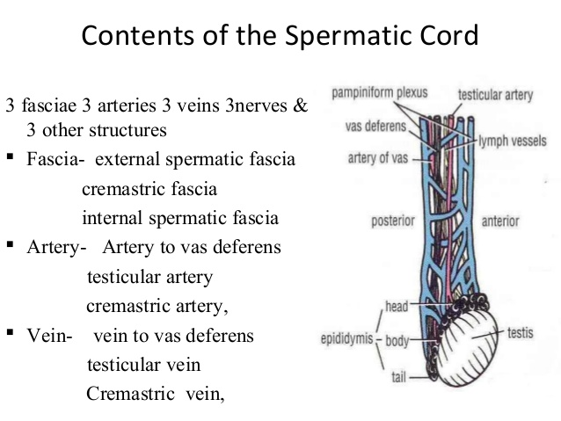

Slide 46
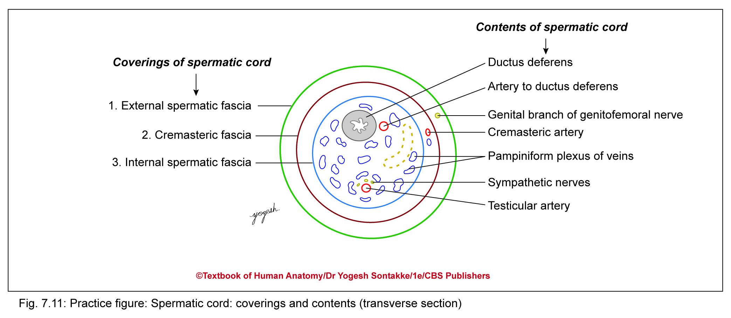
CONTENTS OF SPERMATIC CORD

Slide 47
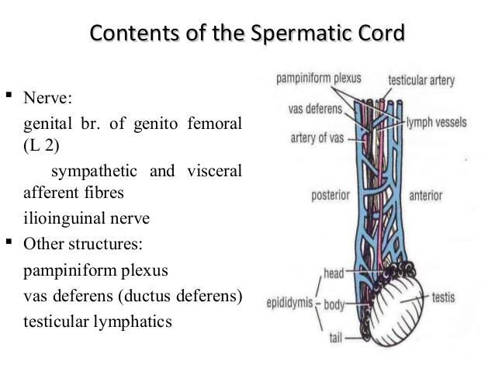

Slide 48
Mechanism to maintain integrity of inguinal canal
Due to weakness at inguinal canal, herniation of abdominal viscera may occur
Naturally prevented by defensive mechanism maintains integrity of inguinal canal
These mechanisms include
  Flap valve mechanism
  Guards of inguinal ring
  Shutter mechanism
  Slit valve mechanism
  Ball valve mechanism

Slide 49
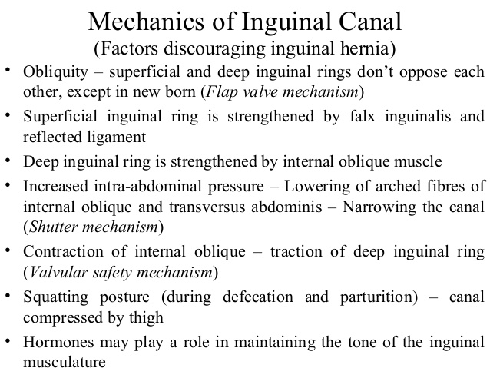

Slide 50
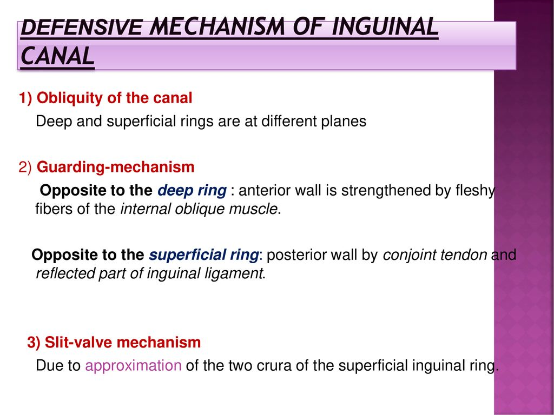

Slide 51
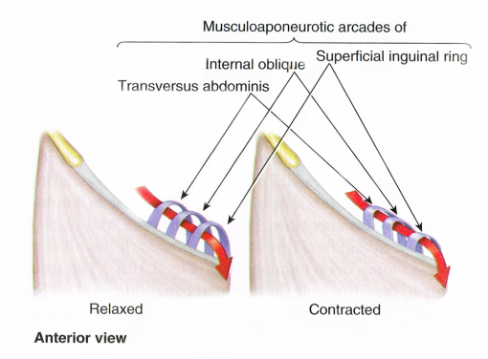

Slide 52
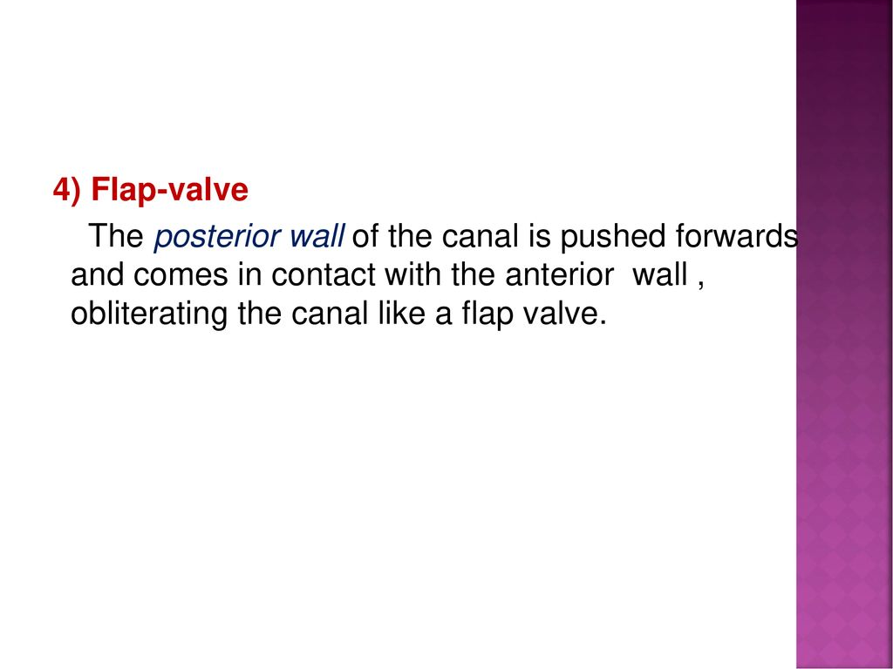

Slide 53
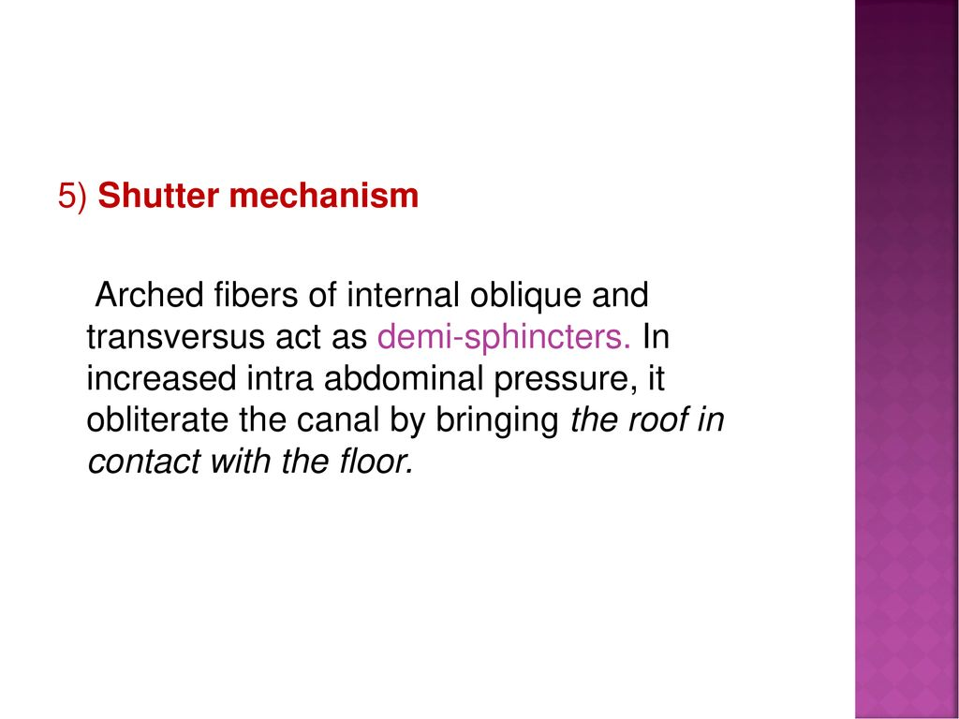

Slide 54
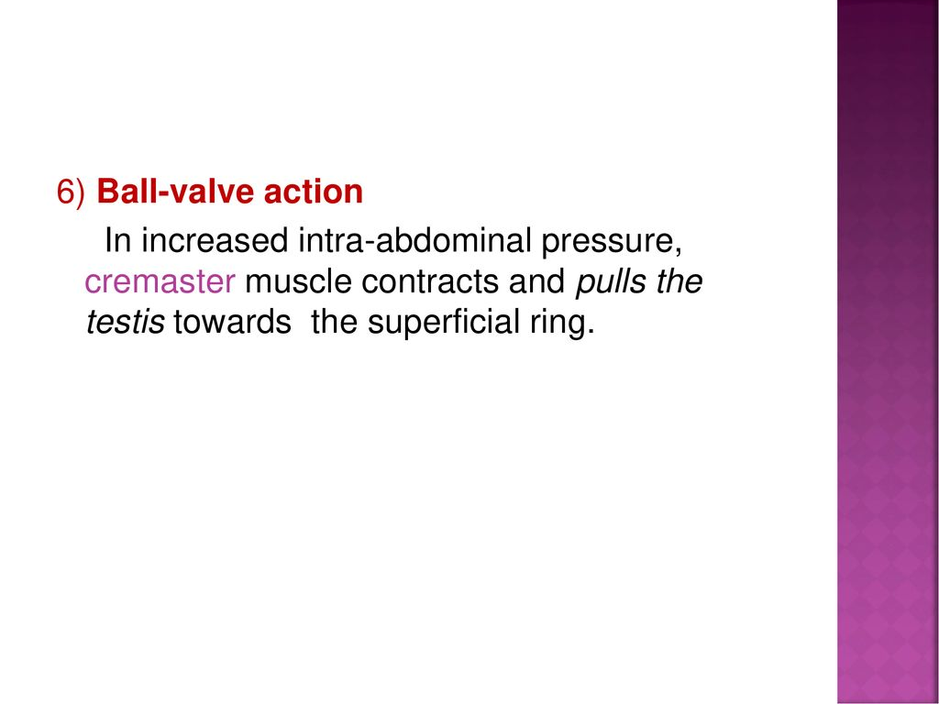

Slide 55
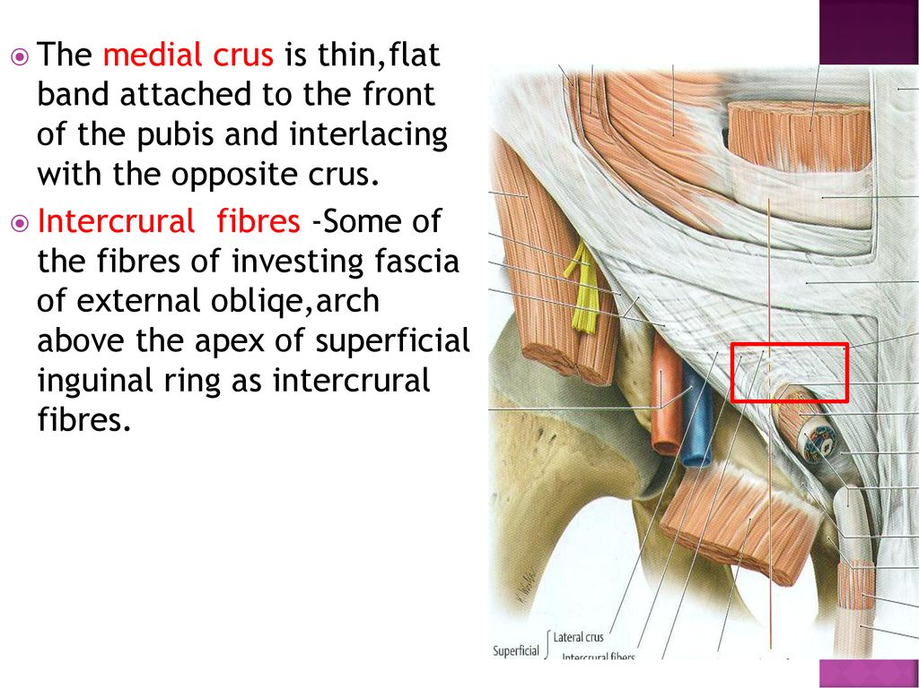

Slide 56
Mechanism of integrity of inguinal canal
Mechanism | Factor responsible
Flap valve mechanism | Obliquity of inguinal canal
Guarding of inguinal ring
Superficial inguinal ring | Posteriorly guarded by conjoint tendon
Deep inguinal ring | Fleshy fibers of internal oblique
Shutter mechanism | Triple relation of internal oblique
Slit valve mechanism | Contraction of external oblique
Ball valve mechanism | Plug action of cremaster muscle

Slide 57
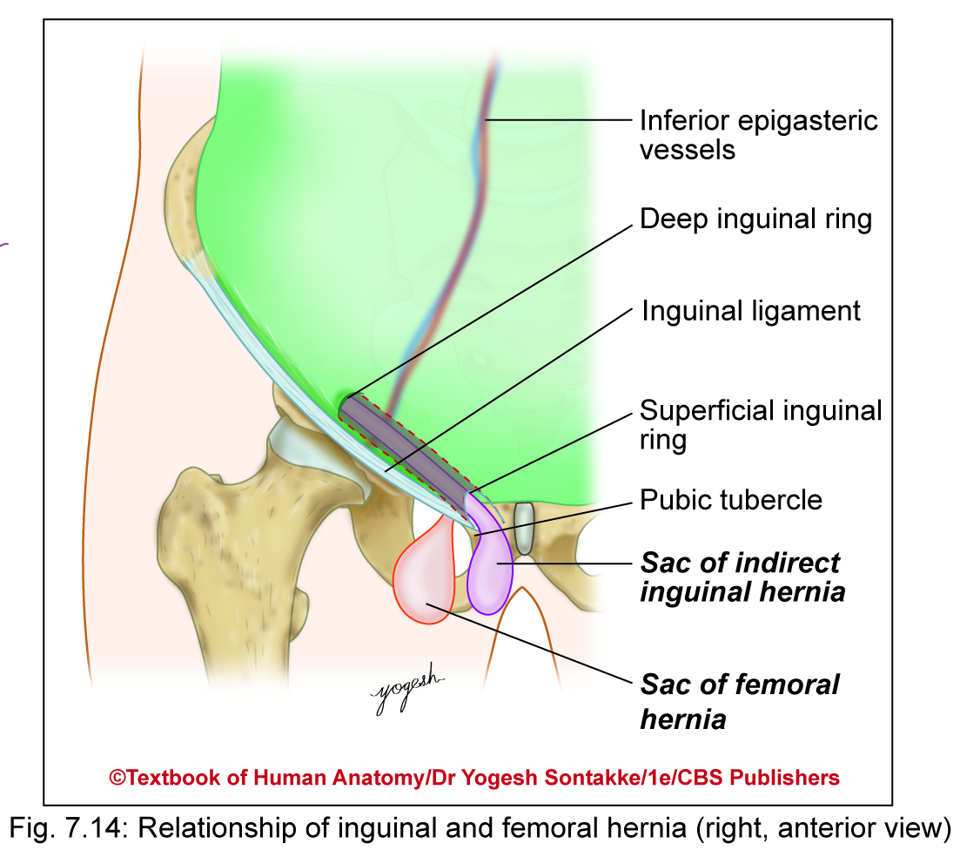
HERNIA
Types of External Abdominal Hernias
Are of following types
Congenital umbilical hernia occurs due to failure of midgut loop to return to abdominal cavity
Acquired infantile umbilical hernia
  Occurs due to weak umbilical scar
  May disappear as infant grows

Slide 58
HERNIA
Types of External Abdominal Hernias
Are of following types
Paraumbilical hernia (belly button hernia) occurs due to protrusion of intestinal coils through linea alba surrounding umbilicalus
Femoral hernia – protrusion of abdominal contents through femoral canal
More common in female due to wider pelvis

Slide 59
HERNIA
Epigastric hernia occurs through anterior abdominal wall in epigastric region
Petit’s hernia occurs in Petit’s lumbar triangle on posterolateral abdominal wall
Spiegel’s hernia occurs at junction of linea semilunaris and arcuate line
Incisional hernia occurs through incompletely healed surgical wound of abdominal wall
Inguinal hernia – protrusion of abdominal content in inguinal canal

Slide 60
CLINICAL ANATOMY
INGUINAL HERNIA
may be indirect or direct:
a) Indirect inguinal hernia is the result of herniation of abdominal contents through the deep inguinal ring which can be extended to the scrotum or labia majora.
b) Direct inguinal hernia originates through Hesselbach s triangle, medial to epigastric vessels and rarely complicated

Slide 61
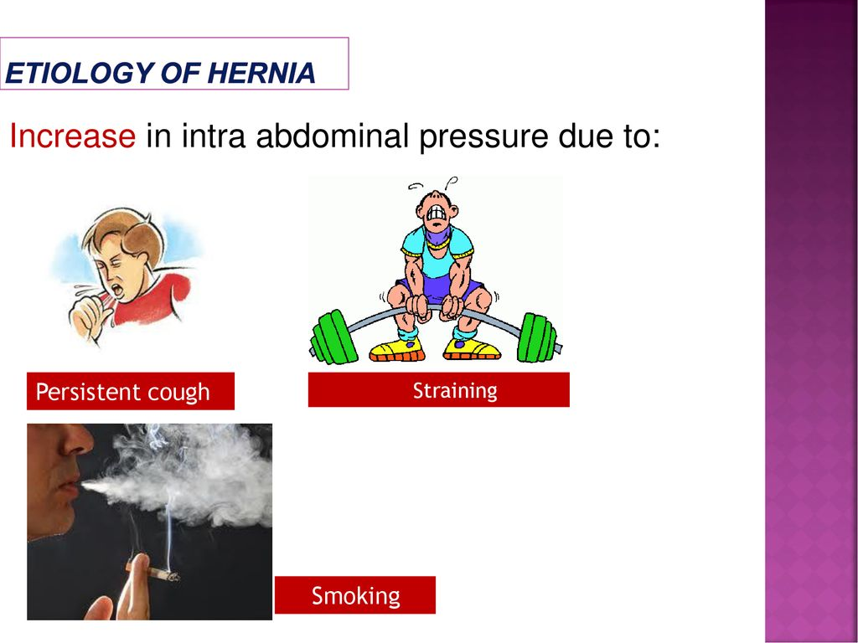

Slide 62
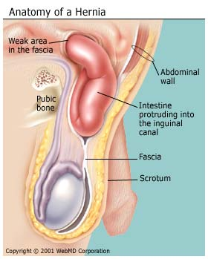

Slide 63
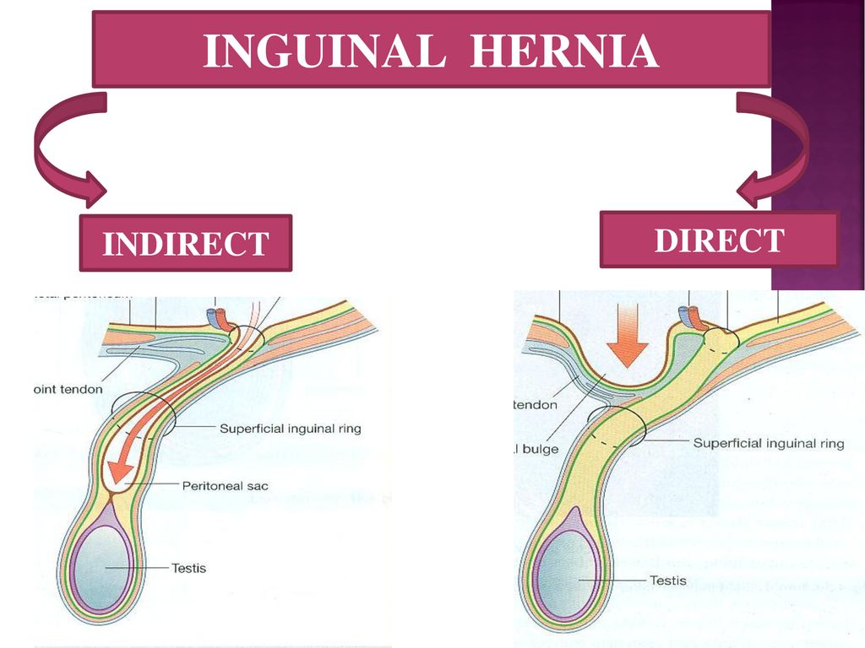

Slide 64


Slide 65

INDIRECT (OBLIQUE) DIRECT

Slide 66


Slide 67


Slide 68


Slide 69
APPLIED ANATOMY
INGUINAL HERNIA Cont’d :
INDIRECT (OBLIQUE) or DIRECT
INDIRECT (OBLIQUE) INGUINAL HERNIA | DIRECT INGUINAL HERNIA
Hernial sac enters Inguinal canal through Deep inguinal ring | Through Hesselbach’s Triangle
Neck : Lateral to Inf Epigastric Artery | Medial to IE Artery
Usually Unilateral . In Young adults | Usually Bilateral . In Old age
Direction : D-F-M | Forwards
Cause : Congenital , Due to persistence of processus vaginalis of peritoneum | Acquired, Due to weakness of Conjoint tendon (AAW)
Receives all the coverings of spermatic cord. Vas Def below the sac | Herneal sac lies between Internal spermatic fascia & cremasteric fascia

Slide 70
Differences between indirect and direct inguinal hernia
Feature | Indirect inguinal hernia | Direct inguinal hernia
Site of entry of hernia | Through deep inguinal ring | Through posterior wall of inguinal canal
Shape of hernial sac | Pear-shaped | Globular
Extent | Extends usually up to scrotum | Remains confined to inguinal canal
Direction of sac | Oblique (downward, forward, and medially) | Straightforward
Neck of hernial sac | Narrow | Wide
Reducibility | Sometimes irreducible | Always reducible
Internal ring occlusion test | Not seen | Seen (negative)

Slide 72


Slide 73


Slide 74
INGUINAL HERNIA Cont’d :
RARE TYPES :
  Maydl’s [Double (‘W’) loop]
  Richters (A portion of the circumference of bowel is strangulated)
  Littre’s (Sac contains Meckel’s diverticulum)
  Epiplocele : (Sac contains omentum)

Slide 75
INGUINAL HERNIA Cont’d :
COMPLICATIONS : Obstruction, Strangulation
TREATMENT :
Herniotomy
  Herniorrhaphy
  Hernioplasty

Slide 76
For Students……..
Don’t take the university exam lightly.
Study hard ,daily, in a routine and all subjects daily.
Don’t break continuity.
Focus on ur future.
Careful about ur health, diet and sleep.
I hope all u will get grand success….
Hoping best for ur future……………
Dr. Praveen Kurrey

Slide 77

THANK YOU

