Slide 1
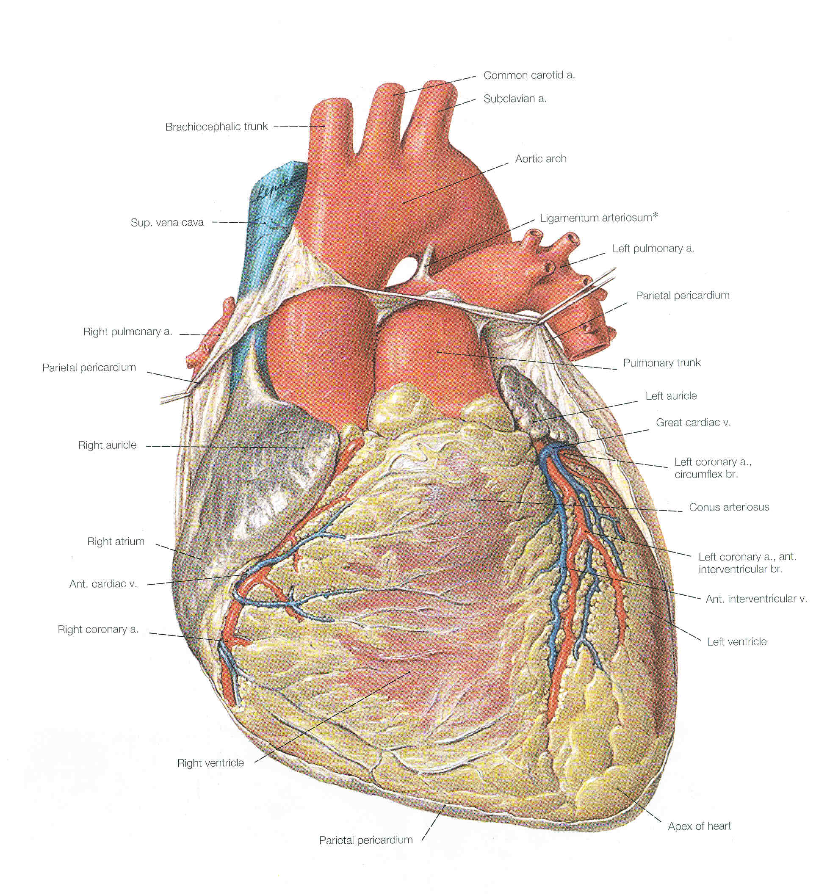
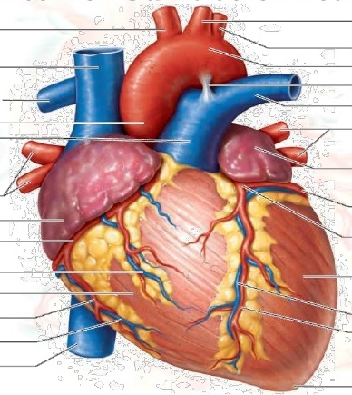
heart
Dr. Praveen Kumar Kurrey
M.B.B.S., M.S. , B.C.M.E, B.C.B.R.
Professor Anatomy

Slide 2
Heart
Approximately the size of your closed fist
Location
  Superior surface of diaphragm
  Left of the midline
  Anterior to the vertebral column
  posterior to the sternum

Slide 3
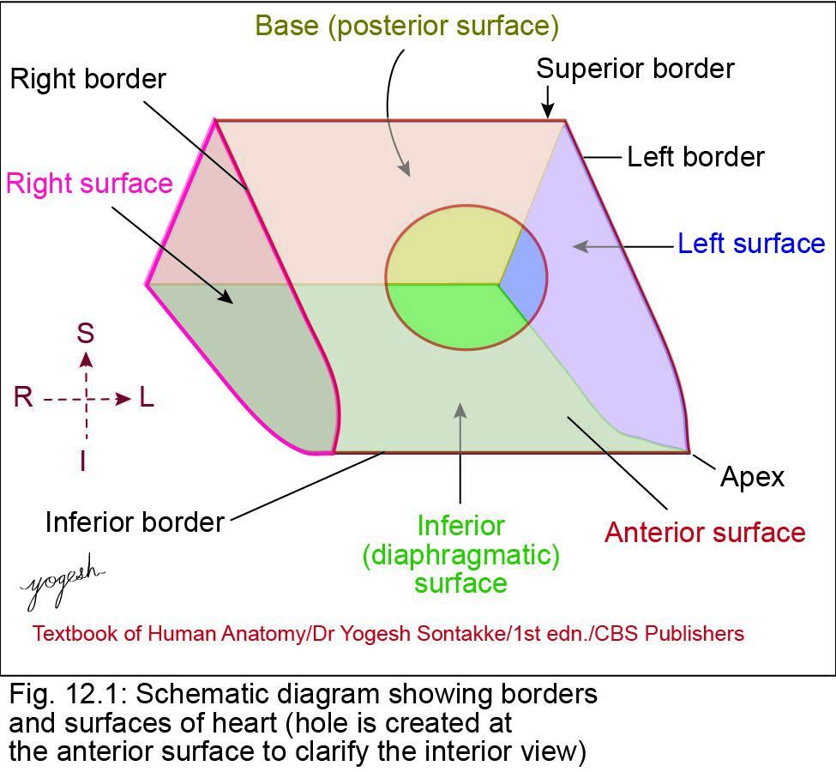
Heart - Introduction
Conical hollow muscular organ located in middle mediastinum
Enclosed within pericardium
About size of clenched fist of individual
Consists of four chambers: right atrium, right ventricle, left atrium, and left ventricle
Right atrium receives deoxygenated blood from superior and inferior venae cavae and transfer – right ventricle

Slide 4
DIMENSIONS
Length – 12 cm
Width – 9 cm
Thickness – 6 cm
Weight – 300 gms in males
250 gms in females

Slide 5
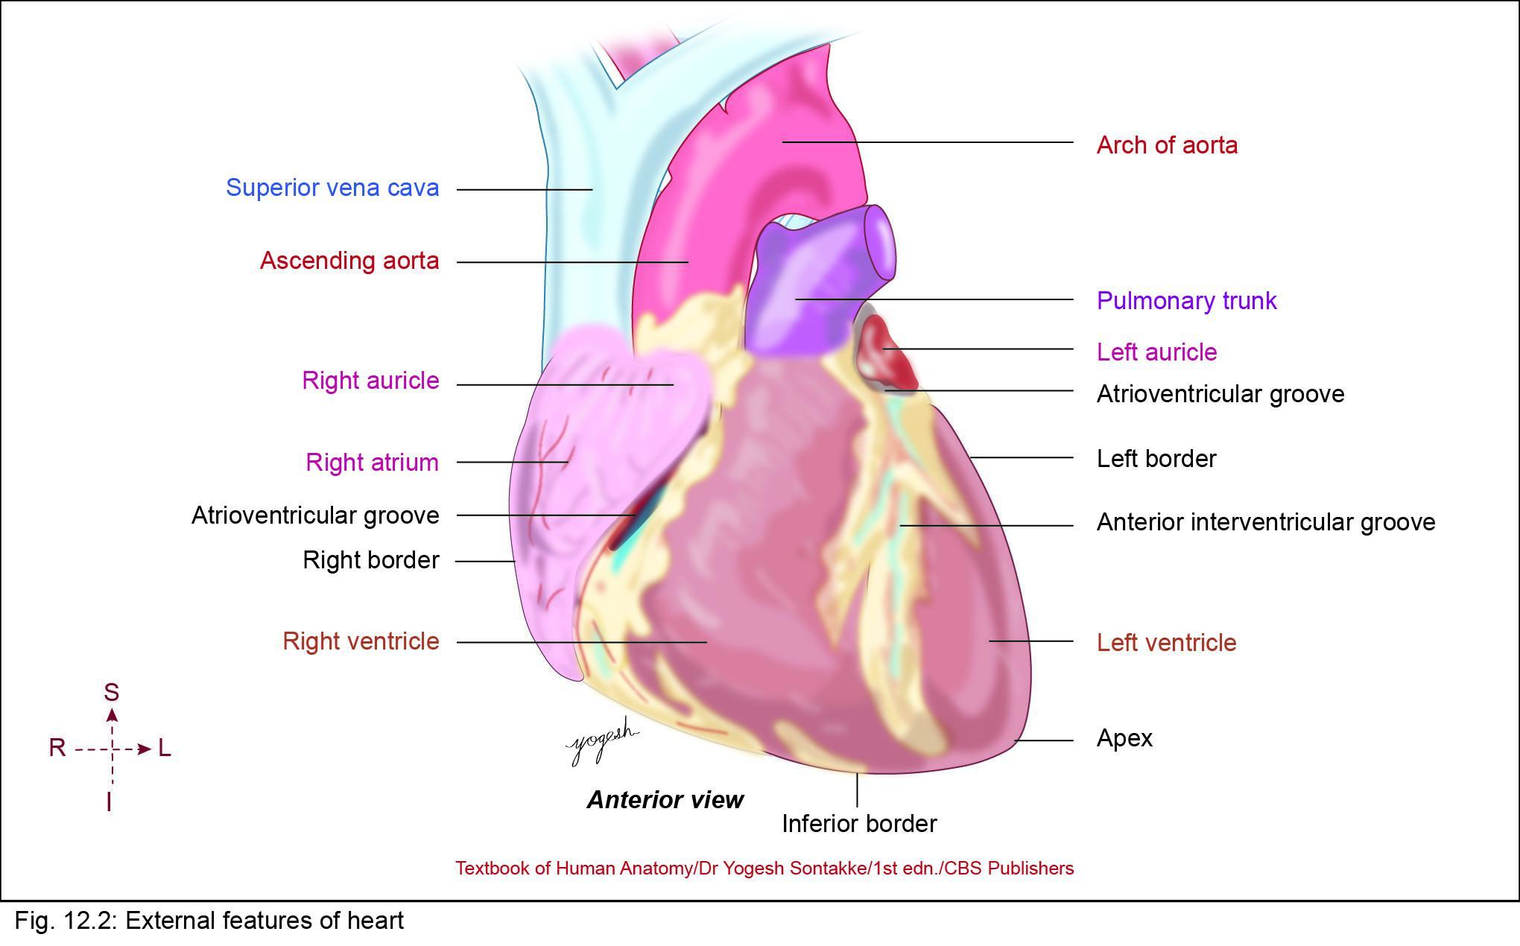

Slide 6
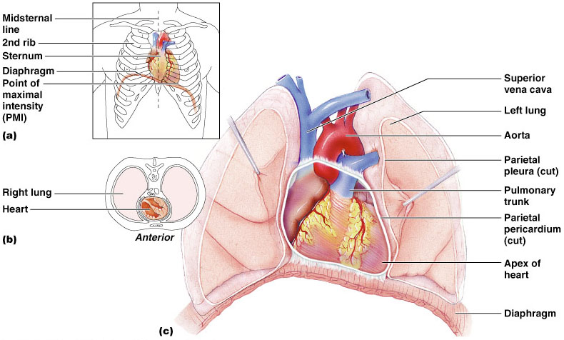
Heart Location
Figure 18.1

Slide 7
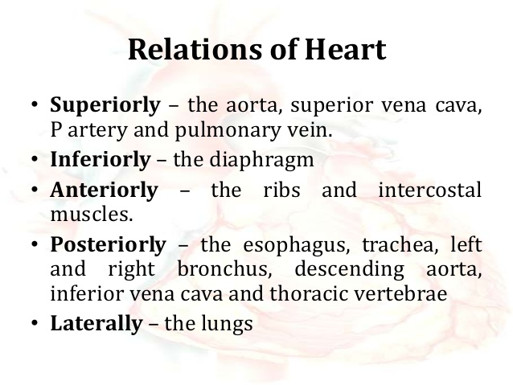

Slide 8
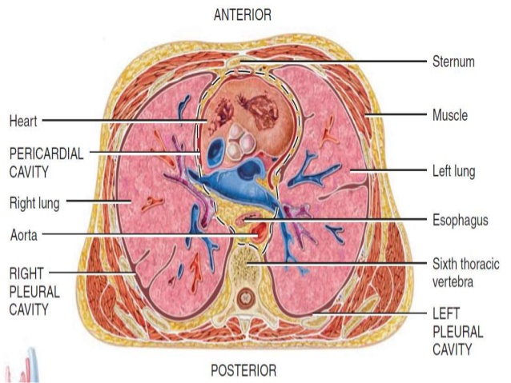

Slide 9
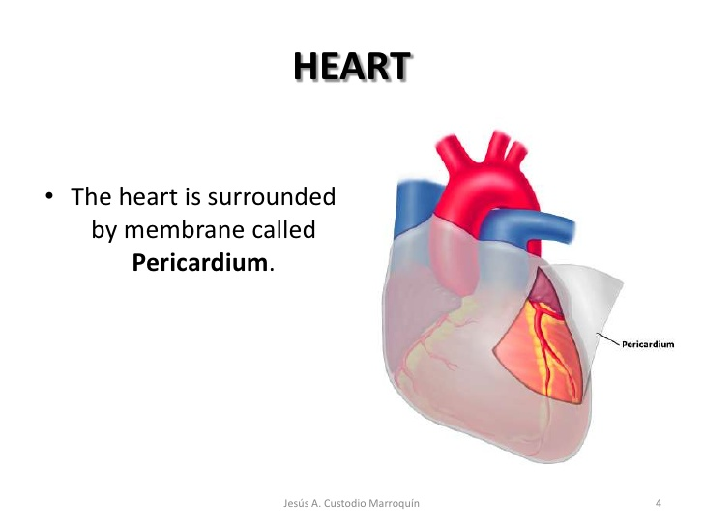

Slide 10
Coverings of the Heart
Pericardium – a double-walled sac around the heart composed of:
  A superficial fibrous pericardium
  A deep two-layer serous pericardium
    The parietal layer lines the internal surface of the fibrous pericardium
    The visceral layer or epicardium lines the surface of the heart
    They are separated by the fluid-filled pericardial cavity

Slide 11
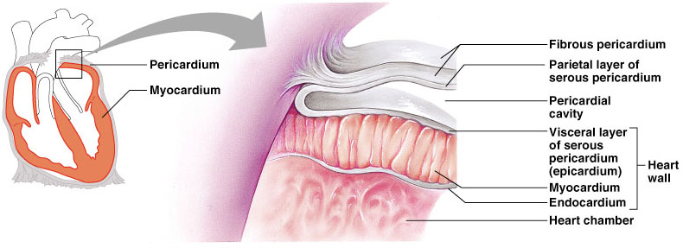
Pericardial Layers of the Heart
Figure 18.2

Slide 12
Heart Wall
Epicardium – visceral layer of the serous pericardium
Myocardium – cardiac muscle layer forming the bulk of the heart
Fibrous skeleton of the heart – crisscrossing, interlacing layer of connective tissue
Endocardium – endothelial layer of the inner myocardial surface

Slide 13
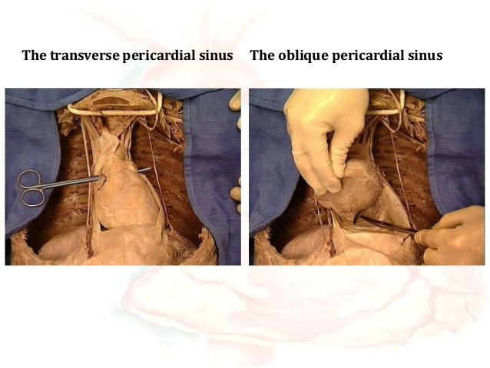

Slide 14
Major Vessels of the Heart
Vessels returning blood to the heart include:
  Superior and inferior venae cavae
  Right and left pulmonary veins
Vessels conveying blood away from the heart include:
  Pulmonary trunk, which splits into right and left pulmonary arteries
  Ascending aorta (three branches) – brachiocephalic, left common carotid, and subclavian arteries

Slide 15
Vessels
Arteries – right and left coronary (in atrioventricular groove), marginal, circumflex, and anterior interventricular arteries
Veins – small cardiac, anterior cardiac, and great cardiac veins

Slide 16
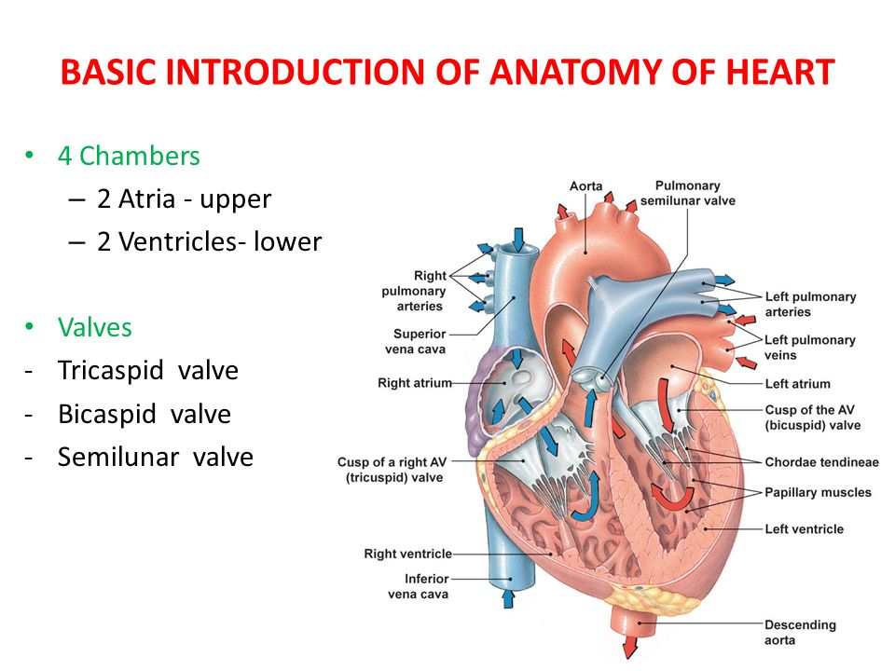

Slide 17
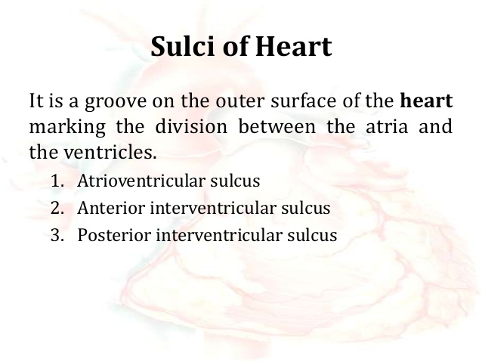

Slide 18
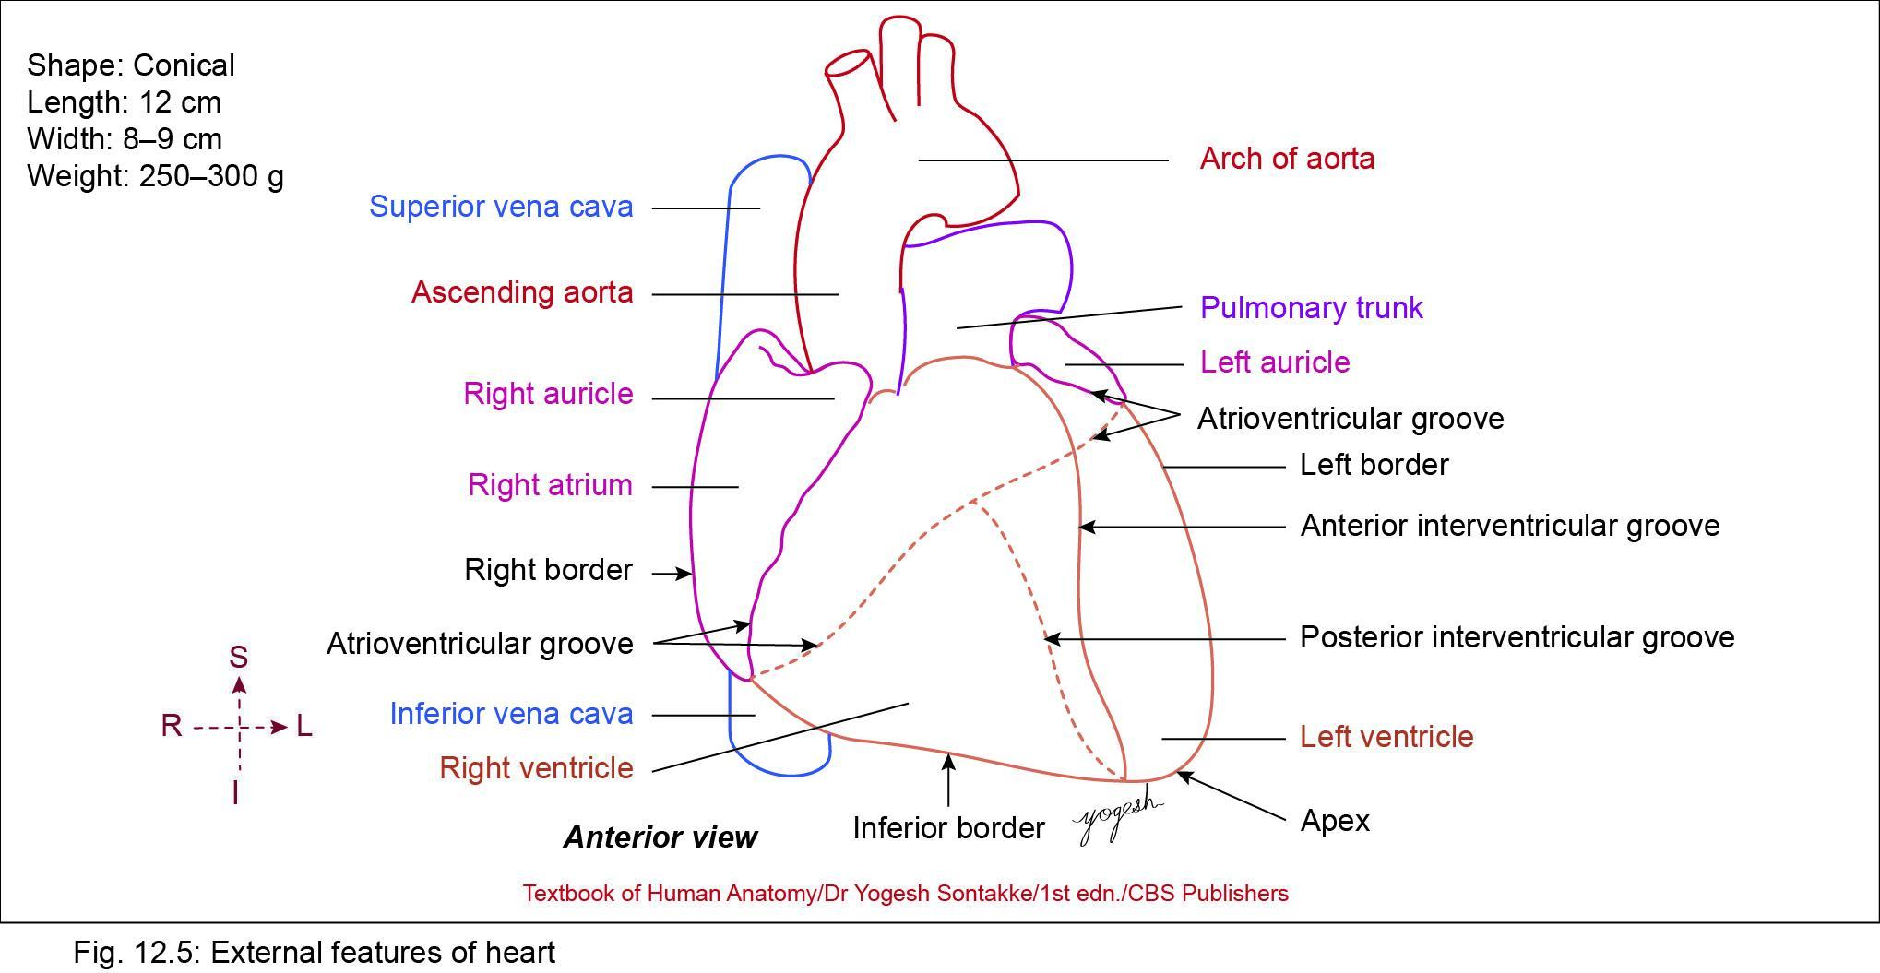

Slide 19
External Features
Apex -- (Present on Left 5th Intercostal space, 9cm lateral to midsternal line)
Base (Posterior surface)
4 Borders – Superior, Inferior, Right, Left Border
3 Surfaces – Anterior (Sternocostal)
Left surface
Inferior (Diaphragmatic)
4 Chambers – Right atrium, Left atrium, Right ventricle, Left ventricle

Slide 20
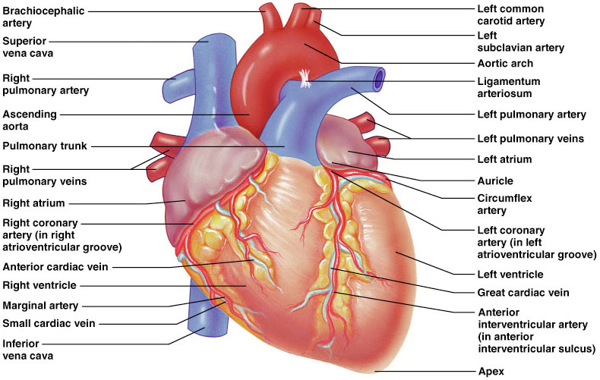
External Heart: Anterior View
Figure 18.4b

Slide 21
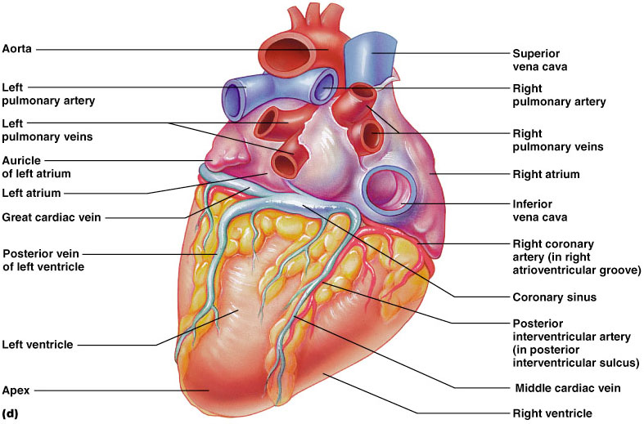
External Heart: Posterior View
Figure 18.4d

Slide 22
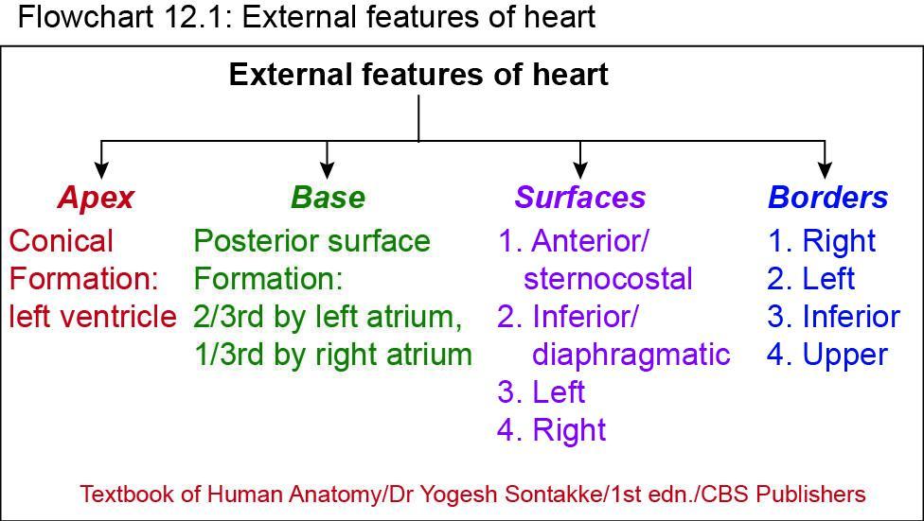

Slide 23
Formation of External features
Apex – Formed by Left ventricle only
Base – Left and Right Atrium
Superior border – LA and RA
Inferior border – RV and LV
Right border – RA
Left border – LA and Left auricle
Anterior surface – RA , RV, LV, Left auricle
Left surface – LV, Left auricle
Inferior surface -- LV, RV

Slide 24
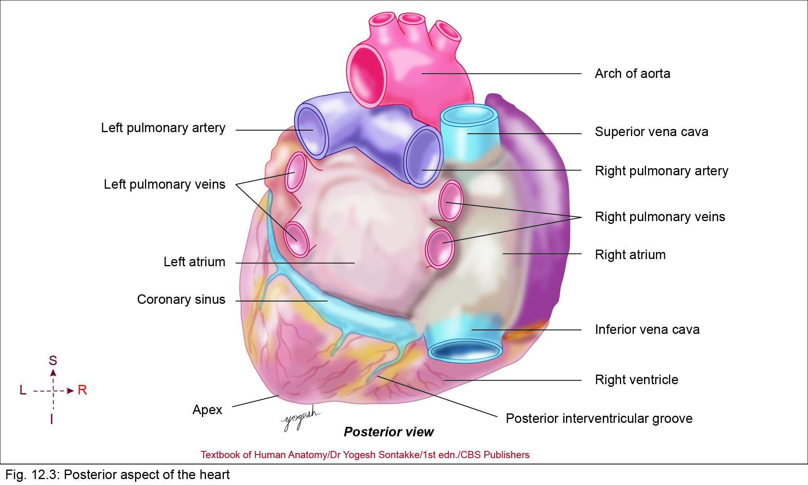
Apex of the Heart
Conical area of heart
Directed downward, forward, and – left
Formation: formed by left ventricle
Overlapped by left lung and left pleura
Location: Fifth left intercostal space, just medial – midclavicular line (at about 9 cm from midline)

Slide 25
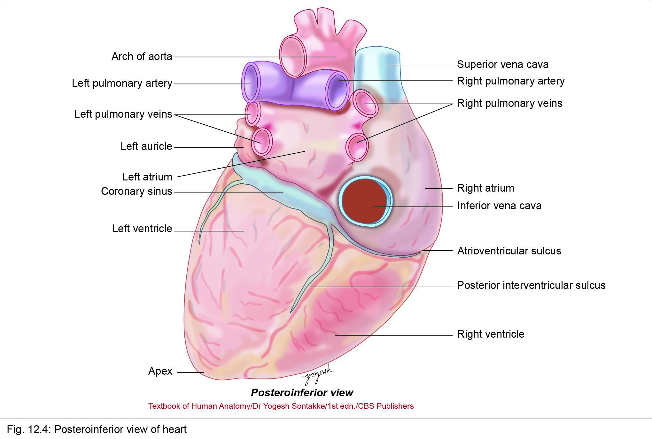

Slide 26
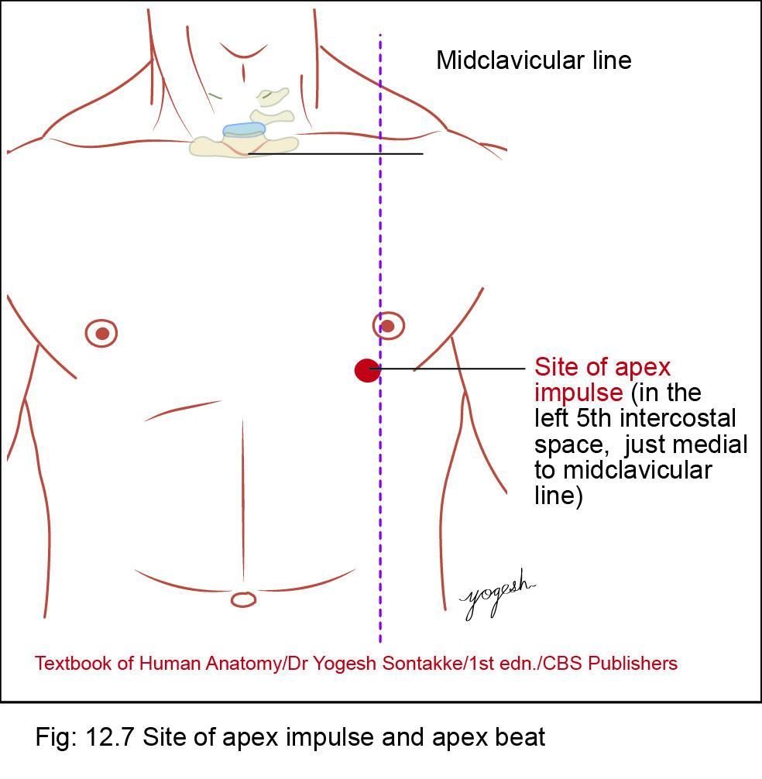
Clinical Integration
Q. Write short note on apex beat of heart
Apex impulse – outer thrust of apex of heart during ventricular systole observed in fifth intercostal space just medial – midclavicular line
Apex beat can be felt – site of apex impulse

Slide 27
Heart in VENTRAL view.
(You see mostly right ventricle!)

Slide 28
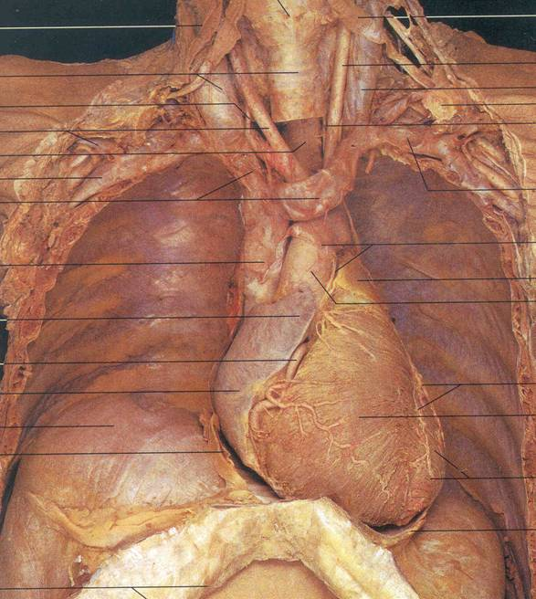
HEART
The real thing in ventral view.
Lungs have been removed.

Slide 29
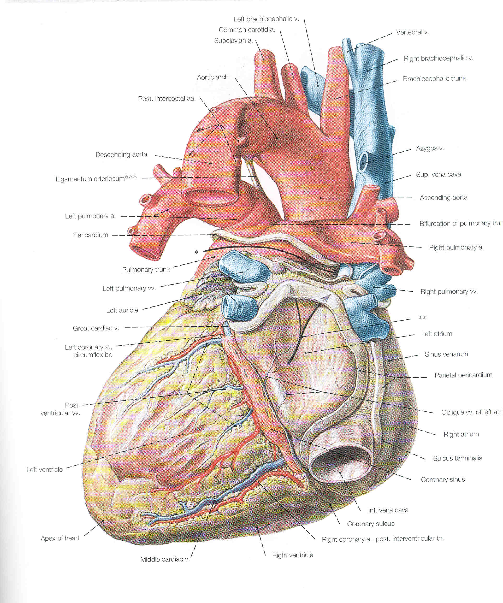
Heart in DORSAL view.
(You see mostly left ventricle.)

Slide 30
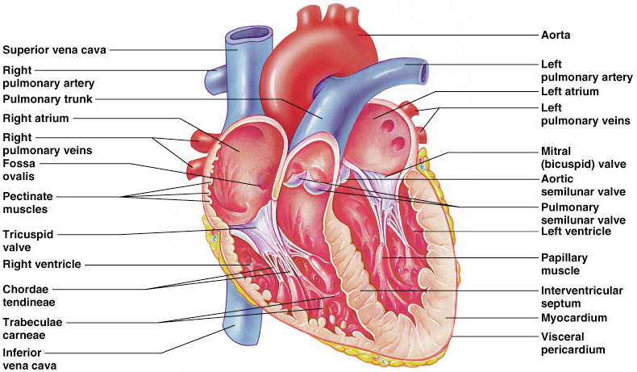
Gross Anatomy of Heart: Front
Figure 18.4e

Slide 31
Atria
Atria are the receiving chambers of the heart
Each atrium has a protruding auricle
Pectinate muscles mark atrial walls
Blood enters right atria from superior and inferior venae cavae and coronary sinus
Blood enters left atria from pulmonary veins

Slide 32
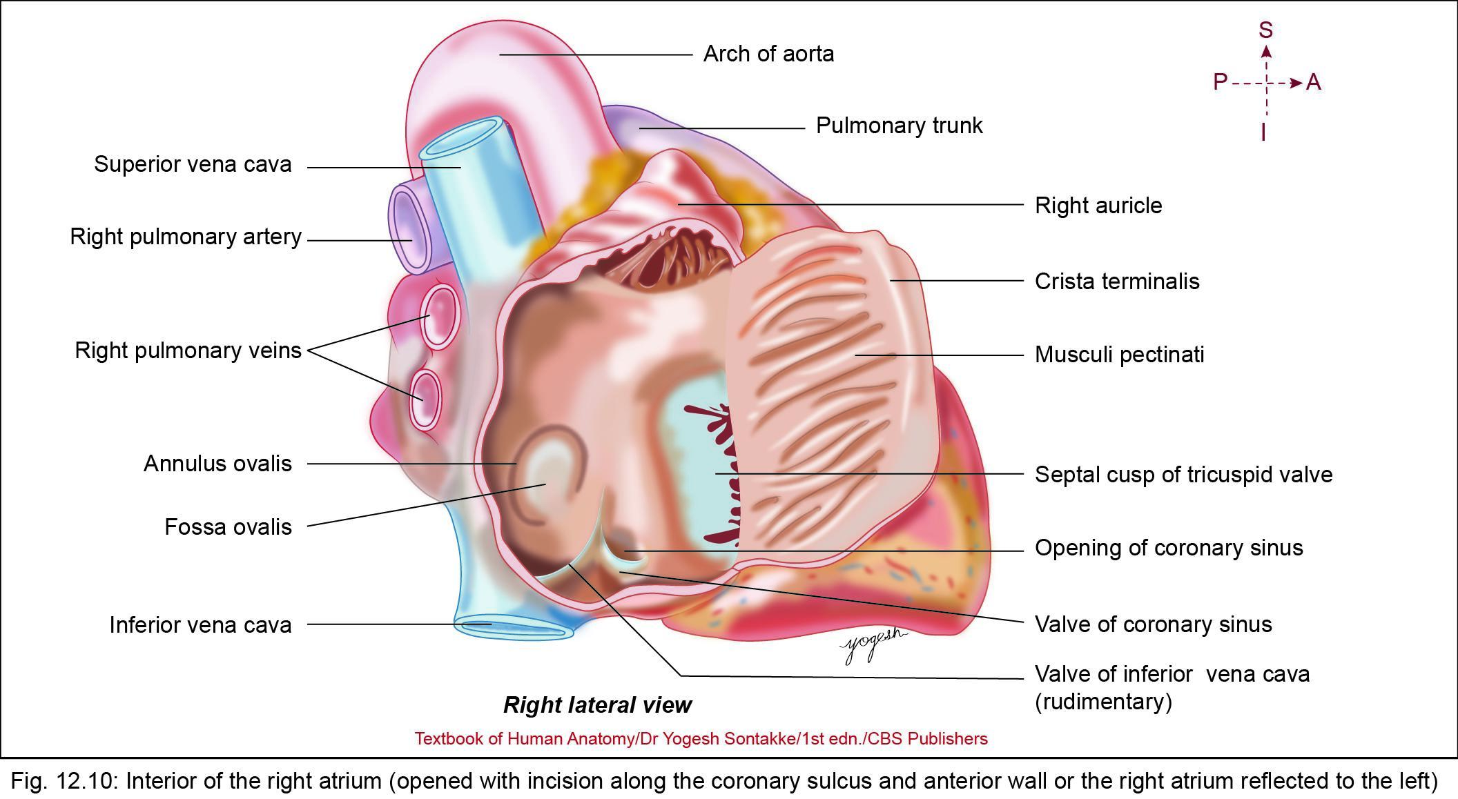
RIGHT ATRIUM
Q. Write short note on right atrium
Q. List openings in right atrium
Q. Draw well-labeled diagram showing internal structure of rights atrium
Quadrilateral chamber of heart
Right atrium receives deoxygenated blood from the body and transmit it –Right ventricle through right atrioventricular opening guarded by Tricuspid valve

Slide 33
RIGHT ATRIUM
Figure 18.4b

Slide 34
RIGHT ATRIUM
Tributaries
Receives blood through following tributaries
Superior vena cava
Inferior vena cava
Coronary sinus
Anterior cardiac veins
Venae cordis minimi
Occasionally right marginal vein

Slide 35
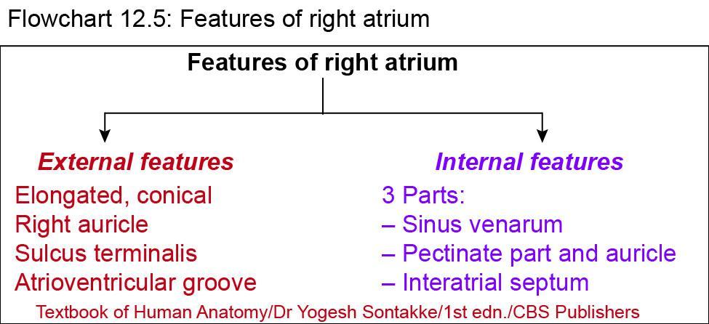

Slide 36
External Features
Shape
  Right atrium – vertically elongated conical chamber
  Extends from superior vena cava (opens – upper end) to inferior vena cava (opens – lower end)
Right auricle
  Small, ear-like projection of right atrium

Slide 37
External Features
Right auricle
  Extends from right heart border – left on anterior (sternocostal) surface of heart
  Margins of right auricle notched
  Right auricle overlaps root of ascending aorta completely and infundibulum of right ventricle partially

Slide 38
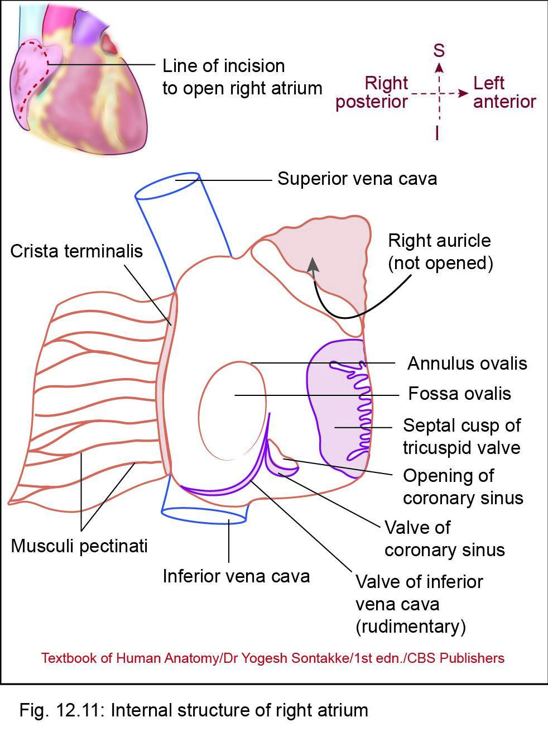
External Features
Sulcus terminalis
  Shallow groove extends from superior vena cava – inferior vena cava, along right heart border
  Corresponds internal muscular ridge called Crista terminalis
  Upper part of sulcus contains sinoatrial (SA) node –acts as pacemaker of heart

Slide 39
External Features
Atrioventricular groove
  Separates right atrium from right ventricle
  Runs vertically downward and to right
  Lodges right coronary artery and small cardiac vein

Slide 40
Internal Features
Interior of right atrium divided into three parts
  Rough Anterior Part-Pectinate part and auricle
  2. Smooth Posterior Part-Sinus venarum
  3. Interatrial septum

Slide 41
RIGHT ATRIUM
6 Openings of Right atrium
A. 3 openings with valve –
1. Inferior vena cava – Eustachian valve
2. Atrioventricular orifice -- Tricuspid valve
3. Coronary sinus – Thebessian valve
B. 3 openings without valve
1. Superior vena cava
2. Anterior cardiac vein
3. Venecordis minimi

Slide 42
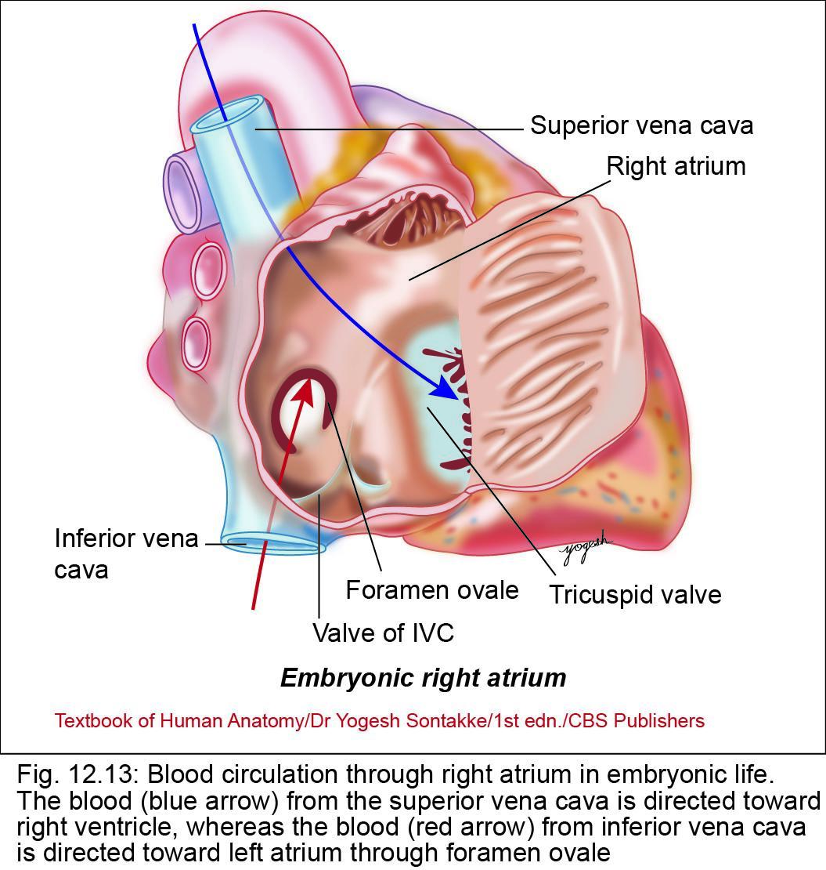
1. Rough Anterior - Pectinate part
Anterior rough part of right atrium called pectinate part
Develops from primitive atrial chamber
Has following features
1. Crista terminalis
  Smooth C-shaped muscle ridge
  Also called terminal crest
  Extends from upper part of septal surface and passes anterior – opening of SVC – reach right of inferior vena cava
  Remnant of upper part of right venous valve

Slide 43
Pectinate part
2. Musculi pectinati (pectinate muscles)
  Transverse, parallel muscular ridges
  They arise from crista terminalis and extend toward atrioventricular wall
  Gives teeth of comb (pectinate) appearance
  Right auricle, musculi pectinati forms network

Slide 44
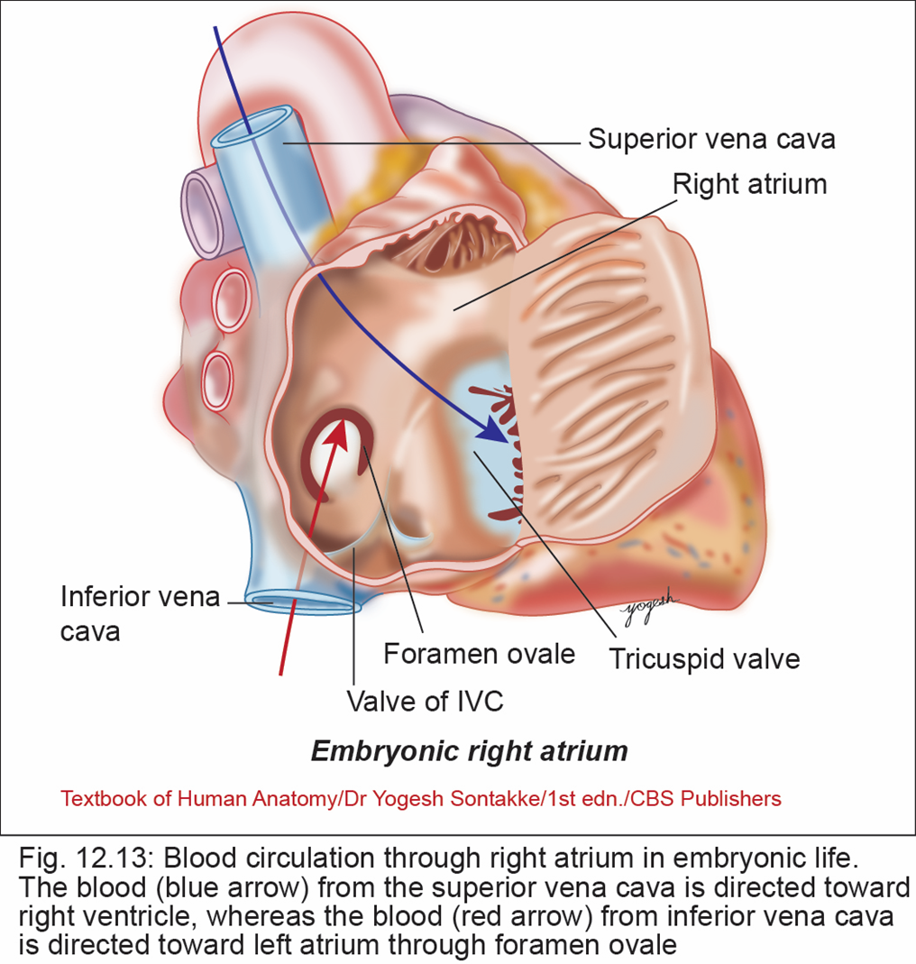
Some Interesting Facts
During embryonic life, value of IVC diverts blood from IVC – left atrium through foramen ovale and thus, helps blood – bypass lungs
Intervenous tubercle of lower (mostly not visible in adults) – small tubercle on posterior wall of right atrium above fossa ovalis
In embryonic life, this tubercle diverts blood of SVC – right atrium

Slide 46
2. Smooth Posteror Part - Sinus venarum
Smooth posterior part of right atrium
Derived from right horn of sinus venosus
Has following features
Opening of superior vena cava
  Present in upper and posterior part of right atrium
  Not guarded by any valve
Opening of inferior vena cava
  Present in lower and posterior part of right atrium

Slide 47
Sinus venarum
Eustachian valve (valve of IVC)
  Opening of IVC is guarded by nonfunctioning, rudimentary semilunar valve
Opening of coronary sinus
  Coronary sinus opens in lower part of interatrial septum, between opening of IVC and tricuspid valve
Thebesian valve
  Rudimentary, nonfunctioning valve of coronary sinus
Foramina venarum minimarum:
  Small openings of venae cordis minimi

Slide 49
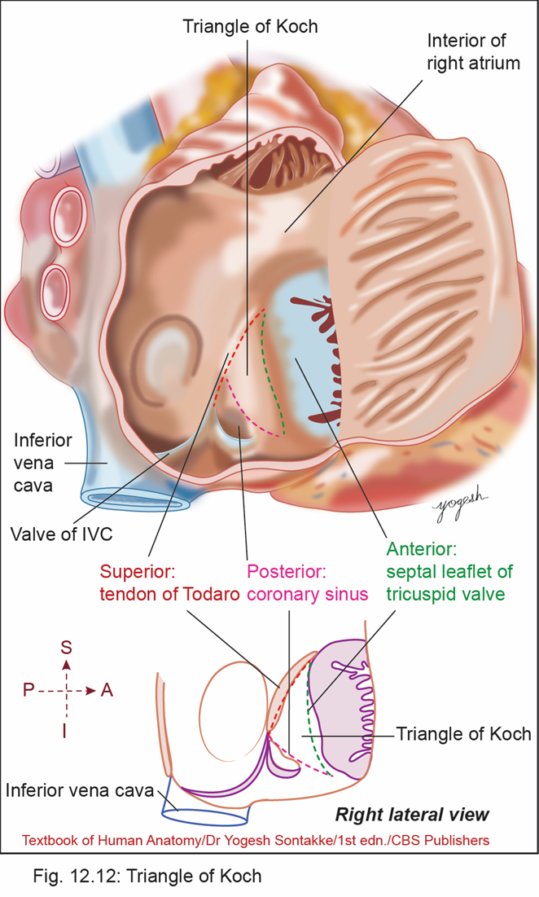
3. Interatrial septum
Q. Write short note on triangle of Koch
Derived from septum primum and septum secundum
Has following features
1. Fossa ovalis
  Oval shallow depression in lower part of interatrial septum
  Floor of fossa ovalis is developed from septum primum

Slide 50
Interatrial septum
Q. Write short note on triangle of Koch
2. Limbus fossa ovalis (Annulus ovalis):
  Sharp, sickle-shaped margin of fossa ovalis
  Derived from lower free margin of septum secundum
  Inferiorly, anterior edge of annulus ovalis continuous with left end of valve of inferior vena cava

Slide 51

Interatrial septum
3.Triangle of Koch
  Triangular area located on septal wall
Boundaries
  Anterior: Base of septal leaflet of tricuspid valve
  Posterior: Anterior margin of opening of coronary sinus
  Superior: Tendon of Todaro
AV Node lies in this triangle

Slide 52
Interatrial septum
4. Tendon of Todaro
  Subendocardial ridge
  Arises from central fibrous body and extends from interatrial septum – left horn of valve of inferior vena cava
5. Torus aorticus
Elevation in anterosuperior part of septum caused by bulging of right posterior aortic sinus of ascending aorta

Slide 53
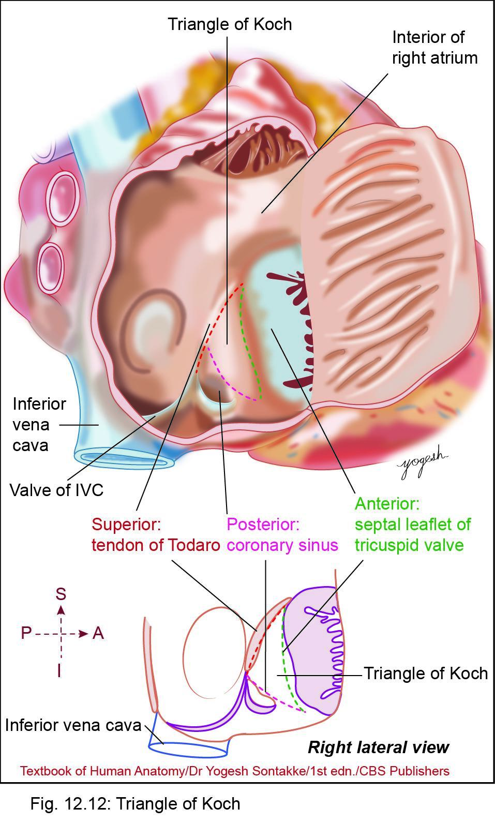

Slide 54

Clinical Integration
Probe patency of foramen ovale
  Occasionally, small opening may be present deep – limbus fossa ovalis
  Represents embryological foramen ovale
  Physiologically, it remains closed
Atrial septal defects
  Includes ostium secundum defects, ostium primum defect, endocardial cushion defect, and cortriloculare biventricularae)

Slide 55
OTHER CHAMBERS OF HEART

Slide 56
Ventricles
Ventricles are the discharging chambers of the heart
Papillary muscles and trabeculae cornae muscles mark ventricular walls
Right ventricle pumps blood into the pulmonary trunk
Left ventricle pumps blood into the aorta

Slide 57
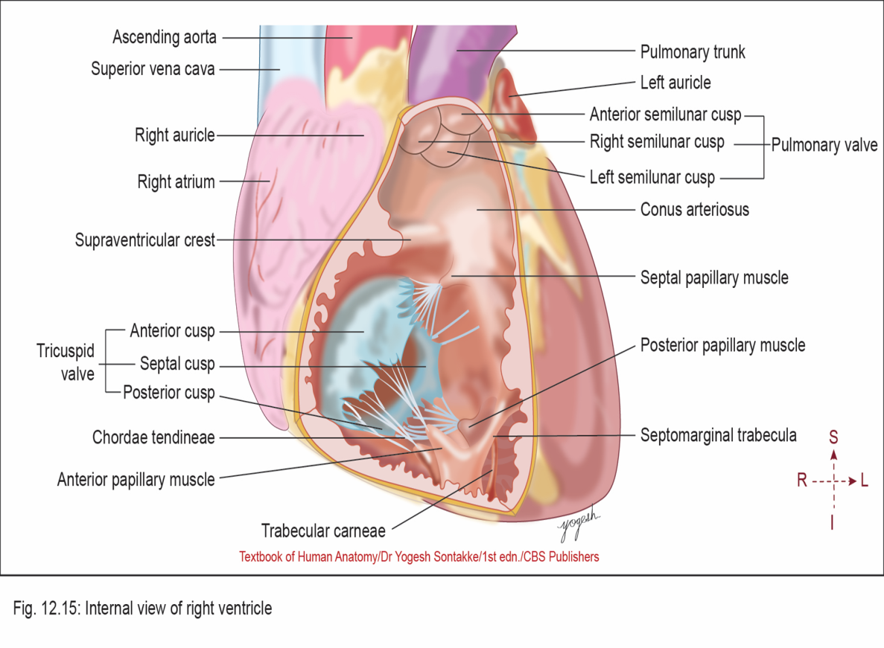
RIGHT VENTRICLE
Q. Write short note on right ventricle and moderator band
Right ventricle – thick-walled triangular chamber
Receives blood from right atrium through right atrioventricular orifice guarded by tricuspid valve
Ejects blood in pulmonary trunk guarded by pulmonary valve
Right ventricle thinner than left ventricle (ratio:1:3)

Slide 58
RIGHT VENTRICLE
External Features
Forms inferior border of heart and most of sternocostal surface and part of inferior surface
Separated externally from right atrium by atrioventricular groove
Separated from left ventricle by anterior and posterior (inferior) interventricular grooves

Slide 59
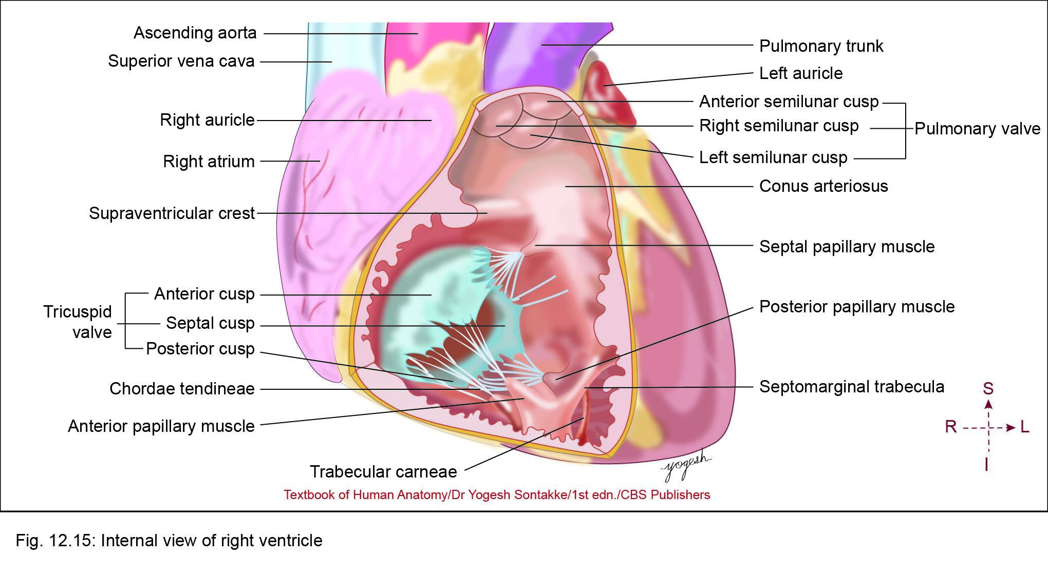
Internal Features of Right ventricle
Internally, shows two parts
  1. Inflowing rough part
  2. Outflowing smooth part or infundibulum
These two parts separated by muscular ridge called supraventricular crest or infundibuloventricular crest
This crest extends from interventricular septum – right atrioventricular opening

Slide 60

1. Inflowing rough part
Lower, rough part of right ventricle
Receives blood from right atrium
Rough due to presence of trabeculae carneae (columnae carneae)
Develops from primitive ventricle
Trabeculae carneae
  These muscular projections in inflowing part of the right ventricle They give sponge-like appearance – right ventricle

Slide 61
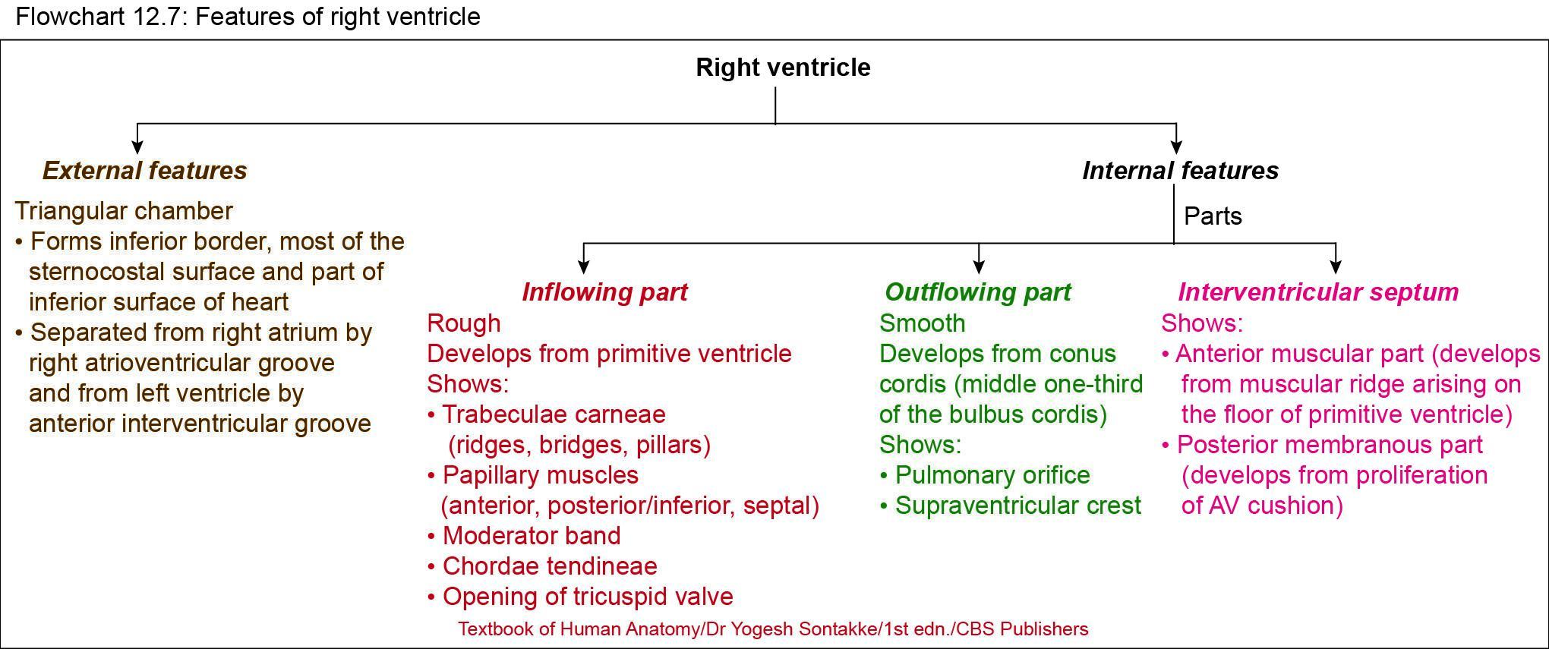

Slide 63
Inflowing Rough Part
Types of trabeculae carneare : 3 types
Ridges: Fixed elevations
Bridges: Only their ends fixed
Pillars: Their bases fixed and apices free
For example, papillary muscles

Slide 64
Inflowing rough part
Papillary muscles
Conical muscular projections of pillar type of trabecular carneae
Each papillary muscle has
  Base – attached – ventricular wall
  Apex – projected into ventricular cavity and attached with cusps of tricuspid valve by chordae tendineae (thin thread-like fibrous cord)

Slide 65
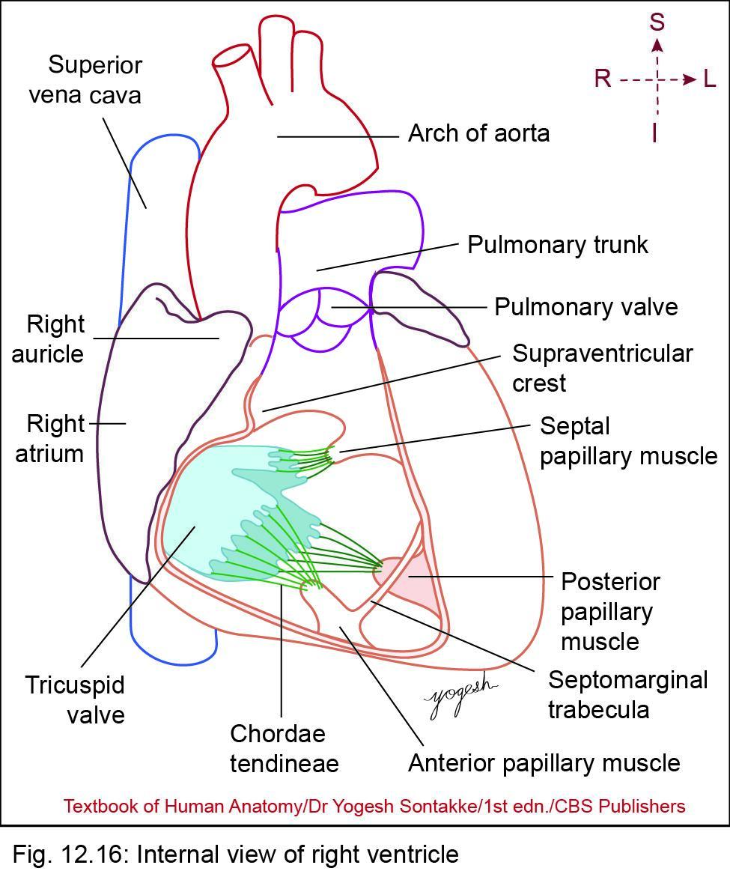
Inflowing rough part
Three papillary muscles in right ventricle
Anterior papillary muscle
  Largest muscle
  Arises from anterior wall of right ventricle
Posterior (inferior) papillary muscle
  Arises from inferior wall of right ventricle
Septal papillary muscle
  Arises from inter ventricular septum

Slide 67
Inflowing rough part
Papillary muscles
Functions:
Prevention of inversion of tricuspid valve:
Papillary muscles contract earlier than ventricular wall
Brings cusps of tricuspid valve together by lengthening of chordae tendineae and prevents prolapse (inversion) of tricuspid valve in right atrium

Slide 68
Inflowing Rough Part
Papillary muscles
Functions:
Prevents regurgitation of blood to right atrium from right ventricle
Moderator band (septomarginal trabecula)
Thick muscular band that extends from lower part of interventricular septum to base of anterior papillary muscle
Contains right branch of atrioventricular (AV) bundle of His

Slide 69
2. Outflow part (Infundibulum)
Also called conus arteriosus or infundibulum
Conical part having apex directed toward pulmonary orifice
Opening of pulmonary orifice guarded by pulmonary valve (semilunar)
Infundibulum separated from inflow part by prominent supraventricular crest

Slide 70
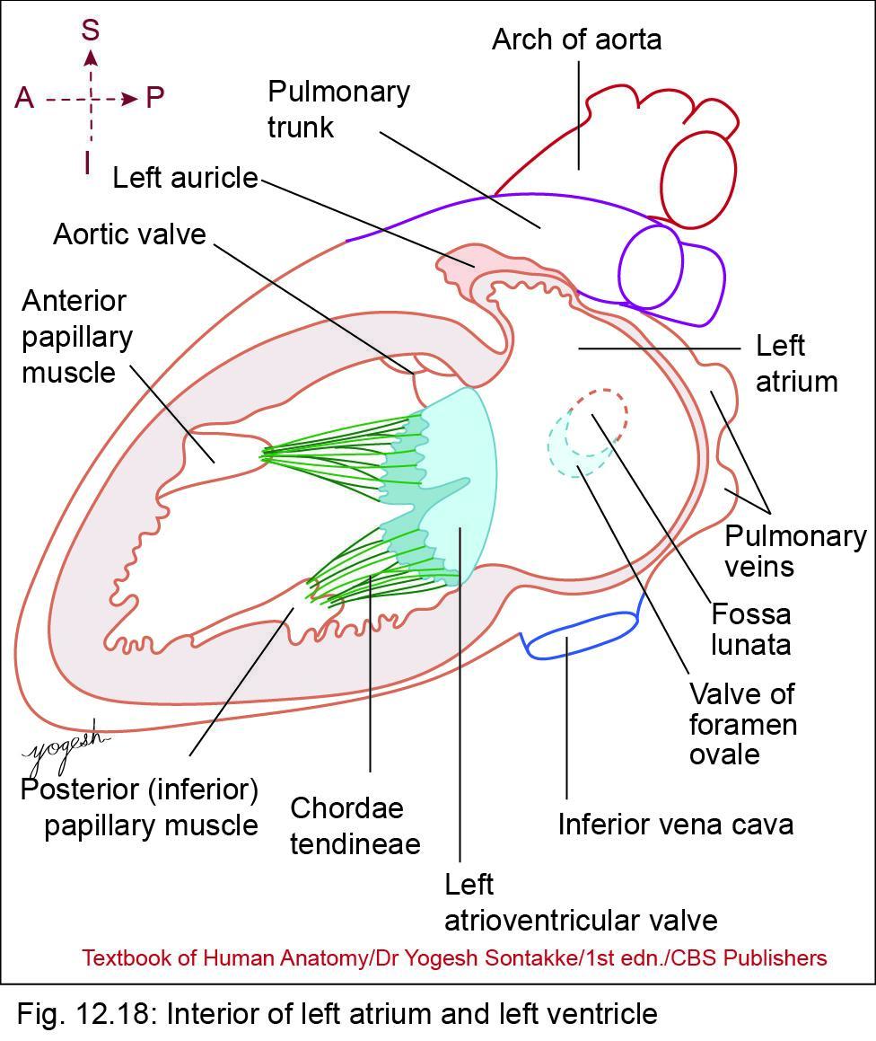
LEFT VENTRICLE
Q. Write short note on left ventricle
Conical, thick-walled chamber of heart
Receives oxygenated blood from left atrium through left atrioventricular (mitral) valve and pumps blood in ascending aorta through the aortic orifice
External Features
Forms
  (1) apex of the heart
  (2) left one-third of sternocostal surface
  (3) left 2/3rd of the inferior surface of heart
  (4) most of left heart border and surface
Has three surfaces: anterior, inferior, and left

Slide 71
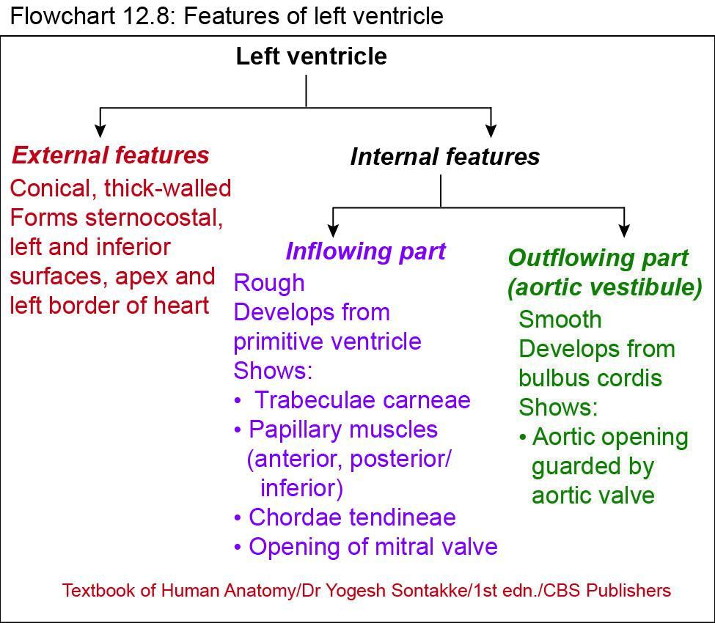

Slide 72
LEFT VENTRICLE
Internal Features
Cavity of left ventricle – circular in cross section
Interior of left ventricle – divided into two parts
  1. Inflowing part
  2. Outflowing part or aortic vestibule

Slide 73
LEFT VENTRICLE
Inflowing part
Rough and forms ventricle proper
Develops from left part of primitive ventricle
Rough due to presence of muscular thickening called trabeculae carneae

Slide 74
LEFT VENTRICLE
Inflowing part
Papillary muscles
– Two papillary muscles in left ventricle
  1. Anterior – arises from sternocostal surface
  2. Posterior (inferior) – arises from inferior or diaphragmatic surface
  Tips of papillary muscles are connected with leaflets of mitral valve by chordae tendineae

Slide 75
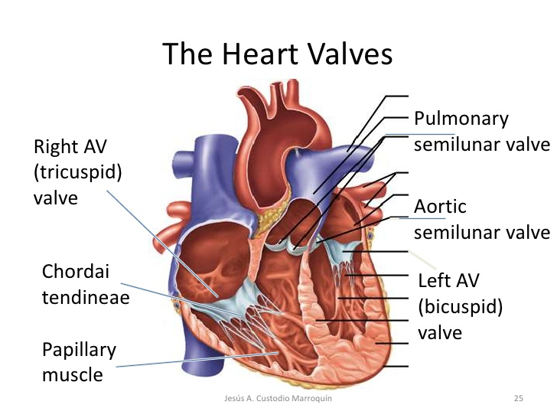

Slide 76
LEFT VENTRICLE
Outflowing part
Called aortic vestibule
Smooth, conical, and situated below aortic opening
Develops from bulbus cordis
Blood from outflowing part enters ascending aorta through aortic orifice
Orifice guarded by semilunar aortic valve

Slide 77
Openings in Left Ventricle
Interior of left ventricle shows two orifices
Atrioventricular orifice – guarded by bicuspid or mitral valve
Aortic opening – guarded by semilunar aortic valves

Slide 78
Interventricular septum
Q. Write short note on interventricular septum
Lies obliquely with convexity towards right ventricle
Has two surfaces: Anterior surface and posterior surface
Has two parts
  Muscular part - Lies anteroinferiorly
  Membranous part - Form small posterosuperior part of septum

Slide 79
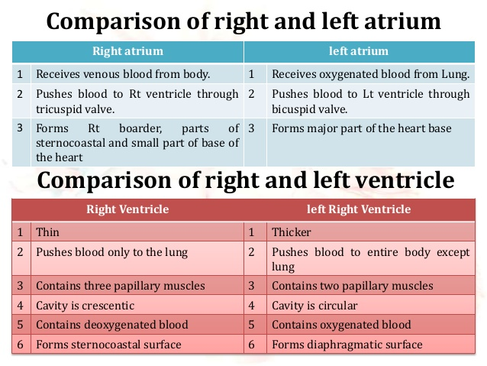

Slide 80
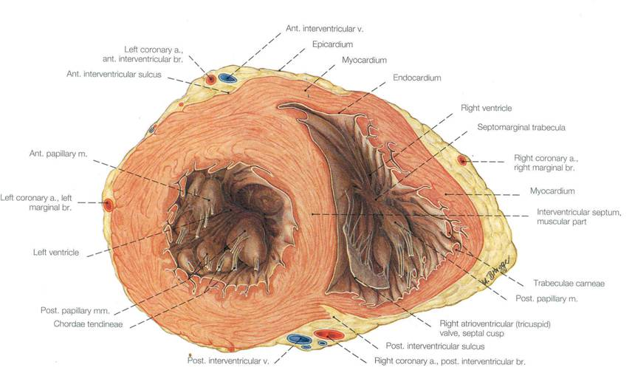
Walls of the ventricles:
Left wall is thicker!

Slide 81
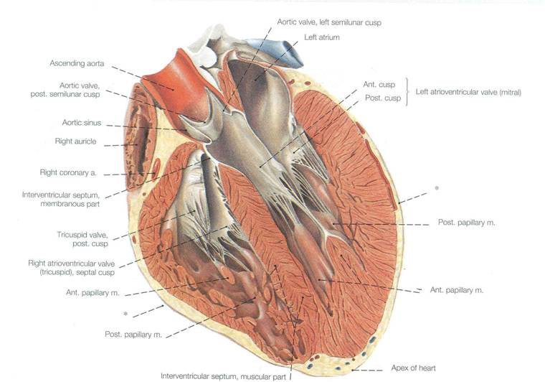
Bicuspid
valve
Chordae
Tendonae
Trabeculae carnae Papillary muscles

Slide 82
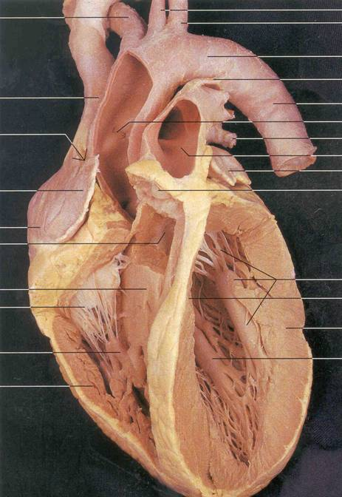
Find:
1. Walls of the ventricles
2. Auricles
3. Inner walls of the atria
4. Fossa ovalis
5. Trabeculae carnae
6. Atrioventricular valve
(a) "Bicuspid valve"
(b) "Tricuspid valve"
7. Chordae tendonae
8. Papillary muscles
9. Aortic & pulmonary valves

Slide 83
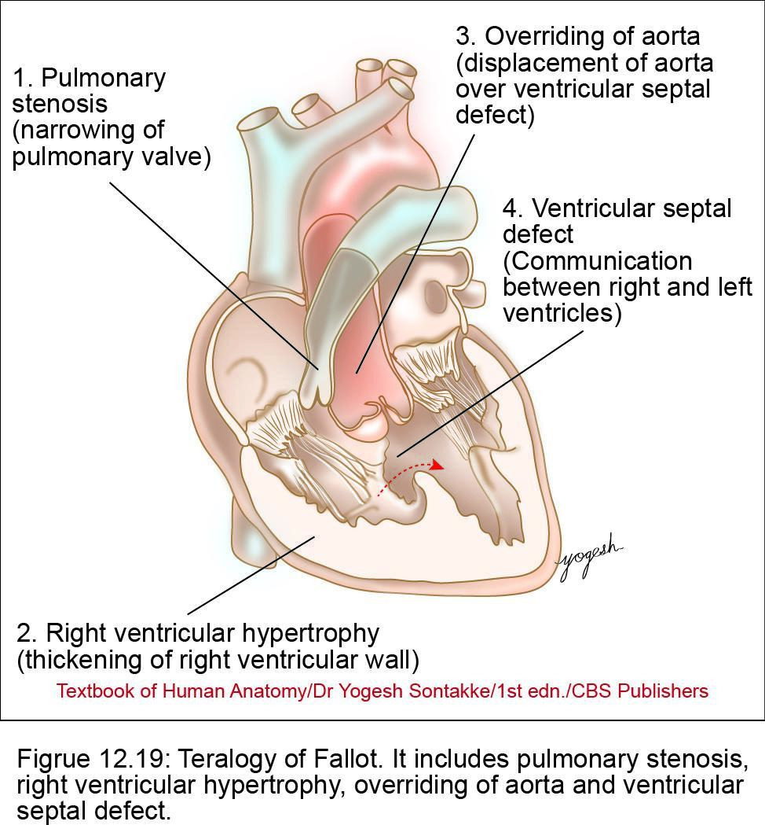
Clinical Integration
• Thrombi from left auricle gets dislodged and may form cerebral, systematic, and renal embolism
Ventricular septal defects (VSDs)
  Improper development of membranous or muscular part of ventricular septum leads – VSD

Slide 84
Clinical Integration
Ventricular septal defects (VSDs)
  Mostly results in shunting of blood from left ventricle to right ventricle
  Excess blood from right ventricle causes pulmonary hypertension and cardiac failure
  Symptoms of VSD depends on its severity
  – Ventricular septal defect is almost common congenital anomaly of heart (12 in 10,000 births)

Slide 85
Clinical Integration
Fallot’s tetralogy
TOF – congenital heart defect
Components
  1. Pulmonary stenosis
  2. Right ventricular hypertrophy
  3. Ventricle septal defect (VSD)
  4. Overriding of aorta

Slide 86
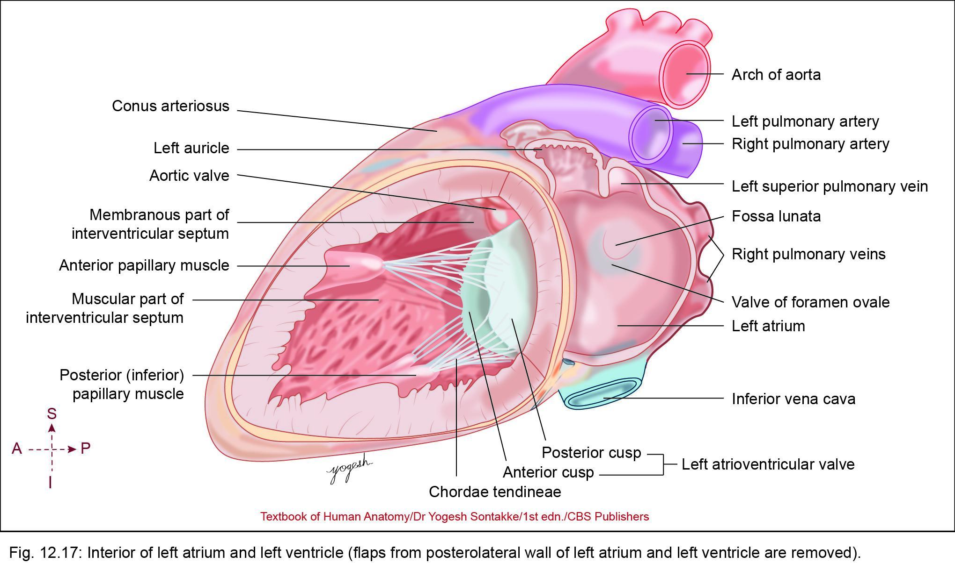
LEFT ATRIUM
Q. Write short note on left atrium
Quadrangular, thin-walled chamber situated posteriorly
External Features
Forms major part (left 2/3) of base (posterior surface) of heart
Left auricle
  Ear-like projection of left atrium that project anteriorly

Slide 87
LEFT ATRIUM
Left auricle
  Overlaps infundibulum of right ventricle
  Forms small part of sternocostal and left surfaces, and left heart border
Atrioventricular groove
  Separates left atrium from left ventricle
Interatrial groove
  Shallow groove that separates left atrium from right atrium posteriorly

Slide 88
LEFT ATRIUM
Opening in Left Atrium
  1. Four pulmonary veins (right superior, right inferior, left superior, and left inferior) – not guarded by any valve
  2. Many venae cordis minimi
  3. Left atrioventricular orifice guarded by mitral valve

Slide 91
Clinical Integration
• Thrombi from left auricle gets dislodged and may form cerebral, systematic, and renal embolism
Ventricular septal defects (VSDs)
  Improper development of membranous or muscular part of ventricular septum leads – VSD

Slide 92
Clinical Integration
Ventricular septal defects (VSDs)
  Mostly results in shunting of blood from left ventricle to right ventricle
  Excess blood from right ventricle causes pulmonary hypertension and cardiac failure
  Symptoms of VSD depends on its severity
  – Ventricular septal defect is almost common congenital anomaly of heart (12 in 10,000 births)

Slide 93
Clinical Integration
Fallot’s tetralogy
TOF – congenital heart defect
Components
  1. Pulmonary stenosis
  2. Right ventricular hypertrophy
  3. Ventricle septal defect (VSD)
  4. Overriding of aorta

Slide 94


Slide 95

THANK YOU

Slide 96
Heart Valves
Heart valves ensure unidirectional blood flow through the heart
Atrioventricular (AV) valves lie between the atria and the ventricles
AV valves prevent backflow into the atria when ventricles contract
Chordae tendineae anchor AV valves to papillary muscles

Slide 97
Heart Valves
Aortic semilunar valve lies between the left ventricle and the aorta
Pulmonary semilunar valve lies between the right ventricle and pulmonary trunk
Semilunar valves prevent backflow of blood into the ventricles

Slide 98
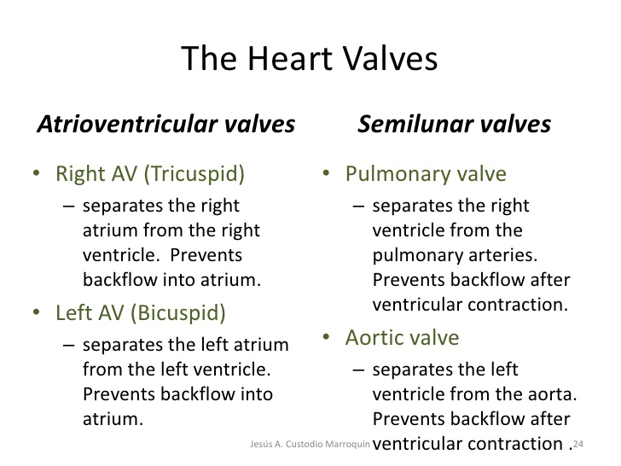

Slide 100
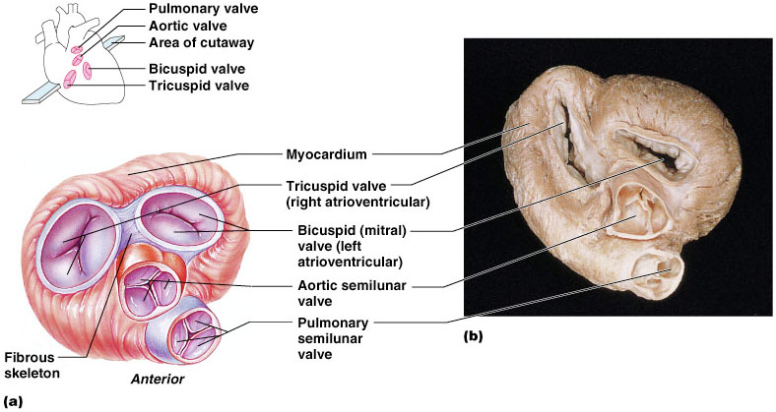
Heart Valves
Figure 18.8a, b

Slide 101
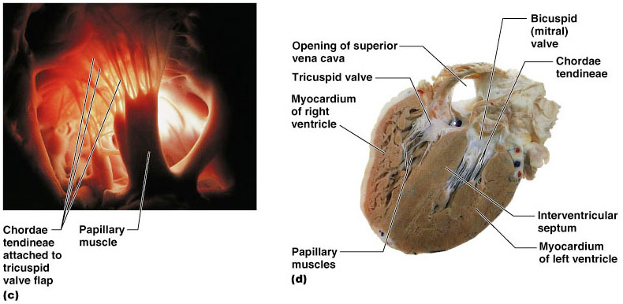
Heart Valves
Figure 18.8c, d

Slide 102
Pathway of Blood Through the Heart and Lungs
Right atrium → tricuspid valve → right ventricle
Right ventricle → pulmonary semilunar valve → pulmonary arteries → lungs
Lungs → pulmonary veins → left atrium
Left atrium → bicuspid valve → left ventricle
Left ventricle → aortic semilunar valve → aorta
Aorta → systemic circulation

Slide 103
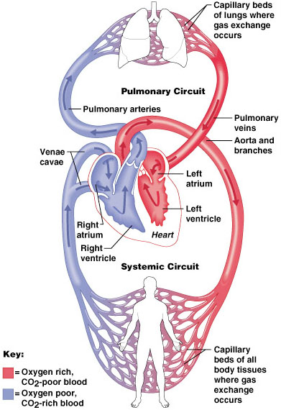
Pathway of Blood Through the Heart and Lungs
Figure 18.5

Slide 104
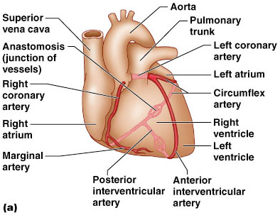
Coronary Circulation: Arterial Supply
Figure 18.7a

Slide 105
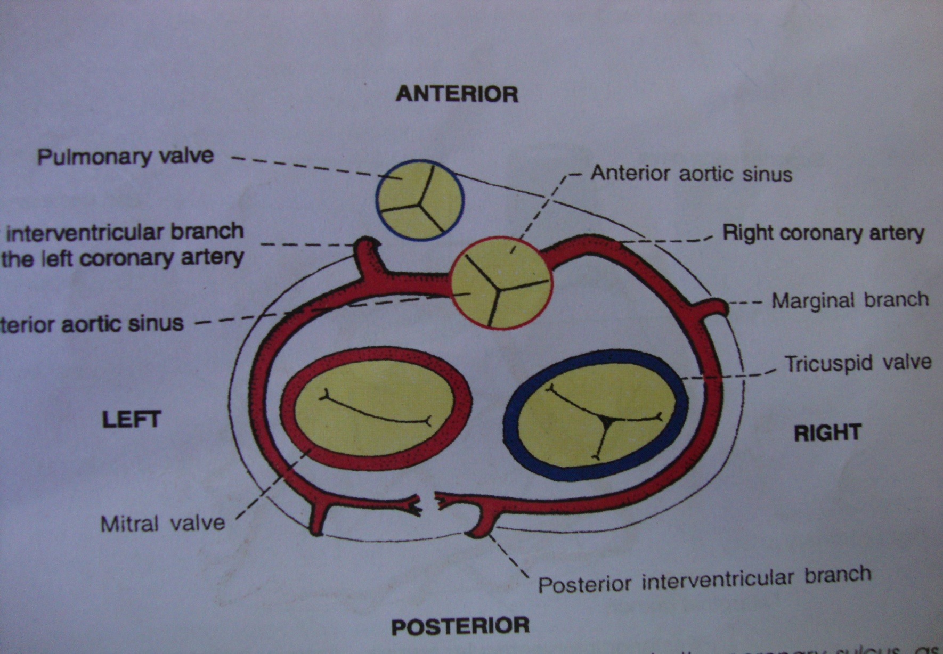
Course of coronary artery

Slide 106
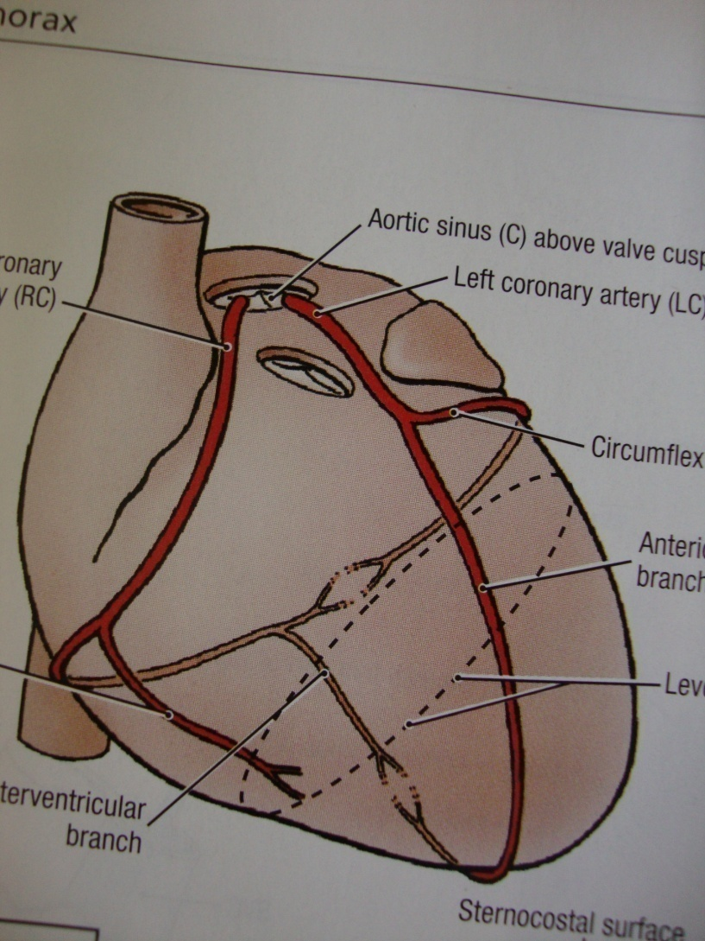
BRANCHES OF RIGHT CORONARY ARTERY
From the 1st segment-upto the inferior border
From the 2nd segment-upto the crux of the heart.
Note-crux of the heart-It is the meeting point of
Interatrial groove
post.interventricular groove
and post. Part of the atrio-ventricular groove.

Slide 107
Area of distribution
1.Right atrium
2.Ventricle-
(a)Greater part of the right ventricle,except the area adjoining the anterior interventricular groove.
(b)A small part of the left ventricle adjoining the posterior interventricular groove.
3.Posterior part of the interventricular septum.
4.Whole conducting system of the heart except a part of the left branch of the AV bundle.
SA node is supplied by lt.coronary art. In about 35% of cases.

Slide 108

Left coronary artery
It is larger than the right coronary artery and supplies larger volume of the myocardium.
It arises from the left posterior aortic sinus of the asending aorta.
Course-It passes behind the pulmonary trunk, and then appear forward and to the left b/n the pulmonary trunk and left auricle.
Then divides into two branches
1.anterior interventricular
2.and Circumflex.

Slide 109
Area of distribution
1.Left atrium
2.Ventricle
(a)Greater part of the left ventricle ,except the area adjoining the posterior interventricular groove.
(b)A small part of the right ventricle adjoining the anterior interventricular groove.
3.Anterior part of the interventricular septum.
4.A part of the left branch of the AV bundle.

Slide 110
Cardiac dominance
Artery giving the posterior interventricular branch is the dominant artery.
Right coronary predominance-in 90%
Left coronary predominance-in 10%
LCP is having higher risk of coronary artery disease because the entire left ventricle & interventricular septum are the nutritional control of the left coronary artery.
On rare occasion posterior interventricular branch are derived from Rt. and Lt.coronary artery –is balanced type of distribution are least affected by coronary disease.

Slide 111
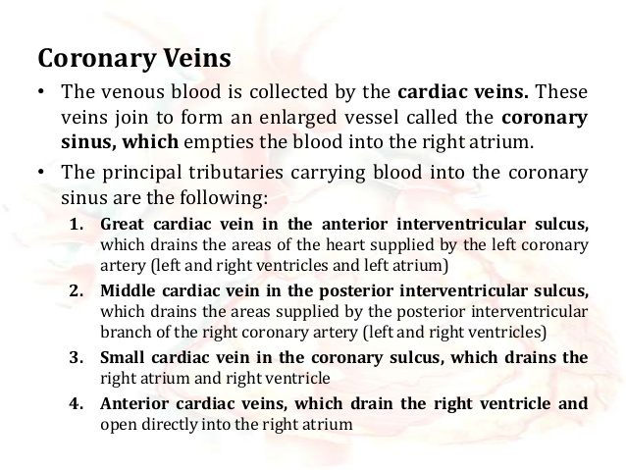

Slide 112

Venous Drainage
Figure 18.7b

Slide 113

Applied anatomy
Angina Pectoris-Incomplete obstruction or due to spasm of the coronary artery,
agonising pain in the precordial region and down the medial side of the left arm and forearm.
Pain is usually referred to the left side , it may referred to
1) right arm
2)jaw
3)epigastrium
4)neck and back

Slide 114
Applied anatomy
MYOCARDIAL INFARCTION-Thrombosis of coronary artery causes ischemia-necrosis-death of cardiac tissue.
It is one of the most common cause of sudden death in past middle age person.
Clinically there are 3 main coronary artery where blockage occur
1)Anterior interventricular branch of left coronary artery-40-50%.
2)Right coronary artery-30-40%.
3)Circumflex branch of left coronaryartery-15-20%.

Slide 115
Applied anatomy
Coronary Angiography-Determine the site of occlusion of coronary artery and their branches.
Here radio-opaque dye is injected in the coronary artery through catheter passing in the femoral artery.
Angioplasty-It helps in removal of small blockage by using small stent or small inflated baloon.
CABG-Cronary Artery bypass grafting surgery for treatment of Ischemic heart disease.A vascular autograft is taken from
1)Internal thoracic artery
2)Great Saphenous vein
3)Radial artery

Slide 116

Coronary artery bypass grafting

Slide 117
For Students…………..
This lockdown holidays are not for sleeping,
Its time to show the hidden talent inside you.
Study hard, selective and study for knowledge.
Its time to study by urself, as all of you are talented neet selected ,intelligent students.
We can only help you through ppts but actual study is done from books.
Exam is near, be ready and prepared.
Stay safe and healthy……………
Dr.Praveen Kurrey

Slide 118

For Students……..
Don’t take the university exam lightly.
Study hard ,daily, in a routine and all subjects daily.
Don’t break continuity.
Focus on ur future.
Careful about ur health, diet and sleep.
I hope all u will get grand success….
Hoping best for ur future……………
Dr. Praveen Kurrey
Be Positive…….Feel Positive…Stay Positive…..and Live Positive…

Slide 120
THANK YOU

