Slide 1
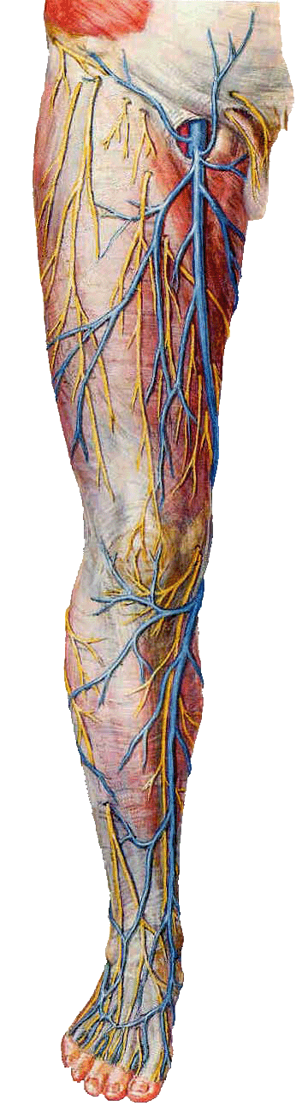
GROSS ANATOMY front of leg and dorsum of foot
Dr. Praveen Kumar Kurrey
M.B.B.S., M.S.,BCME, BCBR
Professor Anatomy

Slide 2
Anterolateral crural region
Superficial veins
Dorsal venous arch: lies in the subcutaneous tissue over the heads of the metatarsal bones and drains on the medial side into the great saphenous v. and on the lateral side into the small saphenous v.
Great saphenous v.:
  Drains the medial end of dorsal venous arch of food and passes upward directly in front of the medial malleolus.
  Then ascends in company with the saphenous n. in the superficial fascia over the medial side of the leg.

Slide 3
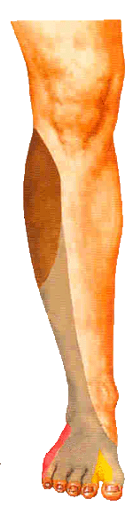
Anterolateral crural region
Cutaneous nerves
Lateral cutaneous n. of the calf: supplies the skin on the upper part of the anterolateral surface of the leg
Superficial peroneal n. supplies the skin of the lower part of the anterolateral surface of the leg and dorsum of the foot
Saphenous n. supplies the skin on the anteromedial surface of the leg
Deep peroneal n. supplies the skin of the adjacent sides of the big and second toes

Slide 4
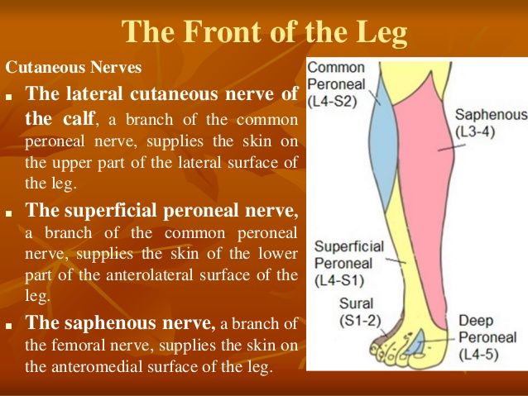

Slide 5
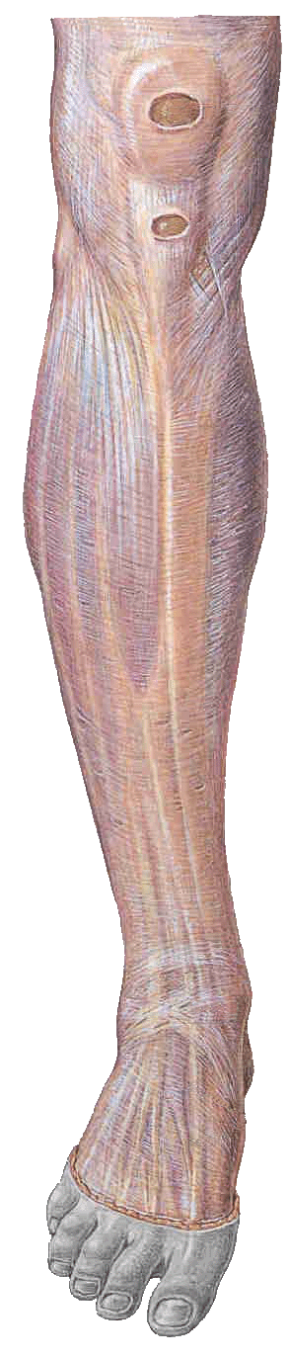
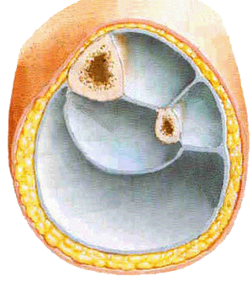
Deep fascia
Surrounds the leg and forms two intermuscular septa to be attached to the fibula.
Divided the leg into three compartments－anterior, lateral and posterior－each of which contains a group of muscles, the vessels and the nerves.
Superior extensor retinaculum
Inferior extensor retinaculum

Slide 6
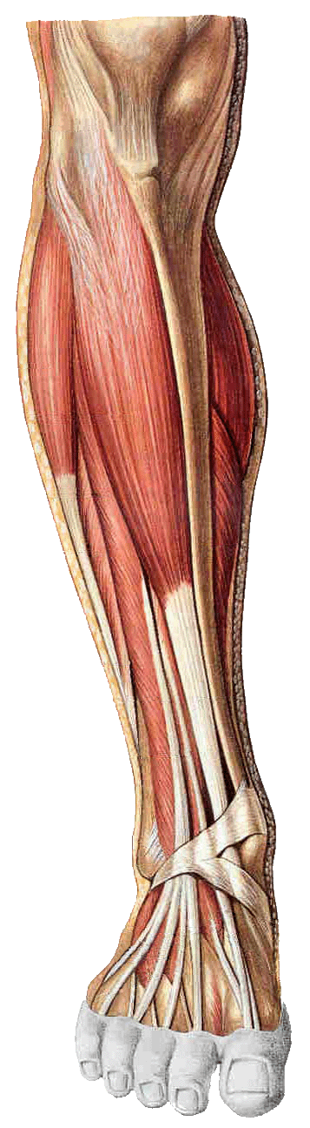
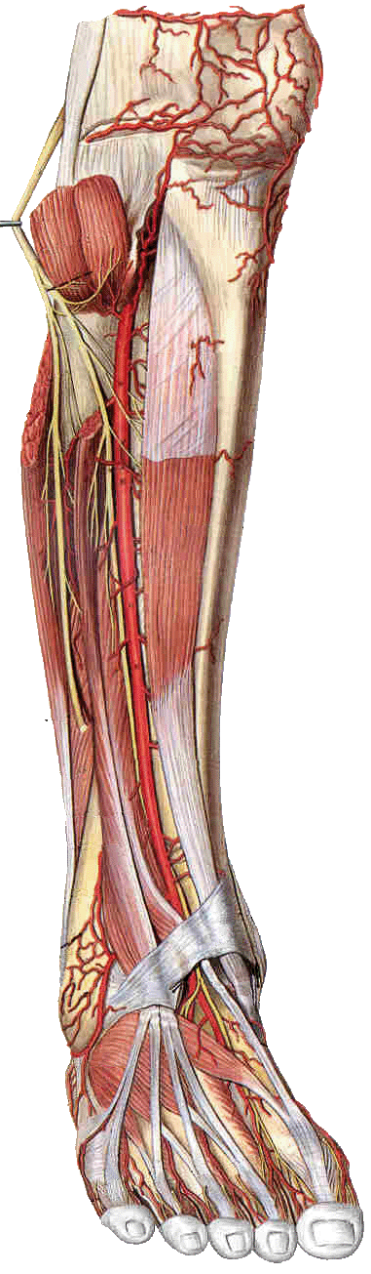
Contents of the anterior fascial compartment of the leg
Muscles:
Tibialis anterior
Extensor digitorum longus
Extensor hallucis longus
Peroneus tertius
Blood supply: Anterior tibial a.
Nerve supply: Deep peroneal n.

Slide 7
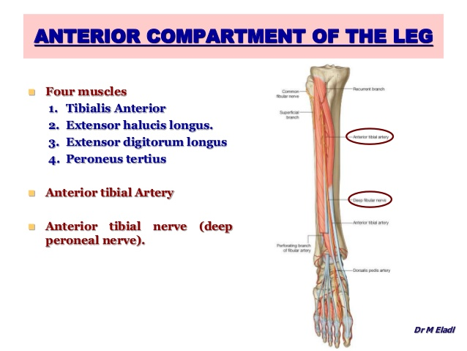

Slide 8
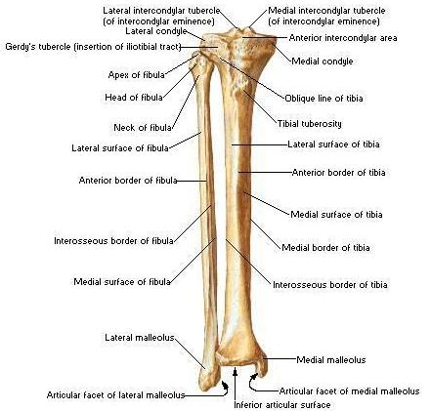
Tibia and Fibula
Anterior View

Slide 9
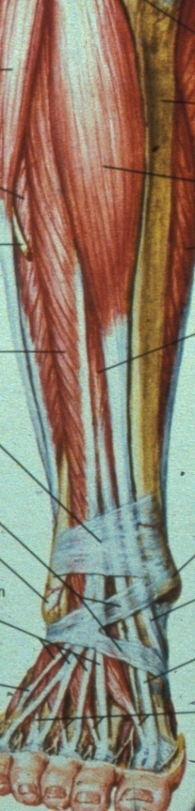
Extensor Retinacula
Superior retinaculum
Thickening deep fascia
Tibialis anterior pierces
Other tendons pass posterior
Inferior extensor retinaculum
Inferior stem attached to calcaneus
Upper limb to medial malleolus
Lower limb plantar aponeurosis

Slide 10
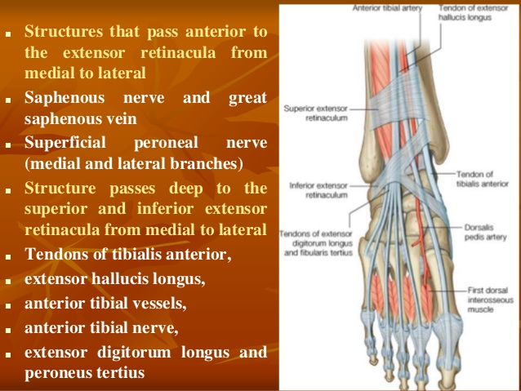

Slide 11
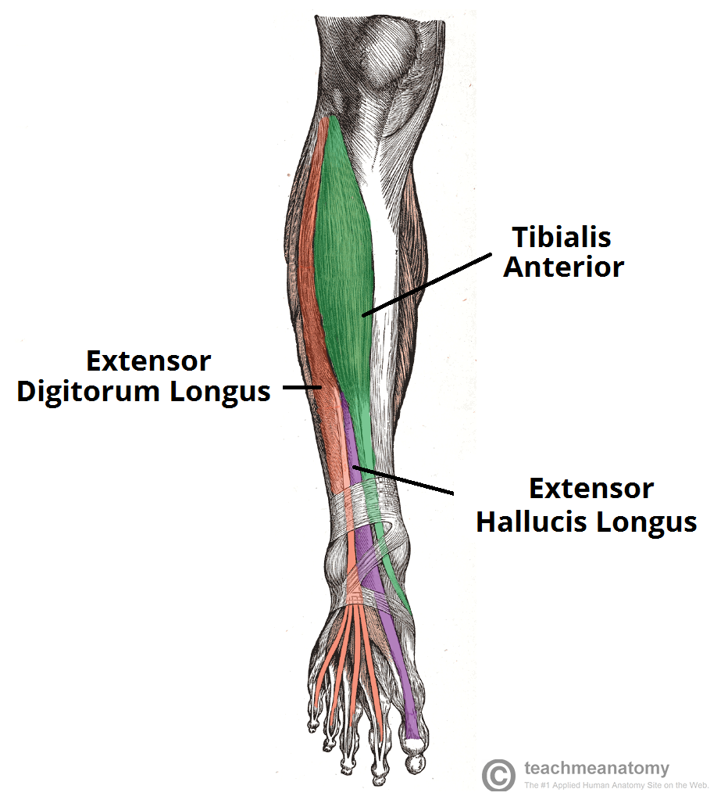

Slide 12
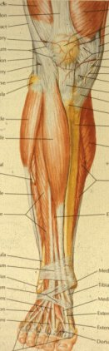
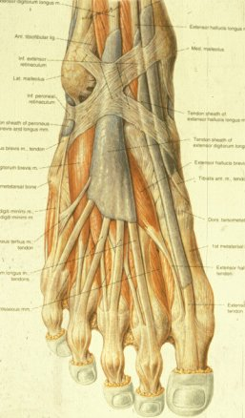
Tibialis Anterior
Synovial sheath
Passes under superior and both limbs of inferior extensor retinaculum
Dorsi flexor and invertor
Eccentric pays out, prevents foot slapping down
Supports medial arch
Deep peroneal nerve

Slide 13
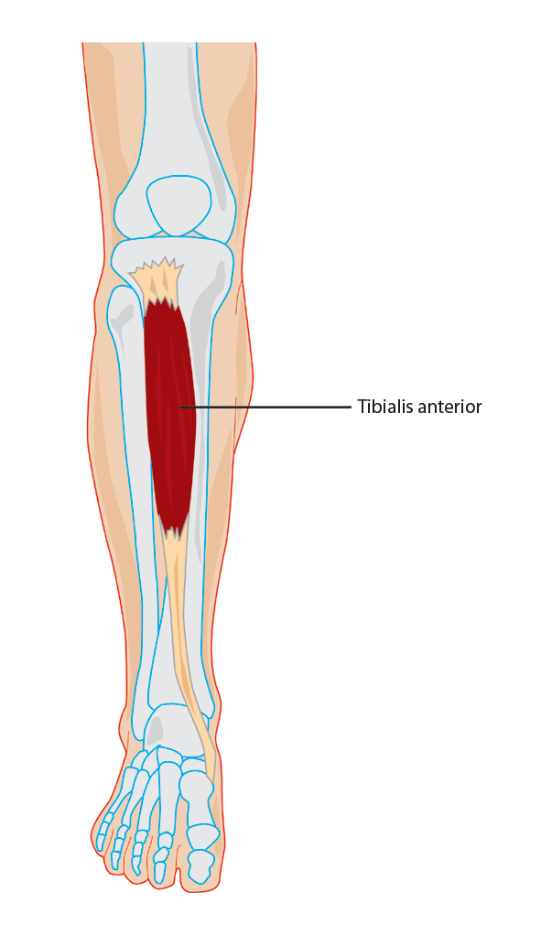

Slide 14
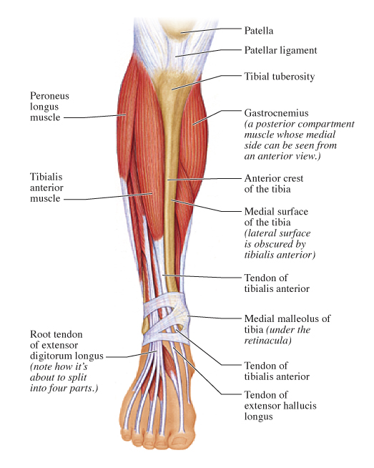

Slide 15
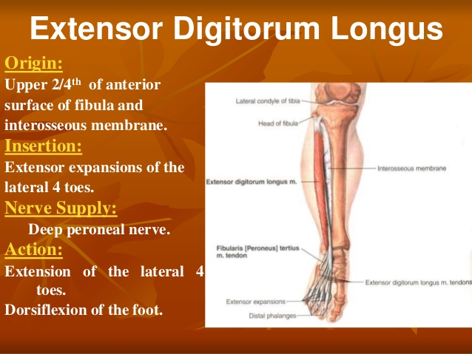

Slide 16
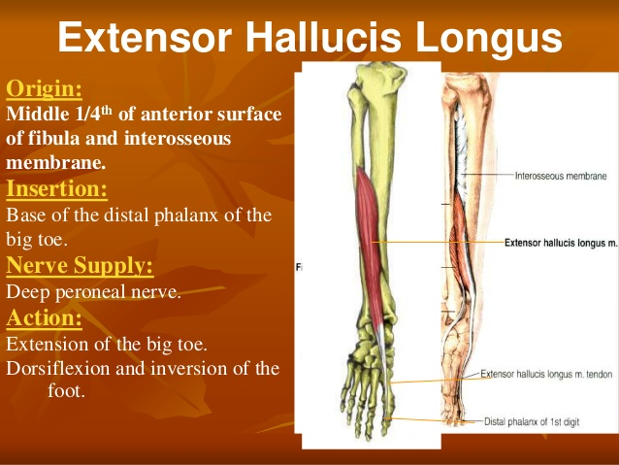

Slide 17
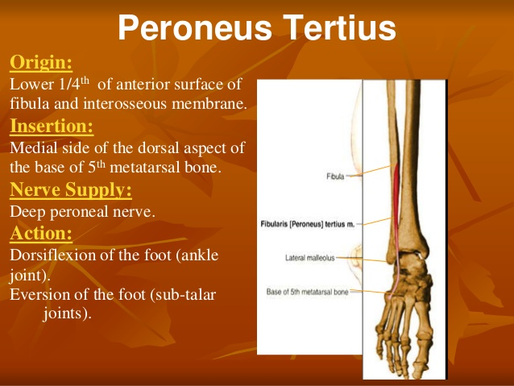

Slide 18
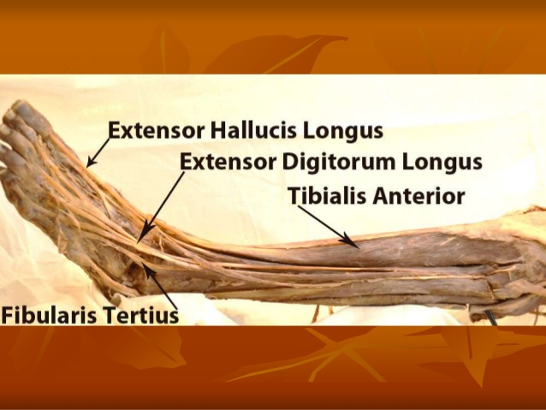

Slide 20
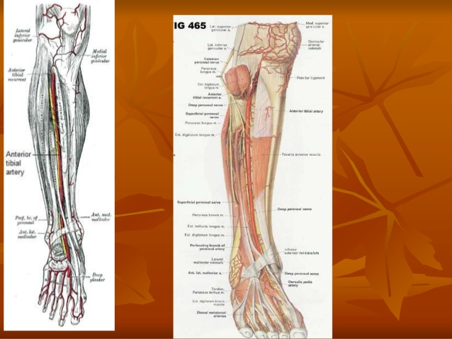

Slide 21
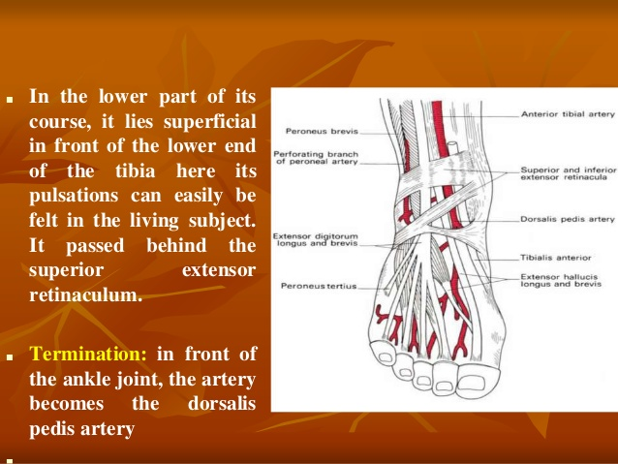

Slide 22
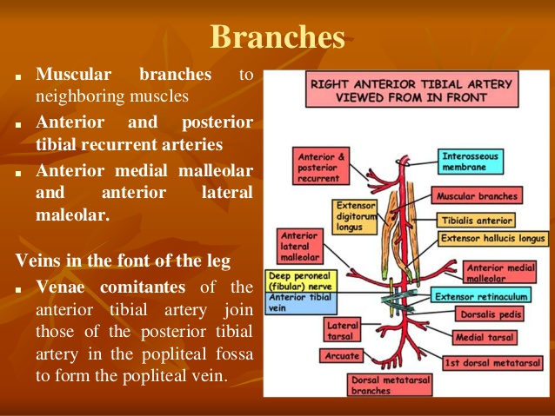

Slide 23
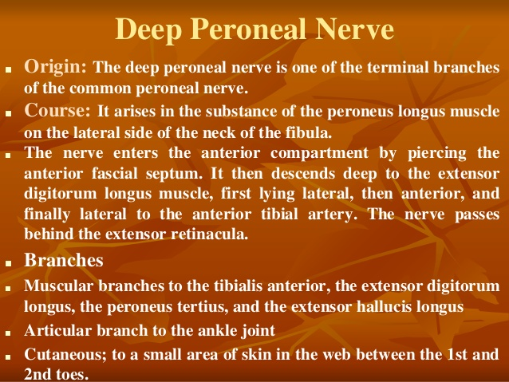

Slide 24
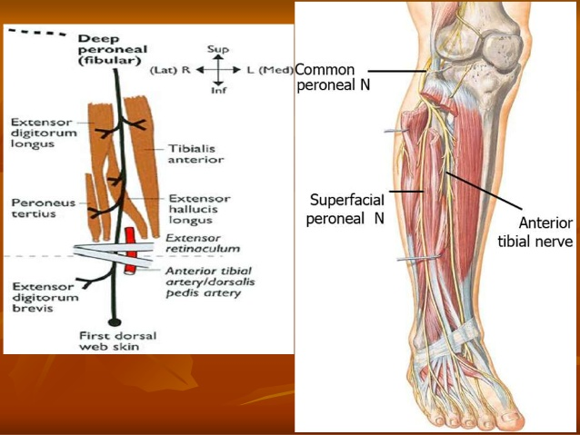

Slide 25
Superficial peroneal n.
Anterior tibial a.
Tibialis anterior
Deep peroneal n.
Extensor digitorum longus
Extensor hallucis longus
Dorsal a. of foot

Slide 26
DORSUM OF FOOT

Slide 27
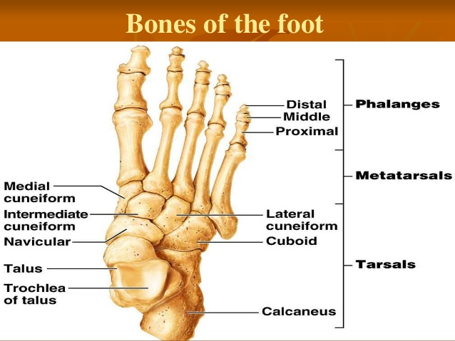

Slide 28
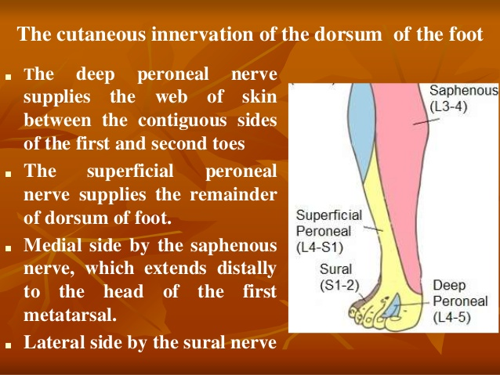

Slide 29
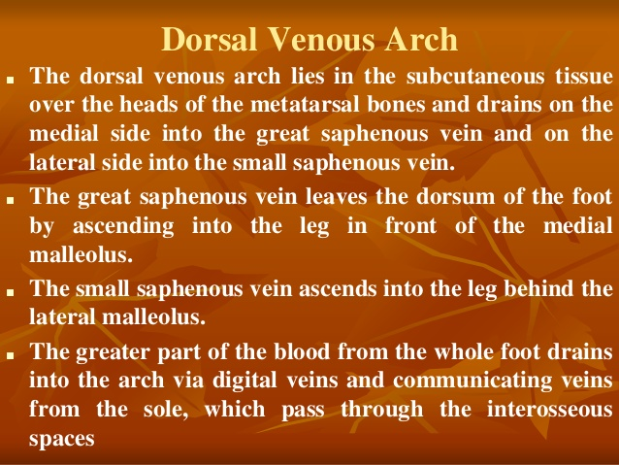

Slide 30
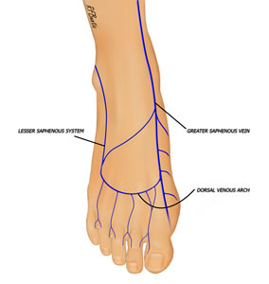
DORSAL VENOUS ARCH

Slide 31
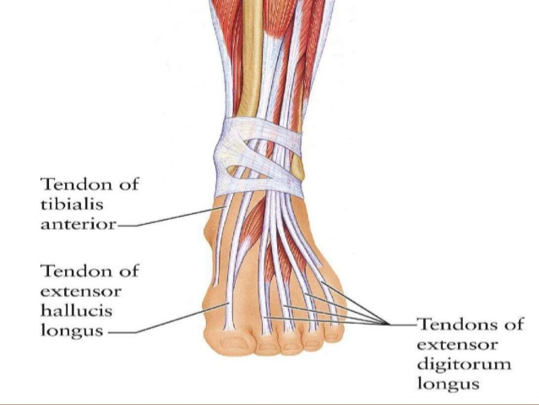
TENDONS IN DORSUM OF FOOT

Slide 32
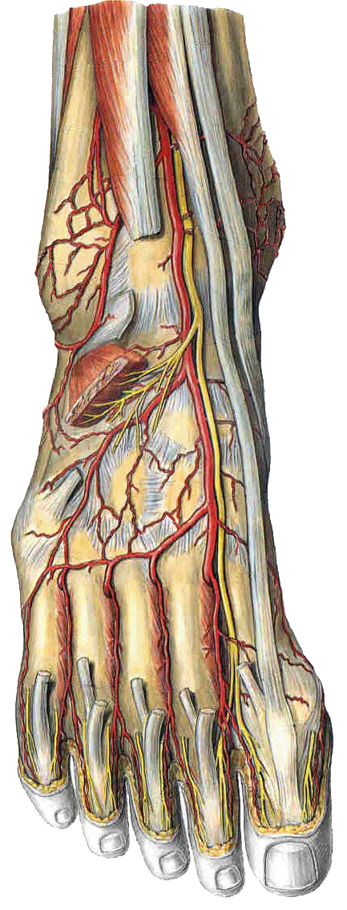
Dorsum of the foot
Dorsalis pedis artery
Begins on the anterior surface of the ankle joint and runs with the deep peroneal nerve
Divides into the arcuate artery and the first dorsal metatarsal artery at the proximal end of the first intermetatarsal space.
On the dorsum of the foot it lies on the tarsal bones and is readily palpated against them between the tendons of extensor hallucis longus and extensor digitorum longus.

Slide 33
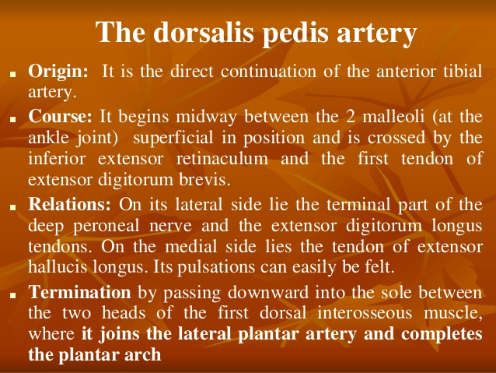

Slide 34
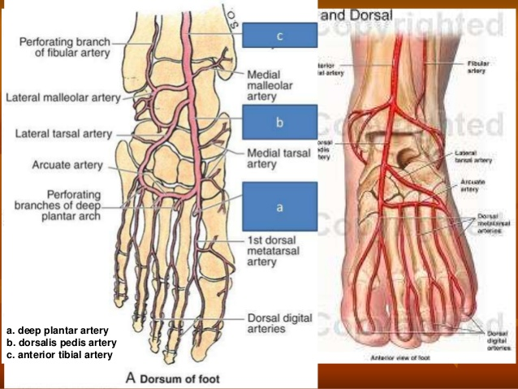

Slide 35
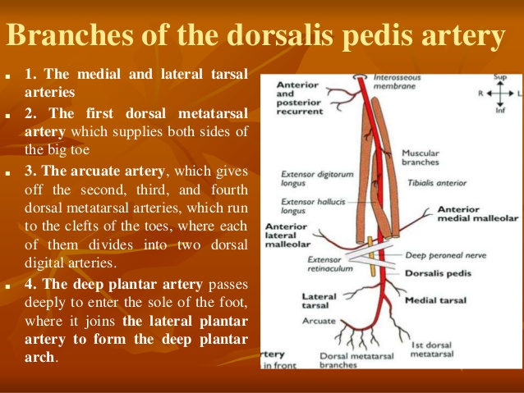

Slide 36
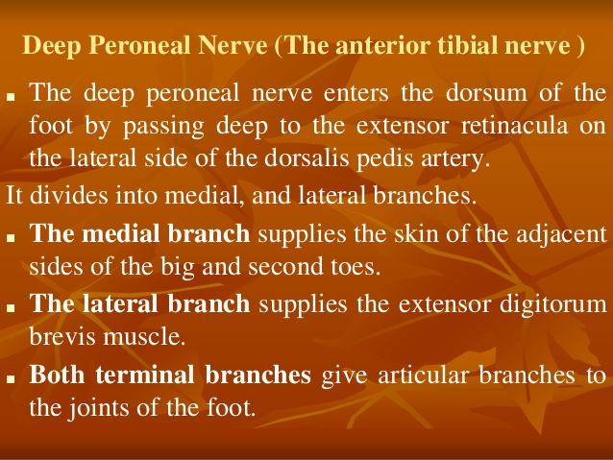

Slide 37
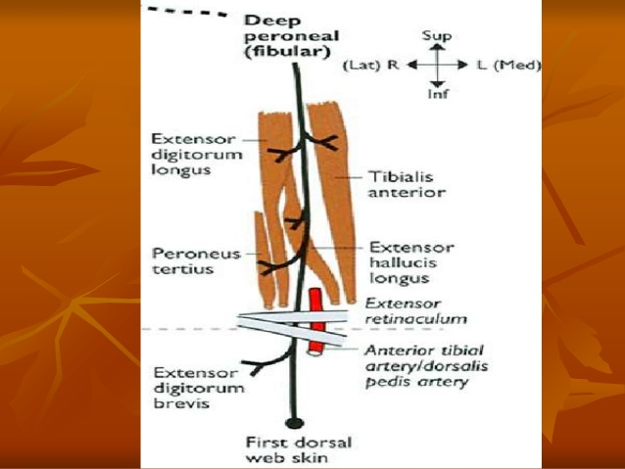

Slide 38
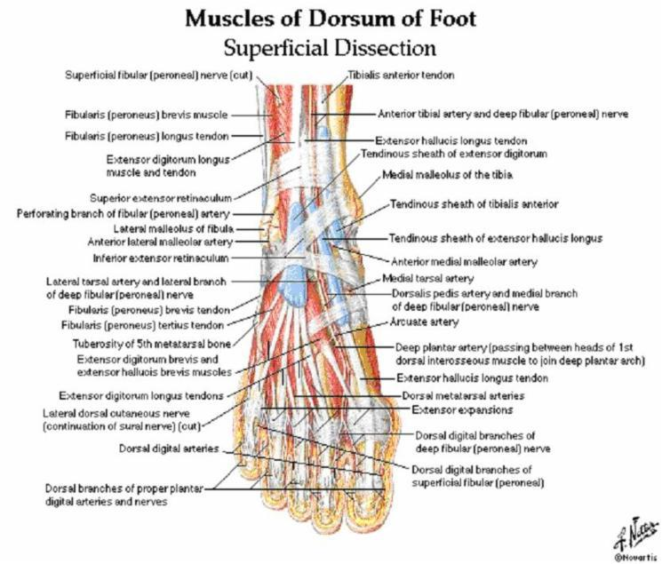

Slide 39
Applied Anatomy

Slide 40
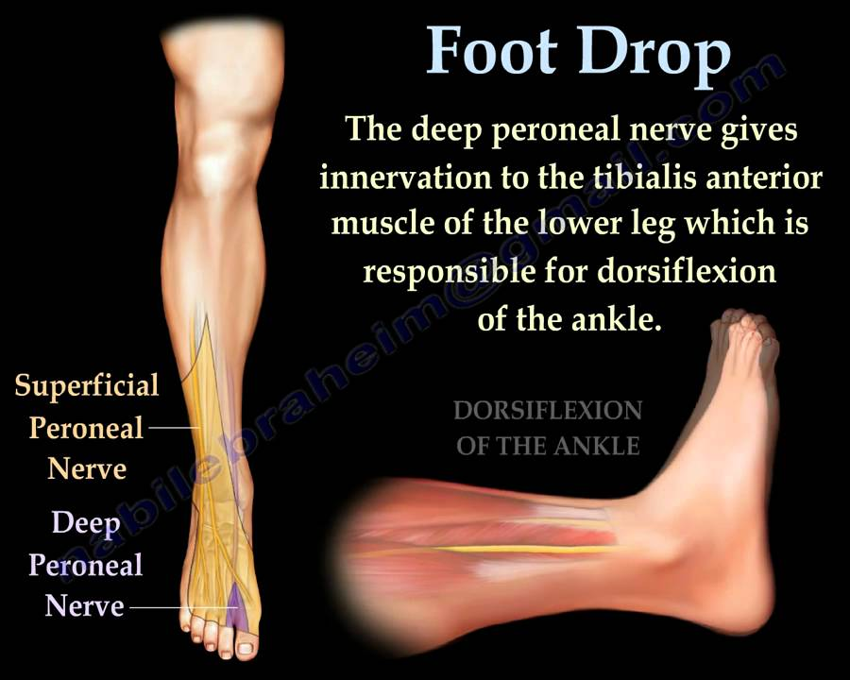

Slide 41
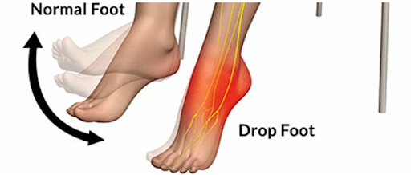

Slide 42
For Students……..
Don’t take the university exam lightly.
Study hard ,daily, in a routine and all subjects daily.
Don’t break continuity.
Focus on ur future.
Careful about ur health, diet and sleep.
I hope all u will get grand success….
Hoping best for ur future……………
Dr. Praveen Kurrey

Slide 43


Slide 44

THANK YOU

Slide 45


