Slide 1

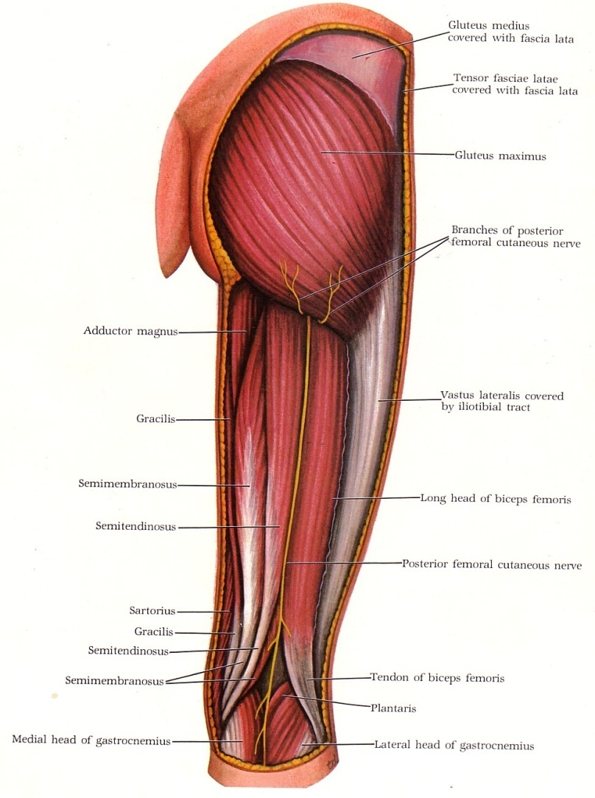
Dr. Praveen Kumar Kurrey
M.B.B.S., M.S.BCME, BCBR
Professor Anatomy

Slide 2
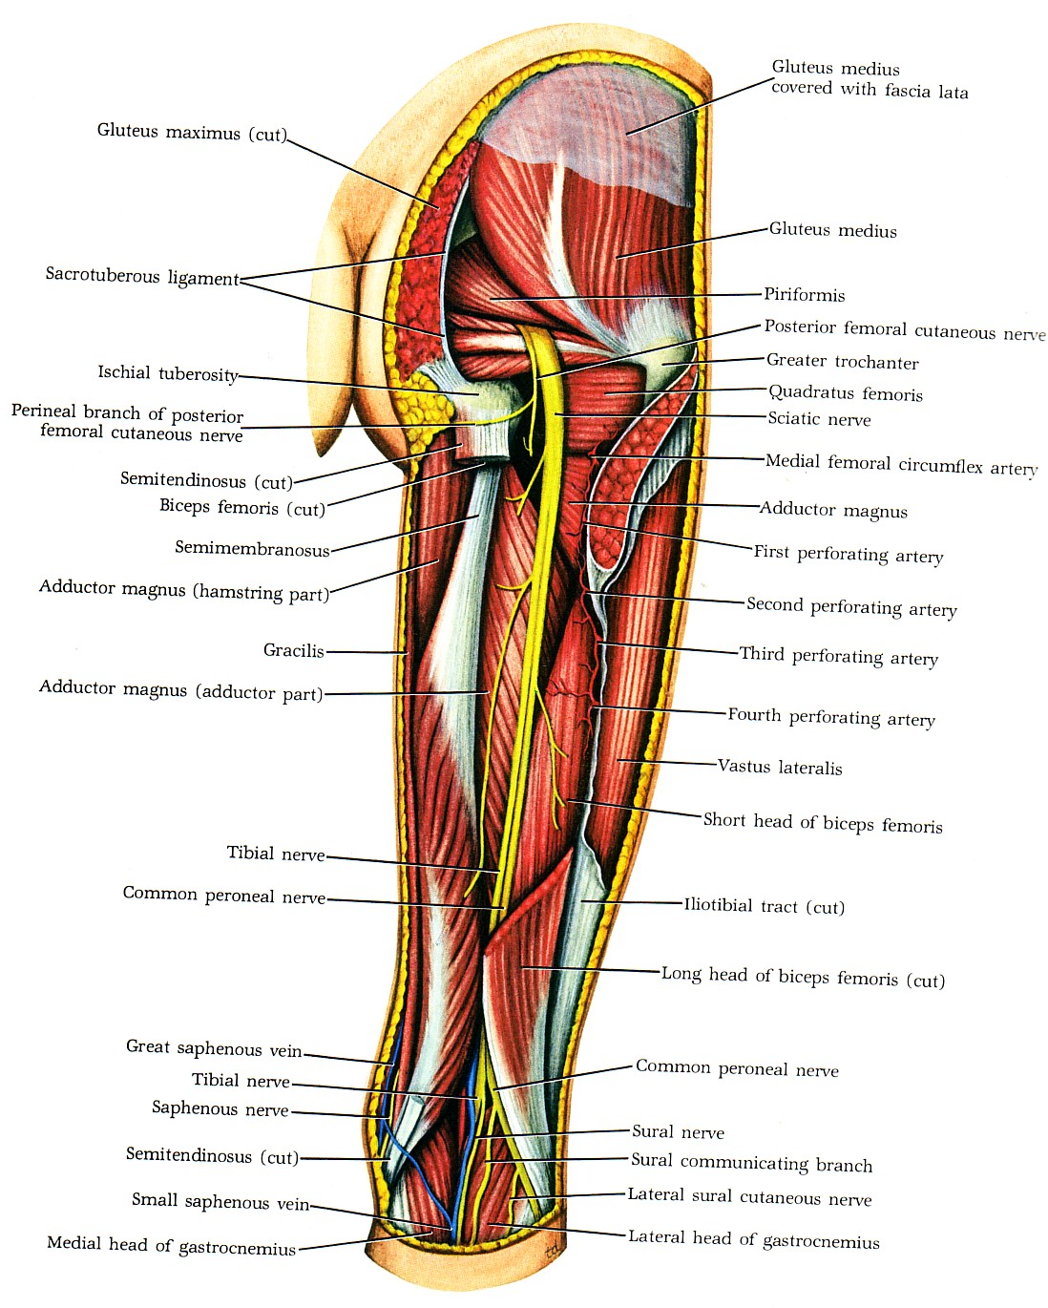


Slide 3
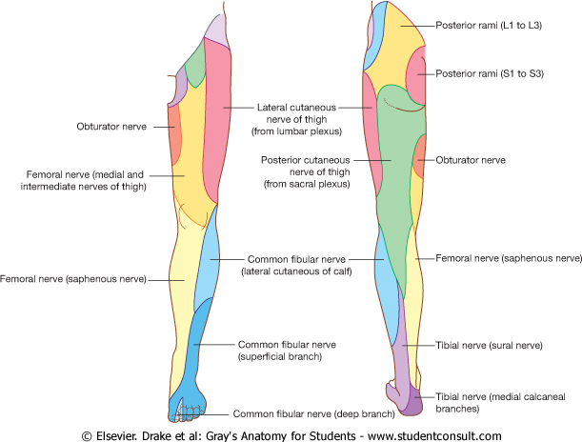
Cutaneous innervations of the back of thigh:
1- Posterior Cutaneous nerve of thigh,S1,2 & 3.
2- Posterior branch of lateral cutaneous nerve of thigh.
3- Posterior branch of medial cutaneous nerve of thigh.

Slide 4
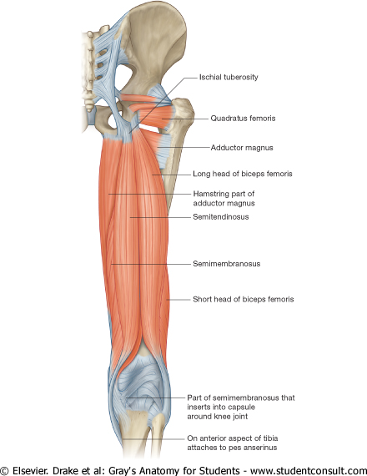
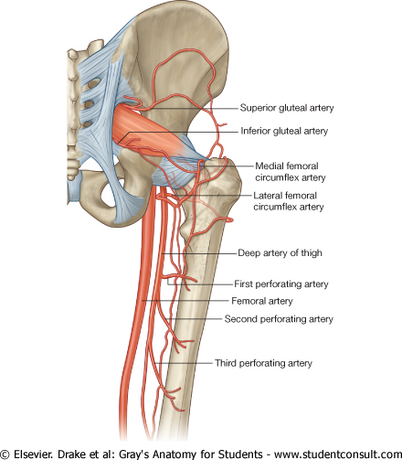
The back of thigh contains the following:
Hamstrings muscles.
Sciatic nerve.
Chain of anastomosis
(perforating arteries & cruciate anastomosis.

Slide 5
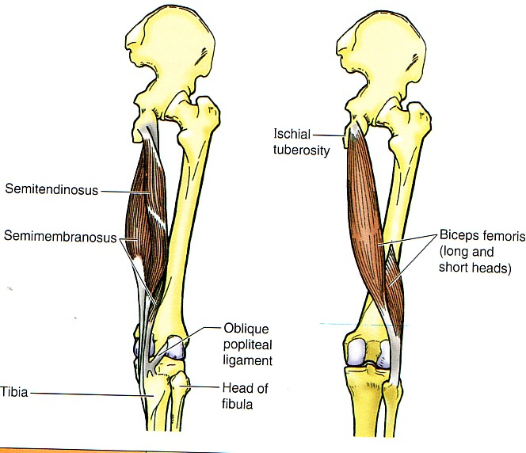

Slide 6
You should remember the following:
The hamstrings are the main Flexors of the knee, but they are also, Extensors of the hip.
All hamstrings arise from Ischial tuberosity, Except Short head of biceps from linea aspera and lateral supracondylar ridge of the femur.
Biceps femoris inserted into head of the Fibula.
Semimembranosus inserted into a groove in the back of medial tibial condyle.
Some fibers from the semimembranosus pass upward and laterally forming oblique popliteal ligament of the knee.

Slide 7
Semitendinosus & long head of biceps have a common origin from the Ischial tuberosity.
Semitendinosus inserted into upper part of medial surface of tibia (SGS(
Muscles inserted into tibia rotate leg medially.
Muscle inserted into fibula rotates leg laterally.
All hamstrings are supplied by tibial nerve
(medial popliteal) except short head of biceps by common peroneal nerve (lateral popliteal).

Slide 8
Sciatic nerve
Larger of the two terminal branches of sacral plexus.
Root value:
L4 and 5 ; S1, 2 and 3.
Leaves the pelvis through greater sciatic foramen, below piriformis.
Covered by gluteus maximus.
It crosses the following from above downwards
Tendon of obturator internus and 2 gemelli, Quadratus femoris, adductor magnus
Surface anatomy: draw a line which begins from midpoint between greater trochanter & ischial tuberosity to the apex of popliteal fossa.

Slide 9
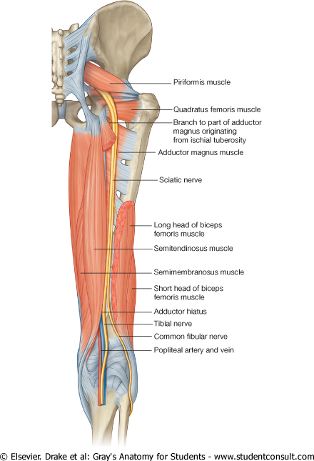
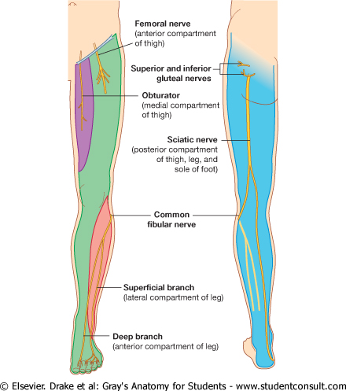

Slide 10
Popliteal Fossa
Definition: Diamond shaped space in the back of the knee joint.
Boundaries:
Upper lateral: Biceps femoris.
Upper medial: Semitendinosus, semimembranosus, supplimented by sartorius, gracilius and Ischial part of adductor magnus.
Lower medial: medial head of gastrocnemius.
Lower lateral: Lateral head of gastrocnemius and Plantaris.
Lower limit of the fossa is the distal border of popliteus.
Roof: Skin, superficial fascia containing upper part of small saphenous vein, deep fascia (popliteal fascia).

Slide 11
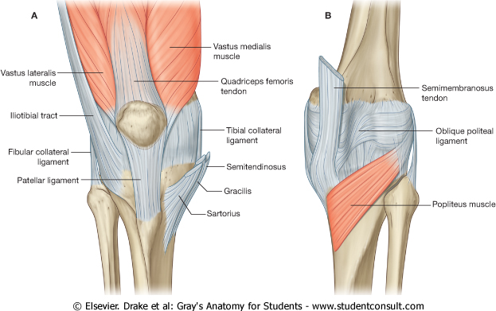

Slide 12
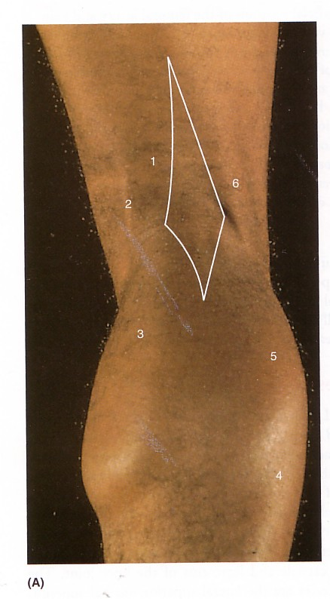
Surface anatomy of
Right popliteal fossa
Upper medial border (1)
(Semitendinosus(2), semi-
membranosus, Ischial part of adductor magnus, gracilius & sartorius.
Lower medial (3): medial head of gastrocnemius
Lower lateral (5) Lateral head of gastrocnemius & Plantaris.
Upper lateral :
Biceps femoris(6).
4- Soleus muscle.

Slide 13
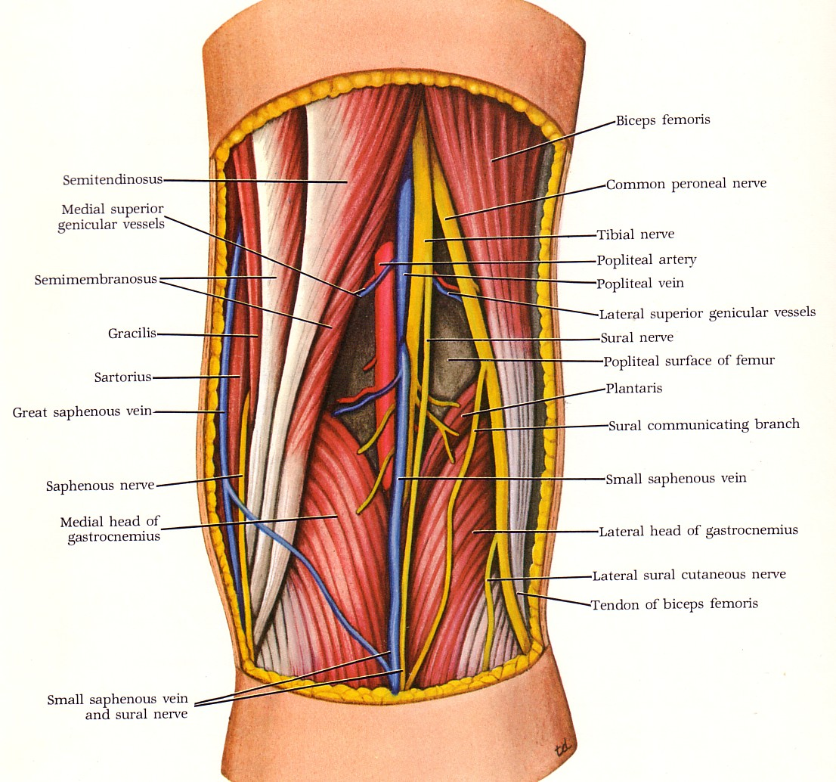

Slide 14
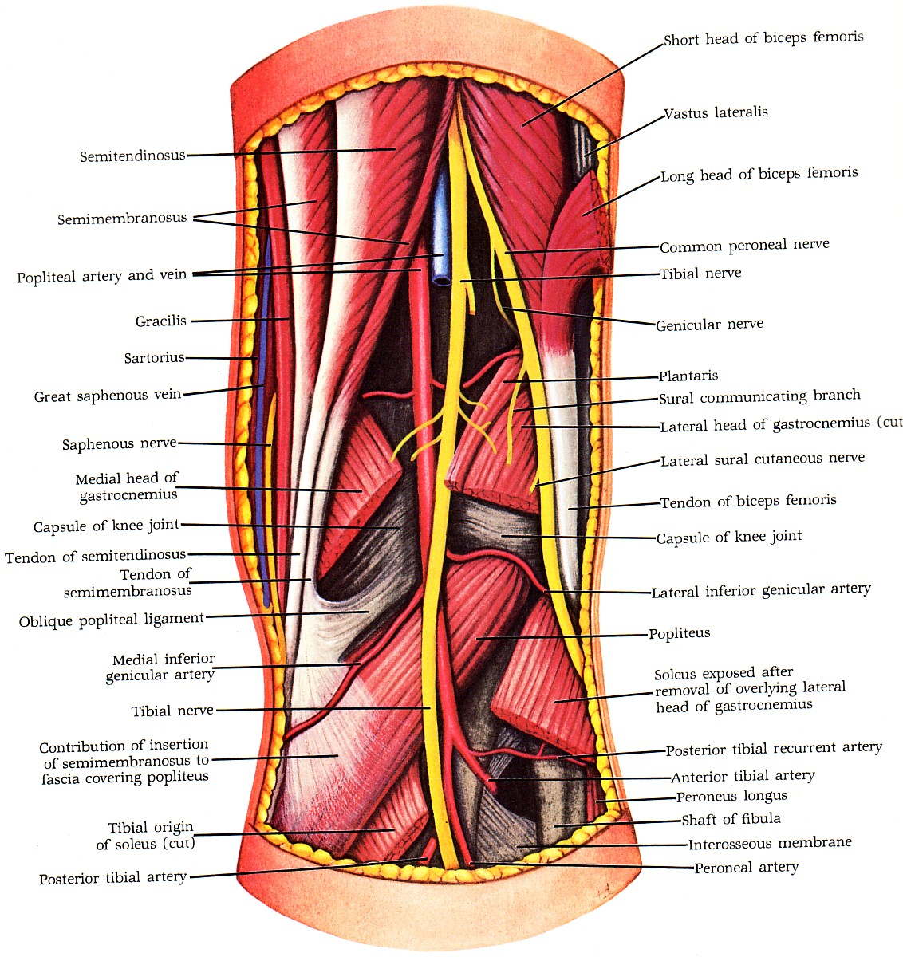
Floor of popliteal fossa:
From above downwards:
Popliteal surface of the femur
Back of capsule of knee joint,
Fascia covering popliteus muscle.
Contents:
Medial popliteal nerve (Tibial).
Lateral popliteal nerve (Common peroneal)
Popliteal artery.
Popliteal vein.
Popliteal lymph nodes.
Popliteal fat.

Slide 15
Popliteal Artery
Origin:
It is the continuation of femoral artery at the opening of adductor magnus.
Termination:
At the distal border of popliteus it divides into anterior & posterior tibial arteries.
Branches:
1- muscular branches.
2- Genicular branches (Superior lateral, superior medial, inferior lateral, inferior medial & middle genicular arteries)
It is the deepest structure in the fossa as it runs on the floor of the fossa.

Slide 16
Medial Popliteal Nerve
Is the larger of two terminal branches of sciatic nerve, which bisects the fossa.
It is the most superficial structure in the fossa
Crossing popliteal vessels superficial from lateral to medial.
Branches:
1- Cutaneous: Sural nerve.
2- Muscular: (5) To each head of gastrocnemius, popliteus, Plantaris and soleus.
3- Articular: (3) Superior medial, inferior medial, and middle genicular nerves.
Termination: At the distal border of popliteus it is continuous as posterior tibial nerve.

Slide 17
Lateral popliteal
(common Peroneal) Nerve
Smaller of the 2 terminal branches of sciatic.
Enters the fossa through its upper angle.
Runs close to medial side of the tendon of biceps.
Leaves the fossa through its lateral angle.
It crosses Plantaris & lateral head of gastrocnemius.
It curves on the lateral side of fibular neck.
Termination: Within the substance of peroneus longus it divides into 2 terminal branches:
anterior tibial (deep peroneal) and
musculo-cutaneous , ( superficial peroneal).

Slide 18
Branches:
1- Cutaneous: 2
Lateral Cutaneous nerve of the calf.
Sural communicating nerve
2- Muscular:
No muscular branches in the fossa.
3- Articular: (3)
Superior lateral genicular nerve.
Inferior lateral genicular nerve.
Recurrent genicular nerve.

Slide 19
Popliteal Vein
Begins at the distal border of popliteus muscle by the union of the 4 venae comitantes of the anterior & posterior tibial arteries.
Leaves the fossa at its upper end as it becomes the femoral vein at the opening of adductor magnus.
Tributaries: muscular, 5 genicular and small sphenous vein.
It lies deep to popliteal nerves and superficial to the popliteal artery.

Slide 20

THANK YOU

