Slide 1
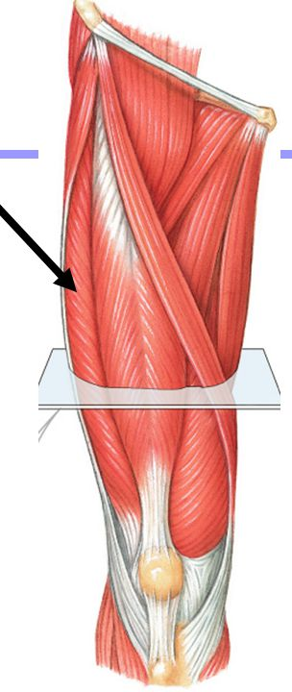
LOWER LIMB
FRONT OF THIGH
Dr. Praveen Kumar Kurrey
M.B.B.S., M.S. , B.C.M.E, B.C.B.R.
Associate Professor
Dept. Of Anatomy
Pt. J.N.M. Medical college

Slide 2
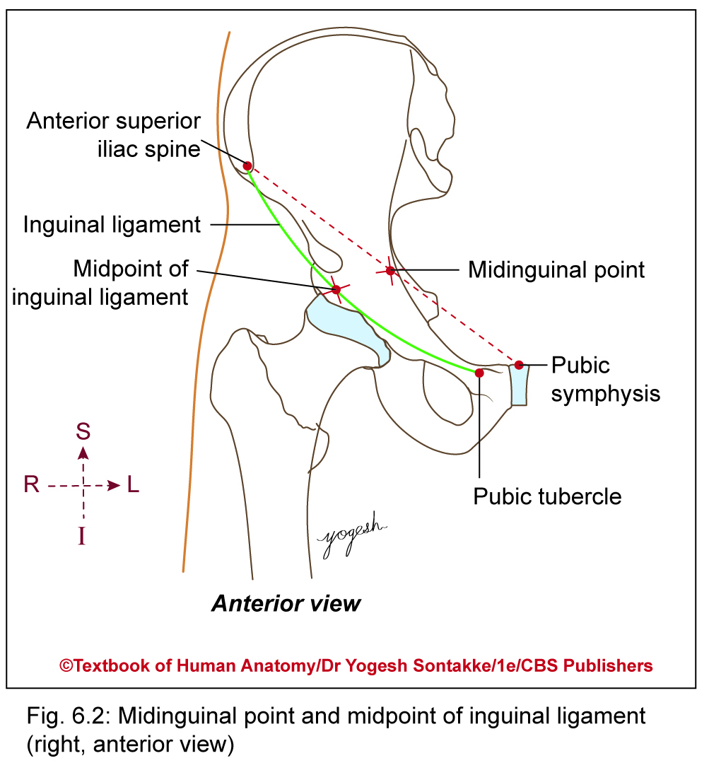
SURFACE LANDMARKS
Midpoint of inguinal ligament
Lies midway between ASIS and pubic tubercle
Midinguinal point
Lies midway between ASIS and pubic symphysis.
Most commonly used reference point in clinical examination
Patella
Knee-cap
Can be felt and seen in front of knee joint
Largest sesamoid bone develops in tendon of quadriceps femoris

Slide 3
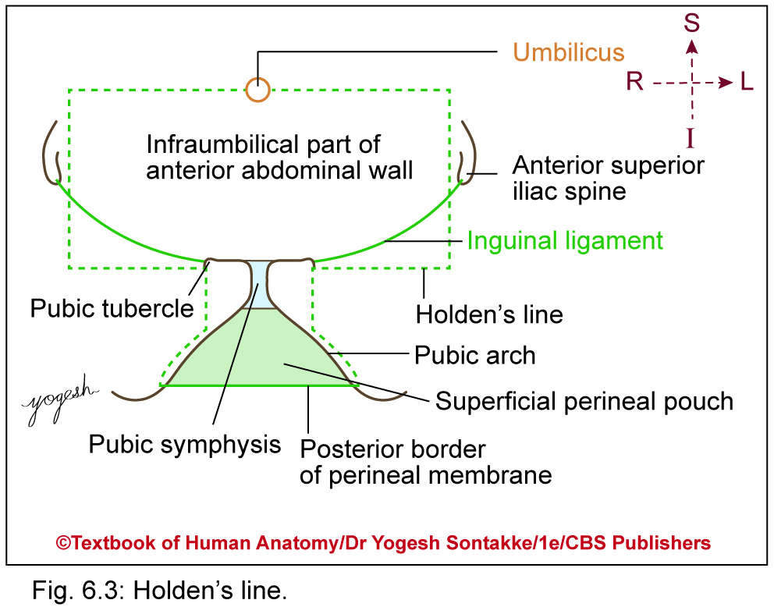
SUPERFICIAL FASCIA
Has two layers only in upper part
  Superficial thick fatty layer
  Deep thin membranous layer
Layers continued with two layers of superficial fascia of anterior abdominal wall
Holden’s line
Along Holden’s line, membranous layer of superficial fascia attached firmly with deep fascia
Extent: Extends horizontally from little lateral to pubic tubercle for about 8 cm
Fascial fusion along Holden’s line prevents urine from descending downward into thigh in case of injury to ureter in perineum

Slide 4
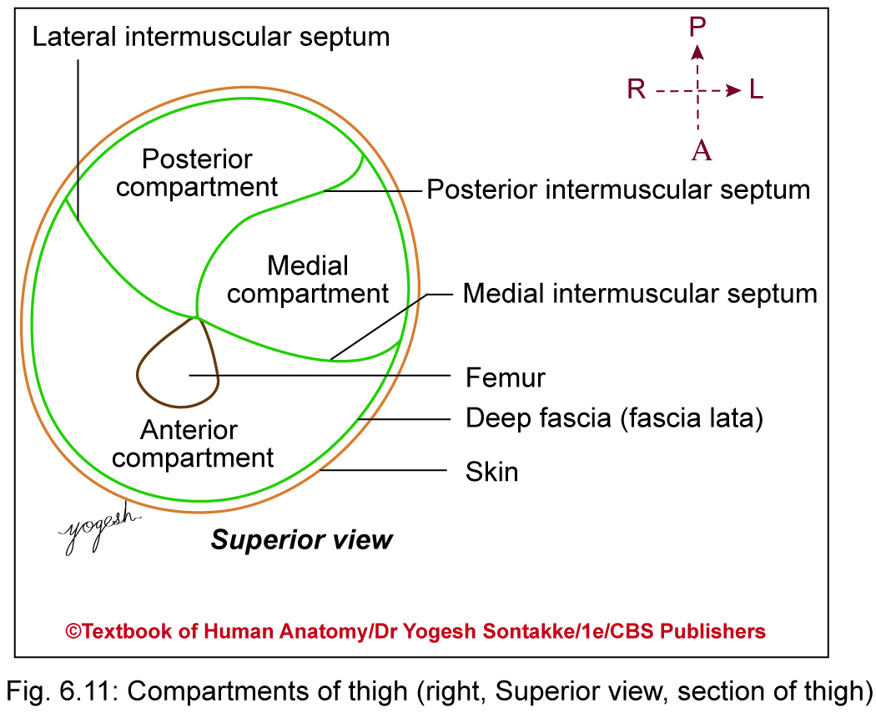
ANTERIOR COMPARTMENT OF THIGH
Contents
Contains:
  Muscles
  Rectus femoris
  3 vasti (vastus medialis, intemedius, and lateralis)
  Sartorius
  Articularis genu
  Tensor fascia latae
  Nerve: Femoral nerve
  Artery: Femoral artery
  Fascial space: Femoral triangle and adductor canal

Slide 5
Muscles of Front of Thigh
Sartorius
Quadriceps femoris- 4 muscles rectus femoris,
vastus lateralis,
vastus medialis,
vastus intermedius
Articularis genu

Slide 6
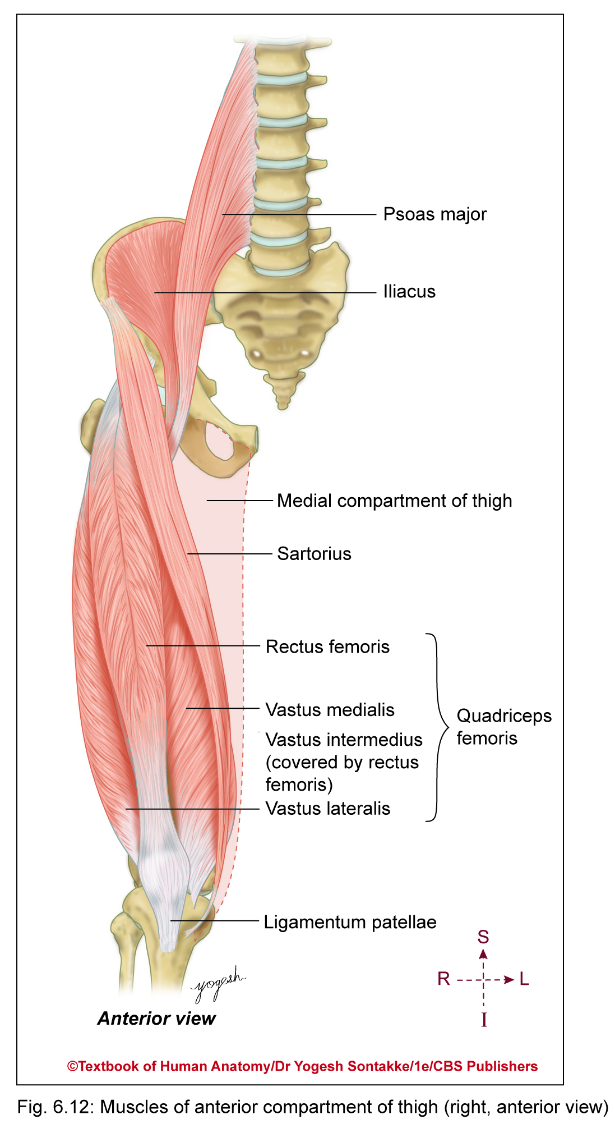

MUSCLES OF ANTERIOR COMPARTMENT OF THIGH
Include following muscles
  Rectus femoris
  Vastus lateralis
  Vastus medialis
  Vastus intermidius
  Articularis genu
  Sartorius
  Tensor fasciae latae
Quadriceps femoris

Slide 7
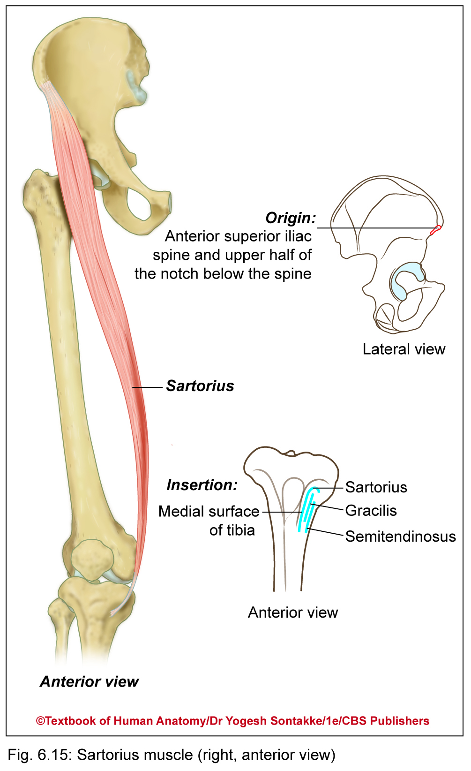
Sartorius
Longest muscle in body
Called as Tailor’s muscle (sartor = tailor in Latin)
Used for palthi position by people for meal or prayer as well as by tailors
Position includes
  Flexion of hip
  Flexion of knee
  Abduction and lateral rotation of thigh

Slide 8
Sartorius
Details
Origin | Anterior superior iliac spine of the pelvic bone
Insertion | Anteromedial surface of the proximal tibia in the pes anserinus in front of insertions of gracilis and semitendineous
Artery | femoral artery
Nerve | femoral nerve (sometimes from the intermediate cutaneous nerve of thigh)
Actions | Flexion, abduction, and lateral rotation of the hip, flexion of the knee

Slide 9
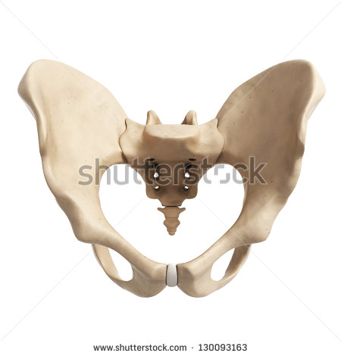
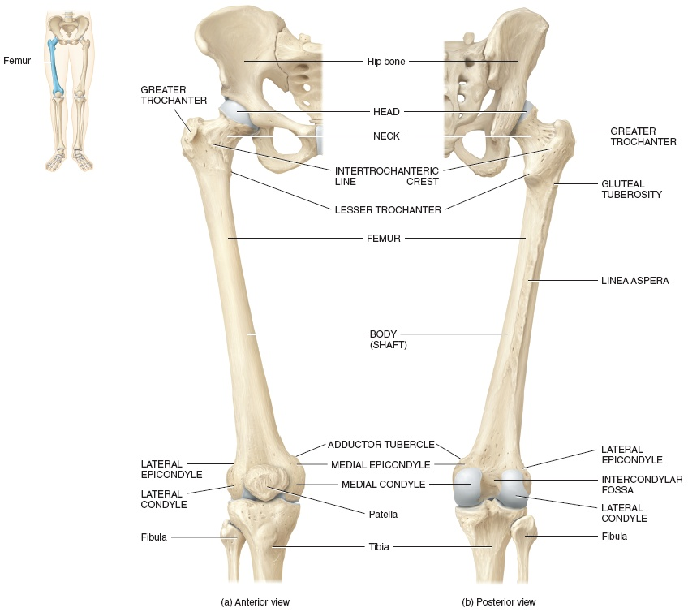
Sartorius
Insertion
Origin

Slide 10
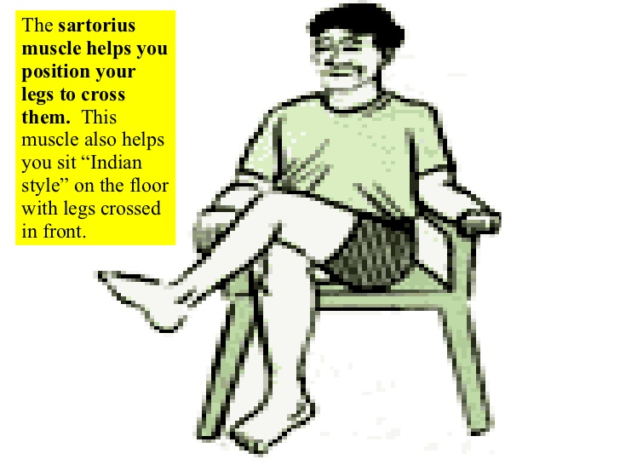
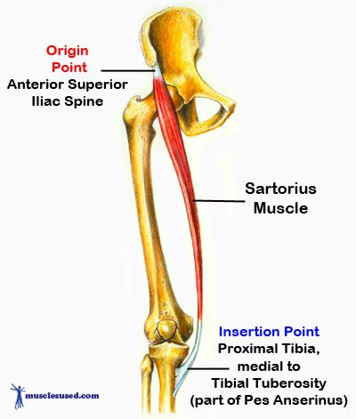
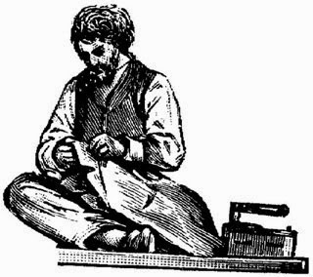
Sartorius
Tailor muscle

Slide 11
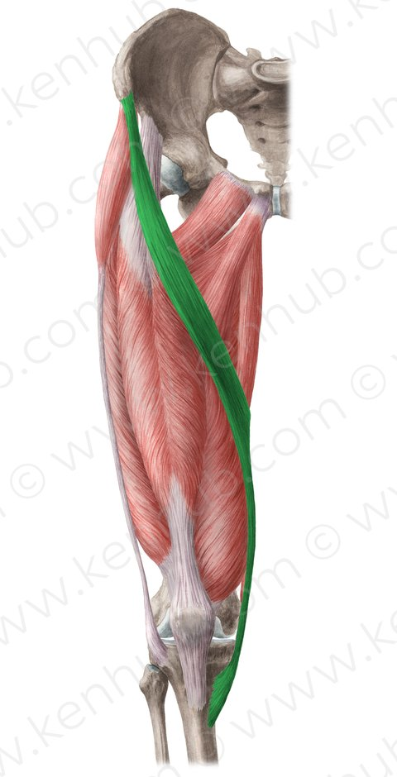
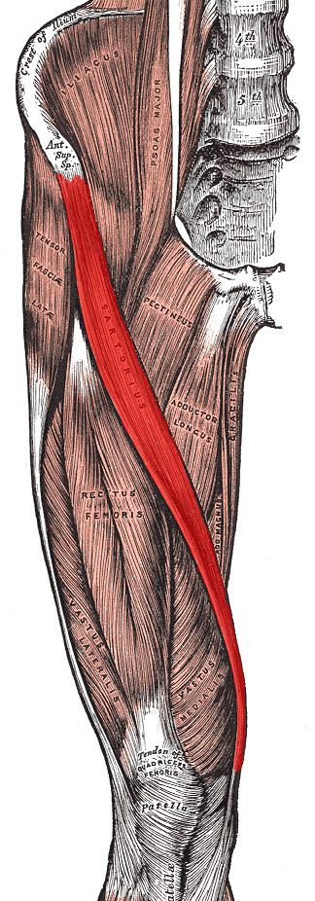
Sartorius

Slide 12
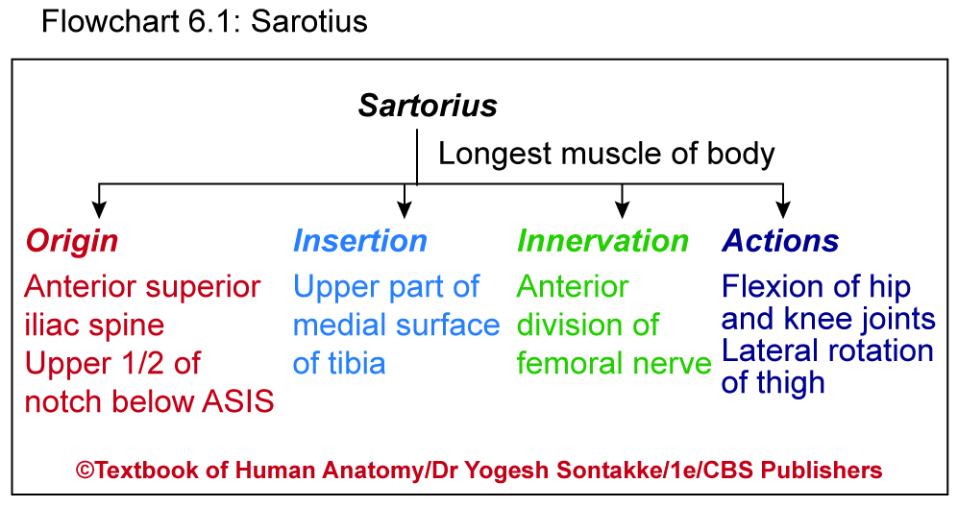

Slide 13
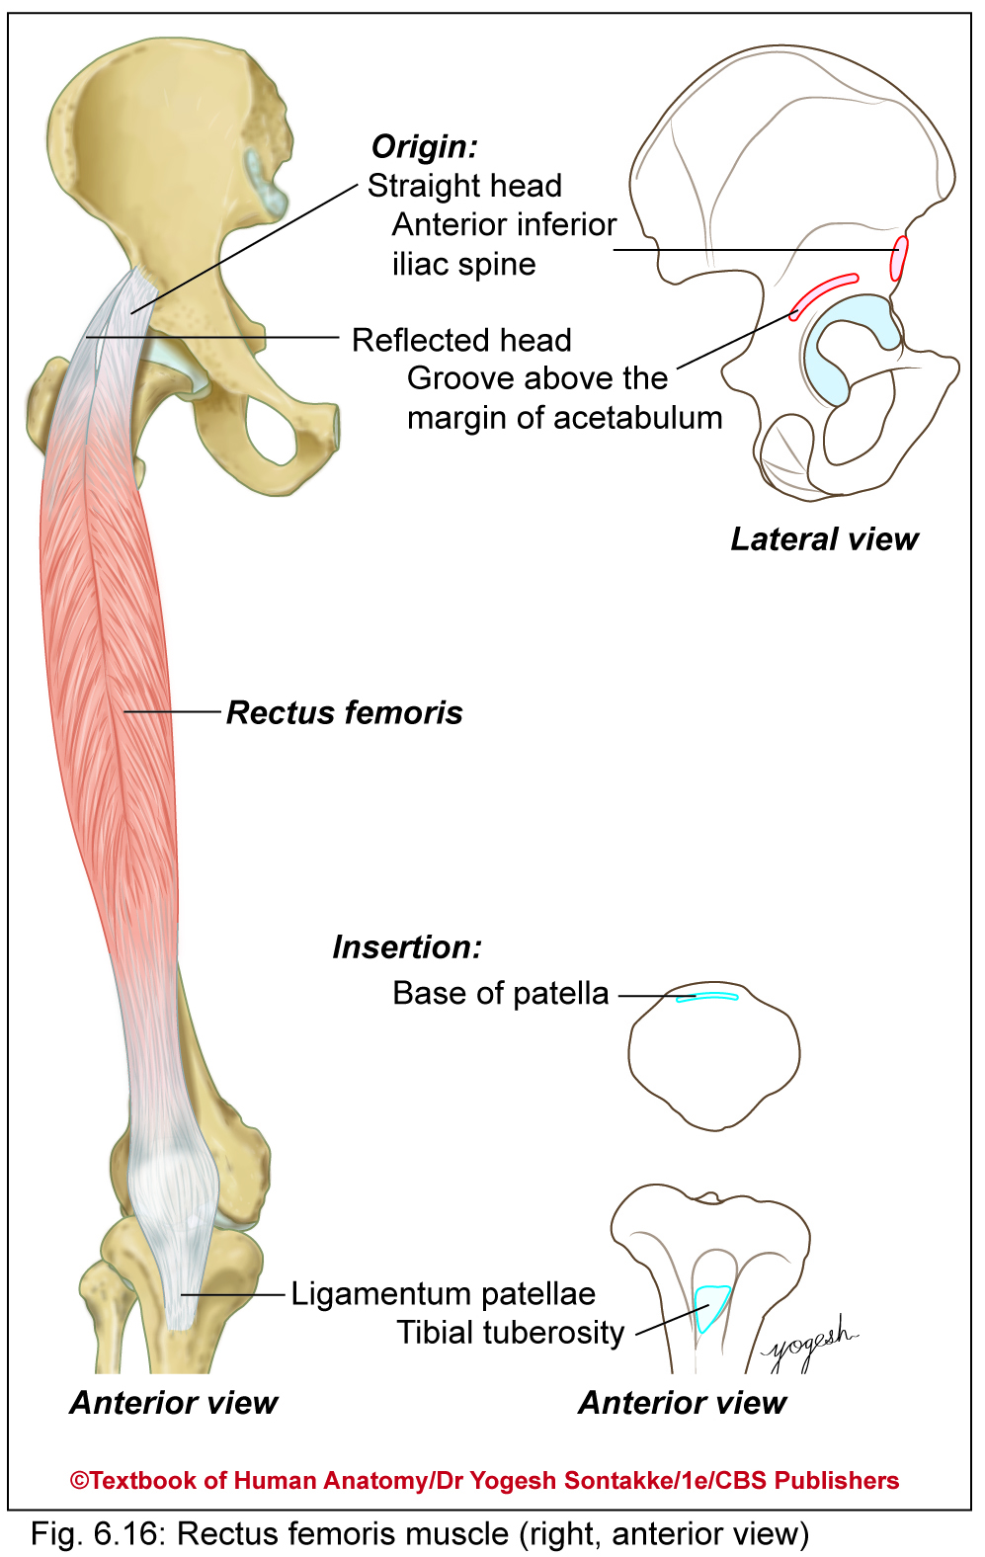
Rectus Femoris
Straight, fusiform, bipinnate muscle (rectus = straight in Latin)
Location: Lies in middle of front of thigh
Origin
Has two heads: straight and reflected
Straight head: Originates from upper half of anterior inferior iliac spine.
Reflected head
  Thin and flat
  Arises from groove above the margin of the acetabulum and from capsule of hip joint

Slide 14
Rectus femoris
Origin | anterior inferior iliac spine and the exterior surface of the bony ridge which forms the groove on the iliac portion of the acetabulum
Insertion | inserts into the patellar tendon as one of the four quadriceps muscles
Artery | descending branch of the lateral femoral circumflex artery
Nerve | femoral nerve
Actions | knee extension; hip flexion

Slide 15
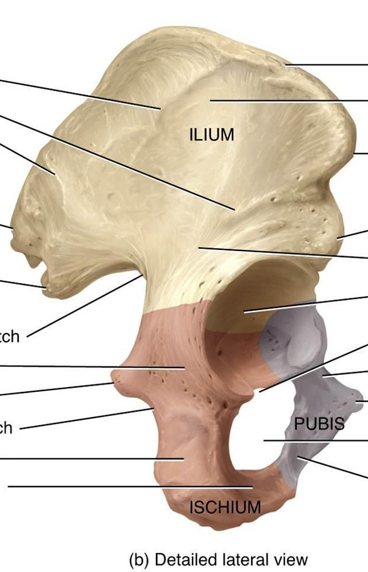
Rectus femoris
Origin

Slide 16
Rectus femoris
Insertion

Slide 17
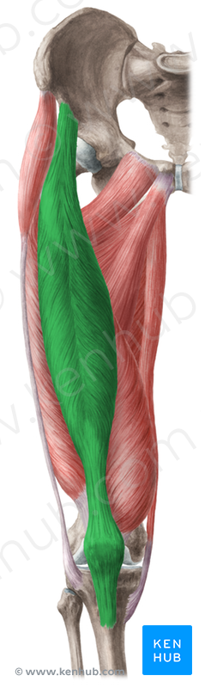
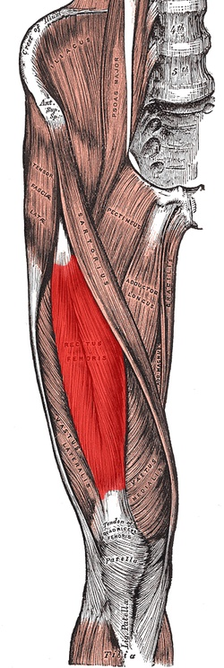
Rectus femoris

Slide 18
Vastus Lateralis
Details
Origin | Greater trochanter , Intertrochanteric line, and Linea aspera of the Femur
Insertion | Patella by the Quadriceps tendon and Tibial tuberosity by the Patellar ligament
Artery | lateral circumflex femoral artery
Nerve | femoral nerve
Actions | Extends and stabilizes knee

Slide 19
Vastus Lateralis
Origin

Slide 20
Vastus Lateralis
Insertion

Slide 21
Vastus Lateralis
Applied – Used for
Intramuscular Injection
in Children

Slide 22
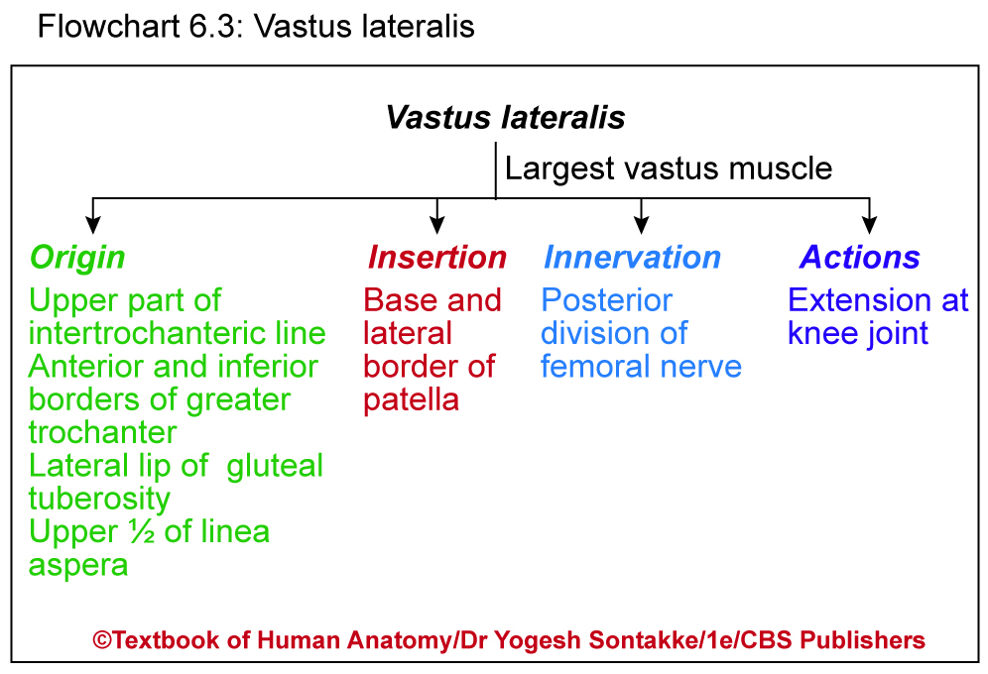

Slide 23
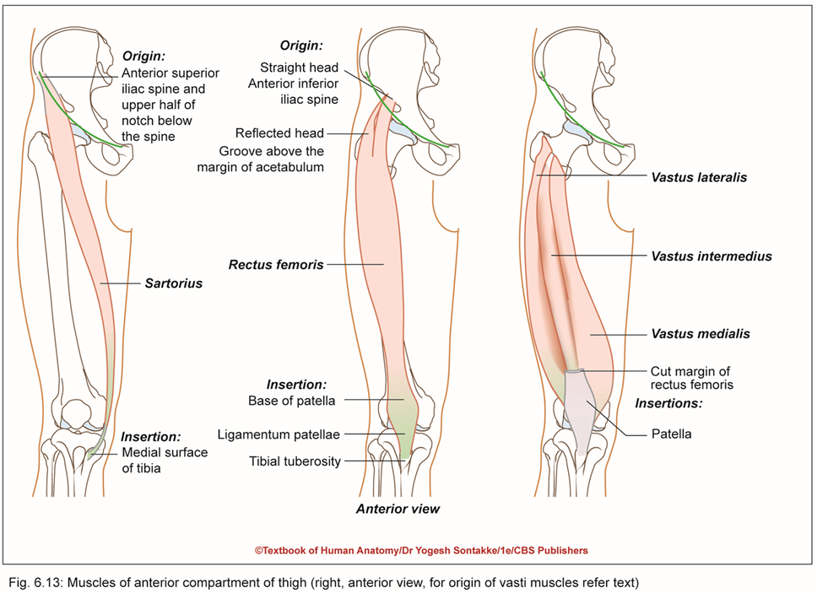
Vastus medialis (Vastus Medialis Obliques)
Also called vastus internus or Teardrop muscle
Location: Bulky muscle covers medial aspect of femur
Origin
Linear fashion from following parts of femur
Lower part of intertrochanteric line
Spiral line
Medial lip of linea aspera
Upper two-thirds of supracondylar line

Slide 24
Vastus Medialis
Origin

Slide 25
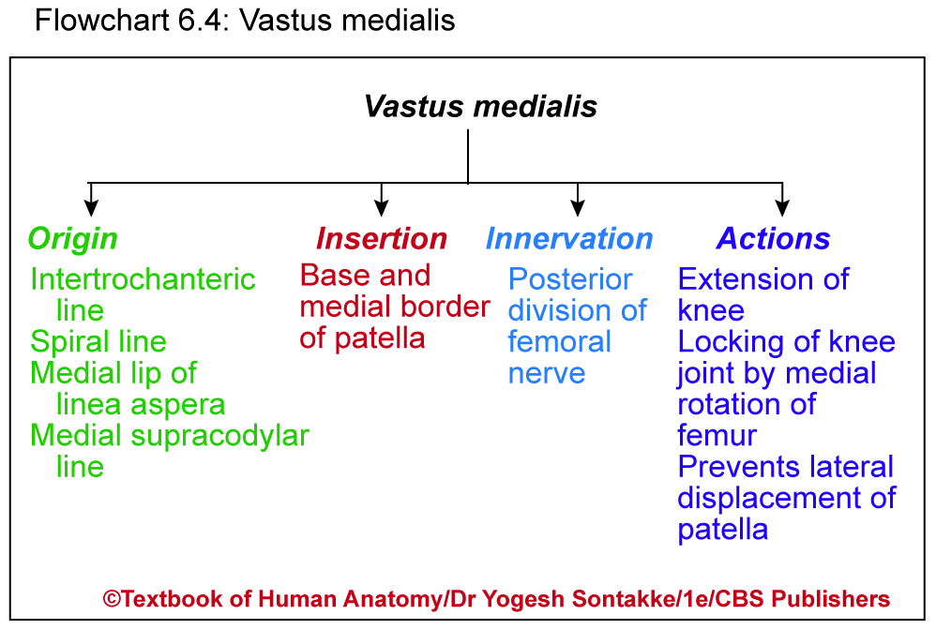

Slide 26
Vastus Medialis
Insertion

Slide 27
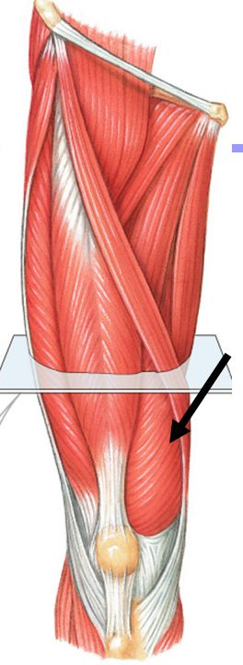
Vastus Medialis

Slide 28
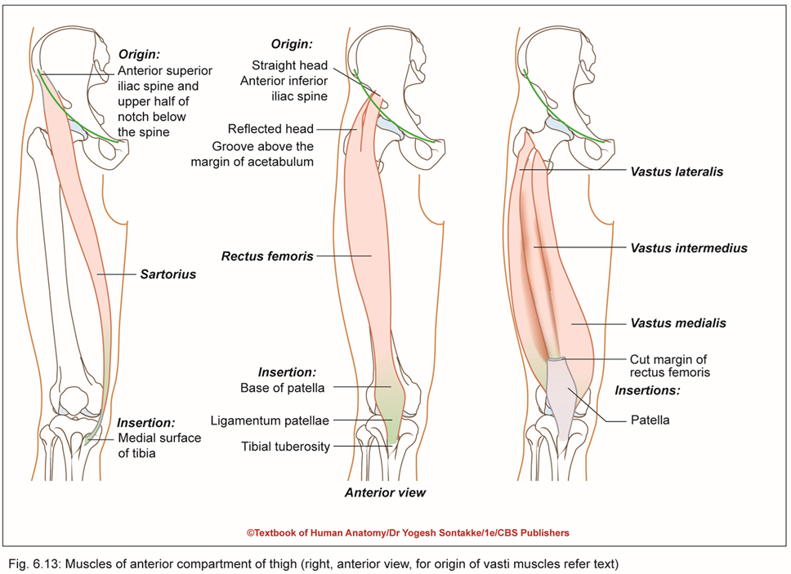
Vastus Intermedius
Situated in thigh under cover of rectus femoris
Reflect rectus femoris muscle to visualize vastus intermediate muscle
Origin
Originates from 3/4th of anterior and lateral surfaces of shaft of femur

Slide 29
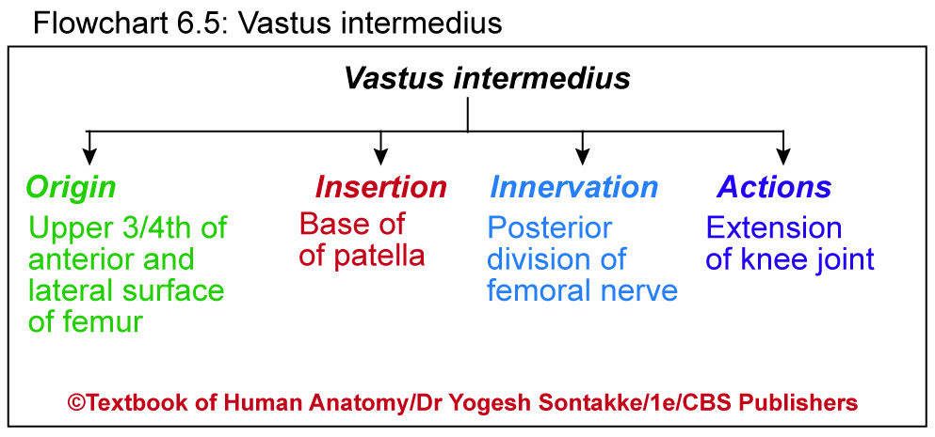

Slide 30
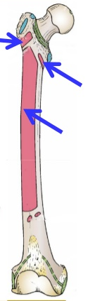
Vastus intermedius
Origin

Slide 31
Vastus Intermedius
Insertion

Slide 32
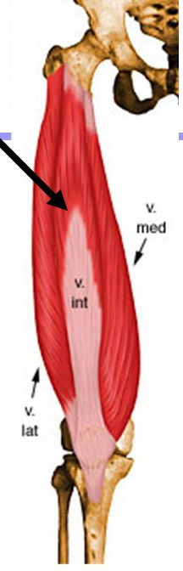
Vastus Intermedius

Slide 33
Articularis genu (subcrureus)
Small muscle consists of three–four slips
Lies deep to vastus intermedius and considered as detached part of vastus intermedius
Origin
Originates from lower part of anterior surface of femur
Insertion
Inserts on upper part of synovial membrane of knee joint
Innervation
Supplied by small branch of nerve to vastus medialis through posterior division of femoral nerve
Action
Prevents damage to synovial membrane knee joint by pulling synovial membrane upward during extension of knee

Slide 34
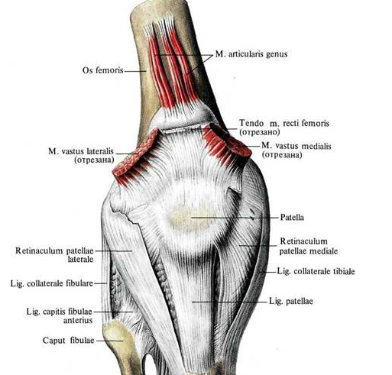
Articularis Genu
Insertion
Origin

Slide 35
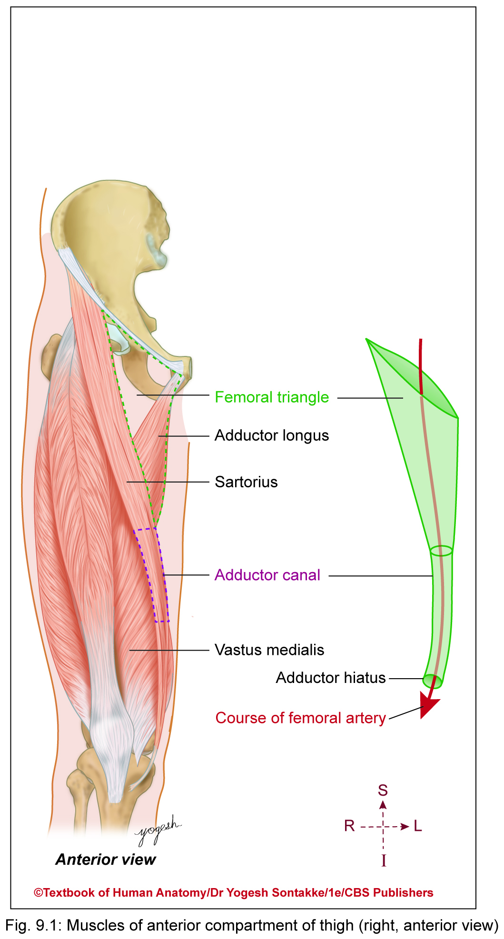
ADDUCTOR CANAL
Intermuscular tunnel situated on medial side of middle one-third of thigh
Also called
  Subsartorial canal – because adductor canal – covered by sartorius muscle
  Hunter’s canal – because John Hunter performed surgeries for treatment of popliteal aneurysm in adductor canal

Slide 36
ADDUCTOR CANAL
Length
About 15 cm long
Extent
Extends from apex of femoral triangle superiorly to tendinous opening in adductor magnus inferiorly
Shape
Triangular on cross-section

Slide 37
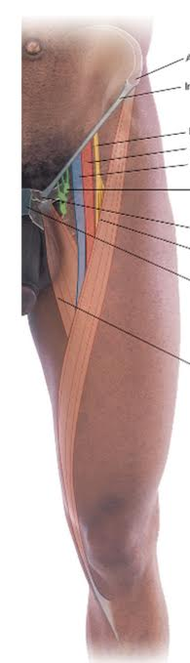
Adductor canal (Subsartorial canal)
Intermuscular canal
Location - Middle 3rd of thigh
Extension – apex of femoral triangle to opening in add.magnus
Triangular in cross section

Slide 38
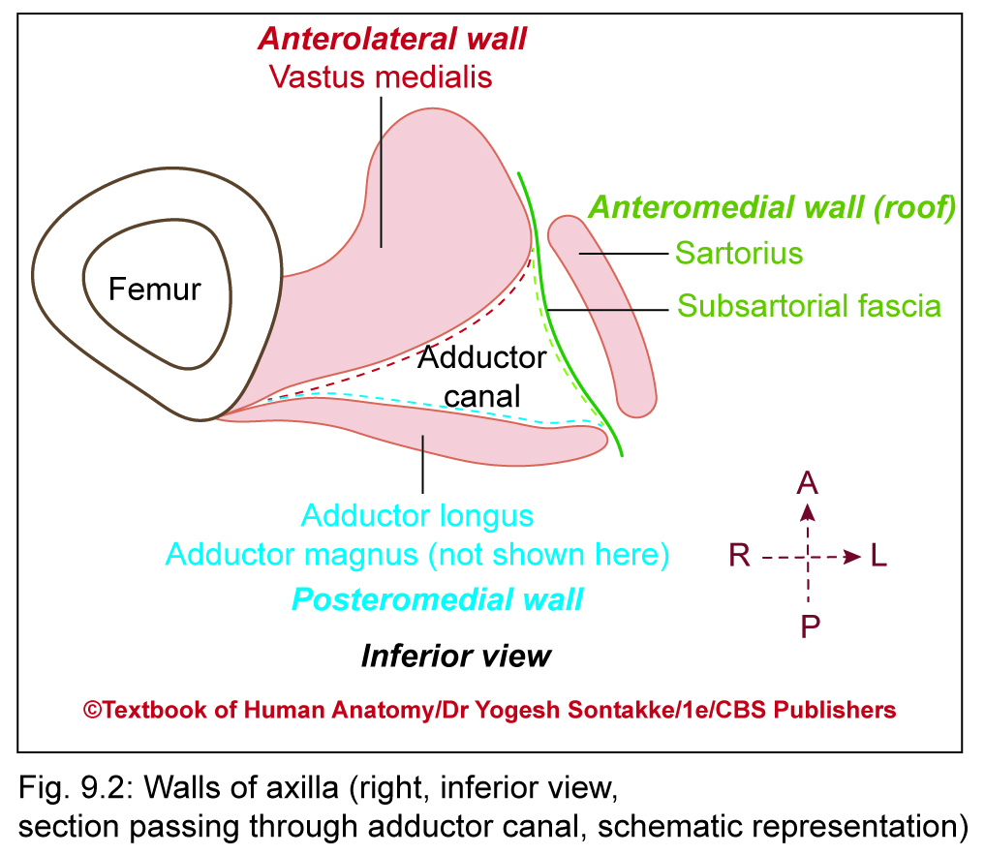
Boundaries of adductor canal
Has three boundaries (wall) as follows
Anterior wall
Formed by vastus medialis
Posterior wall
Formed by
  Adductor longus above
  Adductor magnus below

Slide 39
Boundaries of adductor canal
Anteromedial wall (Roof)
Formed by
  Strong fibrous membrane (subsartorial fascia) extends between anterolateral and posteromedial wall
  Roof – covered by sartorius muscle
  Subsartorial plexus of nerves lies between subsartorial fascia and sartorius

Slide 40
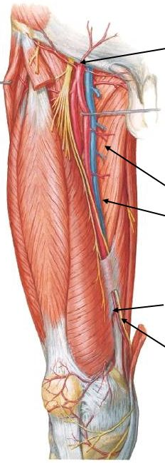
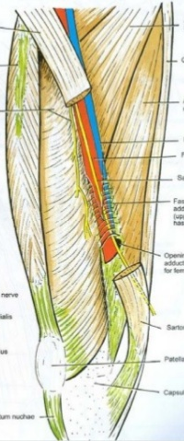
Adductor canal(subsartorial canal)

Slide 41
Adductor canal
Contents -
Femoral artery,
Femoral vein, and
Saphenous nerve, and
Nerve to the vastus medialis
Two divisions of obturator nerve

Slide 42
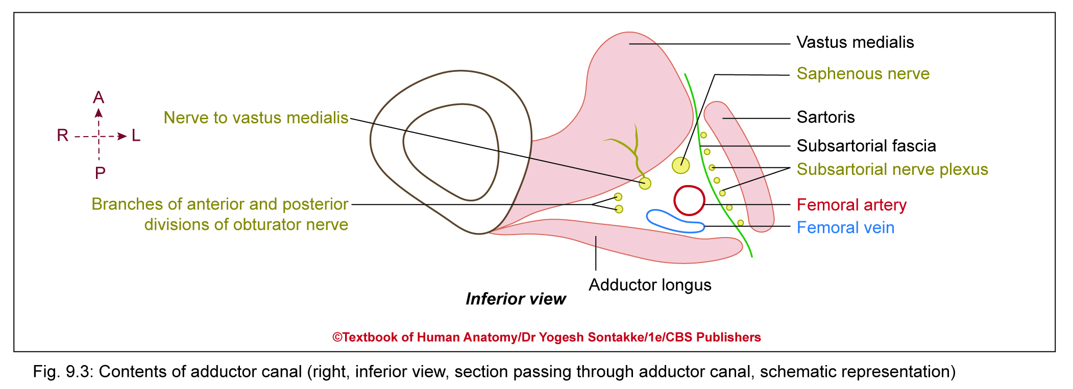

Slide 43
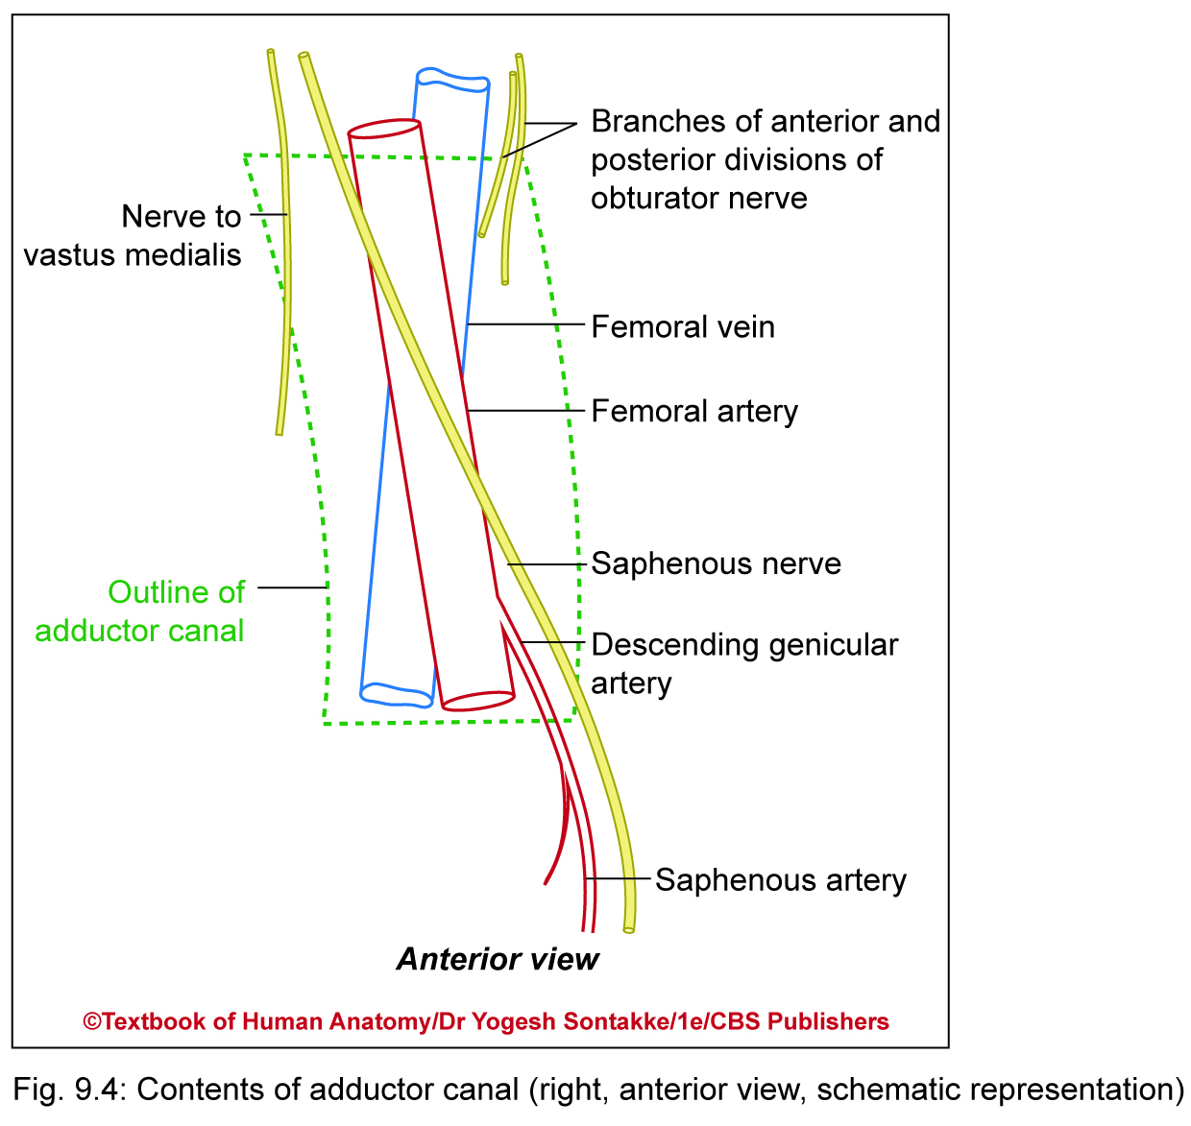

Slide 44
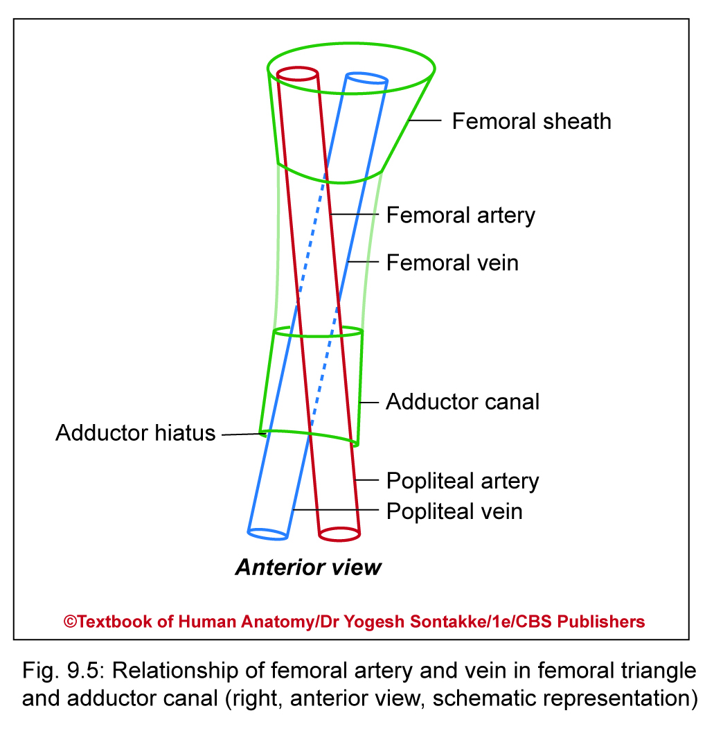
Relationship of femoral vessels and saphenous nerve
  Upper part (anterior to posterior): Saphenous nerve, femoral artery, and femoral vein
  Lower part of canal (lateral to medial): Femoral vein, femoral artery, and saphenous nerve

Slide 45
  Saphenous nerve crosses femoral artery anteriorly from lateral to medial side, and femoral vein crosses femoral artery posteriorly to lie on lateral side of artery
  Rotation of lower limb during embryonic development results in spiral course of nerves and vessels in lower limb

Slide 46
Subsartorial nerve plexus:
Nerve plexus lies on fibrous subsortorial fascia under cover of sartorius
Formation: Subsartorial plexus – formed by contribution of following nerves
  Medial cutaneous nerve of thigh
  Saphenous nerve
  Anterior division of obturator nerve
  - Supplies overlaying fascia lata and skin

Slide 47
Clinical Anatomy
Historic aspect
  John Hunter first performed ligation of femoral artery in adductor canal for treatment of popliteal artery aneurysm (abnormal dilation)
Adductor canal block
  Local anesthetic – injected in adductor canal to block saphenous nerve
Adductor canal compression syndrome
  Hypertrophy of adjacent muscles may cause compression of neurovascular bundle in adductor canal
  may result in claudication symptoms due to femoral artery compression or neurological symptoms due to saphenous nerve compression

Slide 48


Slide 49
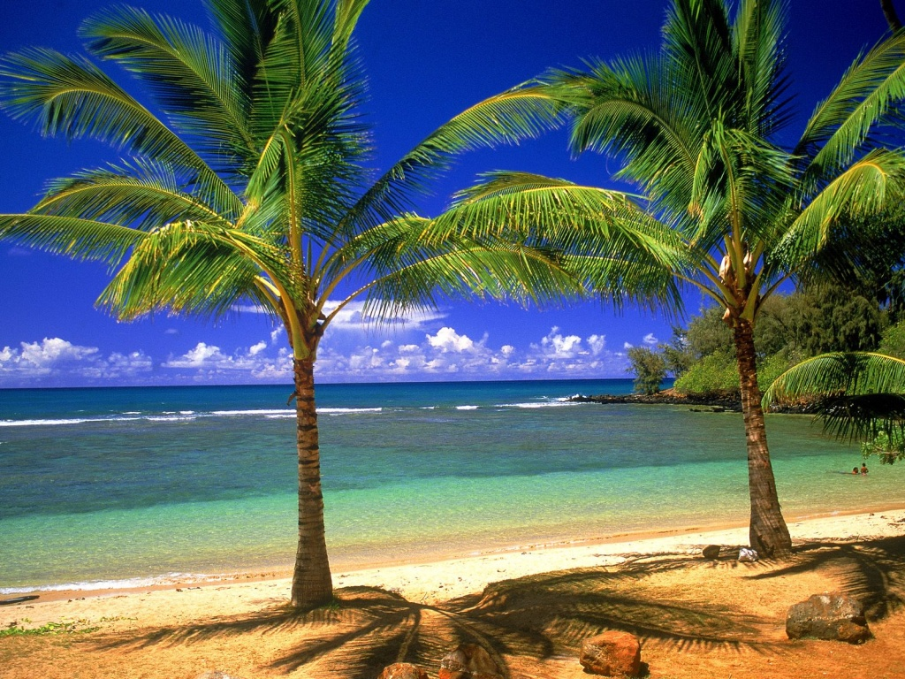
……..THANK YOU……..

