Slide 1
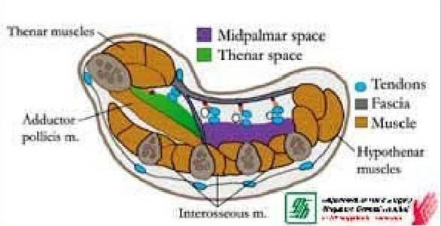
GROSS ANATOMY FASCIAL SPACES OF HAND
Dr. Praveen Kumar Kurrey
MBBS, MS, BCME, BCBR
Professor, Anatomy

Slide 2
Introduction
The arrangement of fascia and the fascial septa in the hand is such that many spaces are formed. These spaces are of surgical importance because they may become infected and distended with pus.

Slide 3
The important spaces of hand are-
(1) Palmar spaces-
The pulp space of the fingers..
The midpalmar space.
The Thenar space.

Slide 4
(2) Dorsal Spaces-
Dorsal subcutaneous space.
Dorsal subaponeurotic space.
(3) The Forearm Space Of Parona.

Slide 5
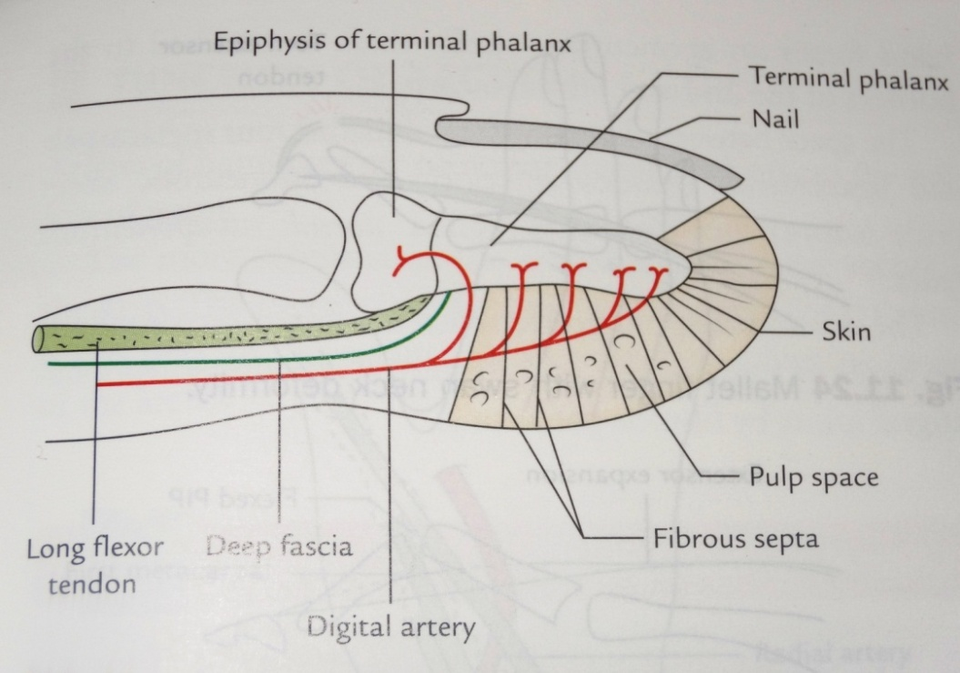
The Pulp space of finger
The tips of the fingers and thumb contain subcutaneous fat arranged in tight compartments formed by fibrous septa which pass from the skin to the periosteum of the terminal phalanx.

Slide 6
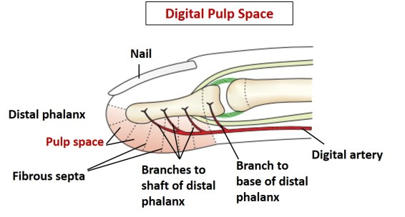

Slide 7
The infection of this space is known as whitlow.
The rising tension in the space give rise to sever throbbing pain.
If neglected a whitlow may lead to necrosis of the distal 4/5th of the terminal phalanx due to occlusion of the vessels by tension. The proximal 1/5th escapes because its artery does not traverse the fibrous septa.

Slide 8
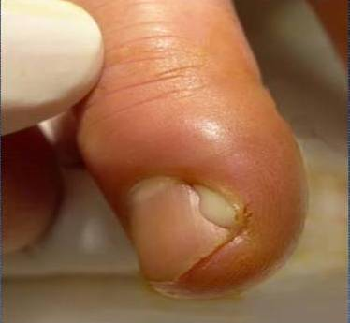
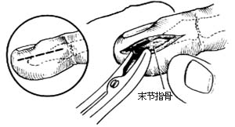
Treatment-
Pus can be drained by a lateral incision.

Slide 9
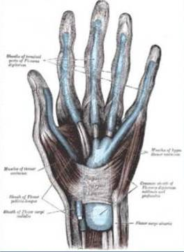
The Digital Synovial Sheath
The digital synovial sheaths of the 2^{nd,} 3^{rd ,} 4thfingers are independent and terminate at the level of the heads of the metacarpals.
Notes:
The sheaths enclo

Slide 10
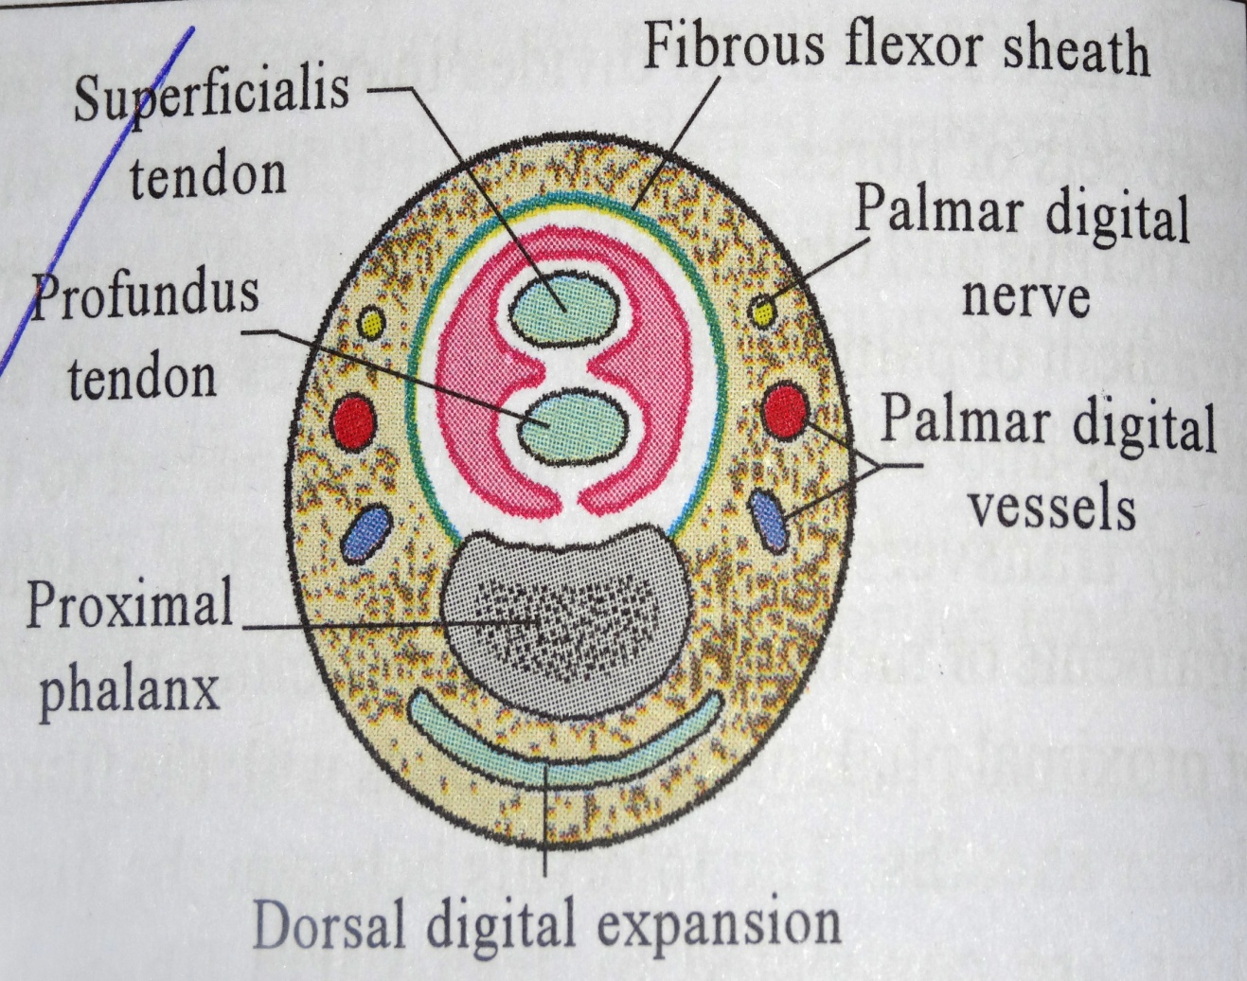
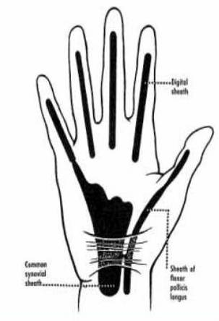

Slide 11
Synovial sheath of the little finger is continuous with the ulnar bursa, and that of the thumb with radial bursa. Therefore, infections of the little finger and thumb are more dangerous because they can spread into the palm and even up to 2.5 cm above the wrist.

Slide 12
Tenosynovitis
Tenosynovitis is the inflammation of the fluid filled sheath that surrounds the tendon.
Cause –Penetrating trauma.
Symptoms -
Tenderness along the course of the flexer tendon.
Symmetric edema of invloved finger.
Pain on passive extension.
Flexed resting posture of finger.

Slide 13
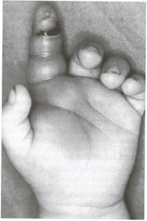

Slide 14
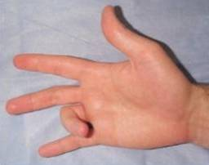
Trigger finger
Trigger finger occurs due to fibrosis of the flexor
tendon sheath and due to localised thickening of the long flexor tendon.
Finger get locked in
flexion and can
only be extended by
passively by the
other hand.

Slide 15
Radial Bursa
Radial bursa encloses the tendon of flexor pollicis longus.
Radial bursa extends through the carpal tunnel into the distal forearm.
Infection of the radial bursa can spread to the ulnar bursa.
It can be drained by an incision along the medial margin of the thenar eminence.

Slide 17
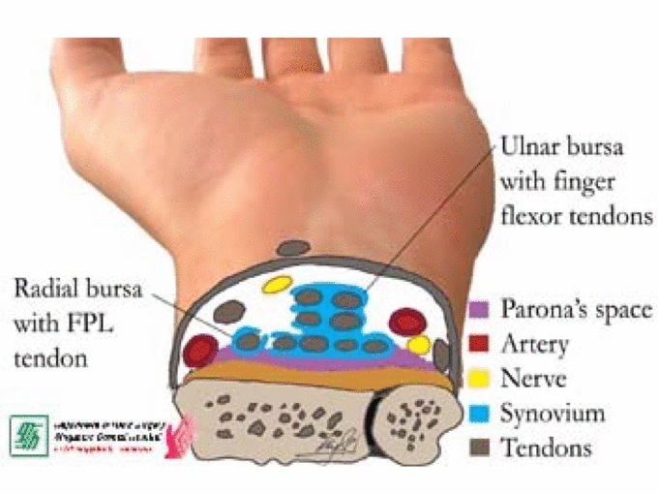

Slide 18
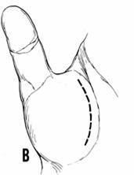
Infection of the thumb
may spread to the radial
bursa and to the ulnar
bursa.

Slide 19
Ulnar Bursa
Ulnar bursa encloses the long flexor tendons of the fingers.
The ulnar bursa extends upwards for 5 - 7.5 cm into the forearm and downwards up to the middle of the shafts of the metacarpal bone.
Lower medial end is continuous with the digital synovial sheath of the little finger.

Slide 20
Infection in this bursa is usually secondary to the infection of the little finger, and this may spread to the forearm space of Parona. It may result in an hour- glass swelling.
Infection in this bursa can be drained
by an incision given along the lateral
margin of the hypothenar eminence.

Slide 21
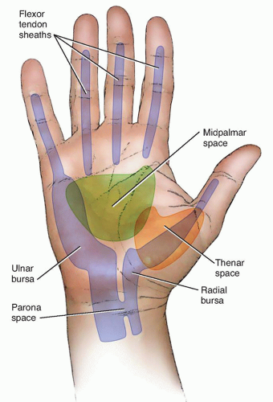
RADIAL AND ULNAR BURSA

Slide 22
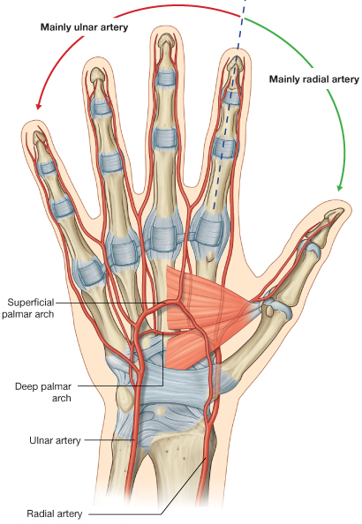

Slide 23
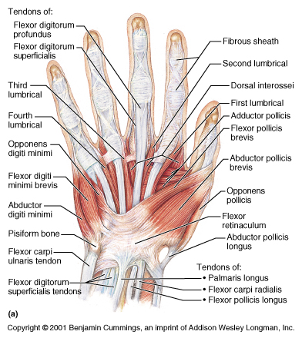

Slide 24
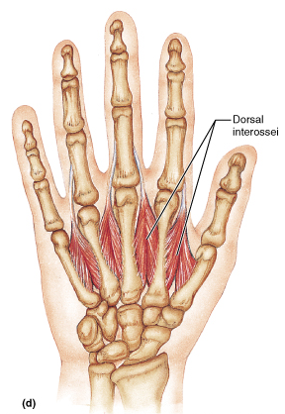
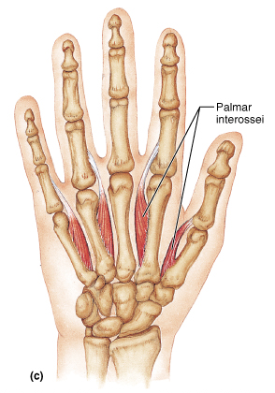
THE INTEROSSEI
ABDUCTION
ADDUCTION

Slide 25
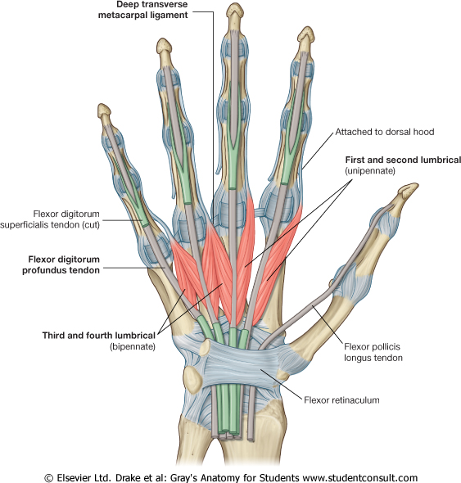

Slide 26
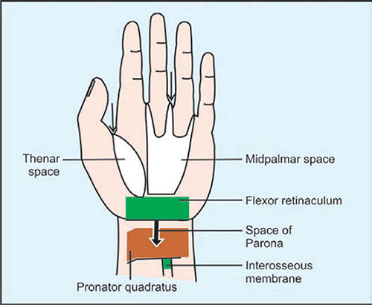
THENAR AND MIDPALMAR SPACE

Slide 27
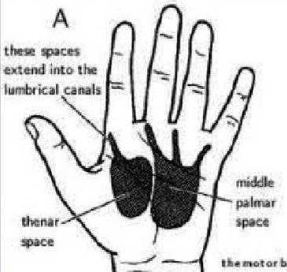
Midpalmar Space
The midpalmar space is located under the medial half of hollow of the palm.

Slide 28
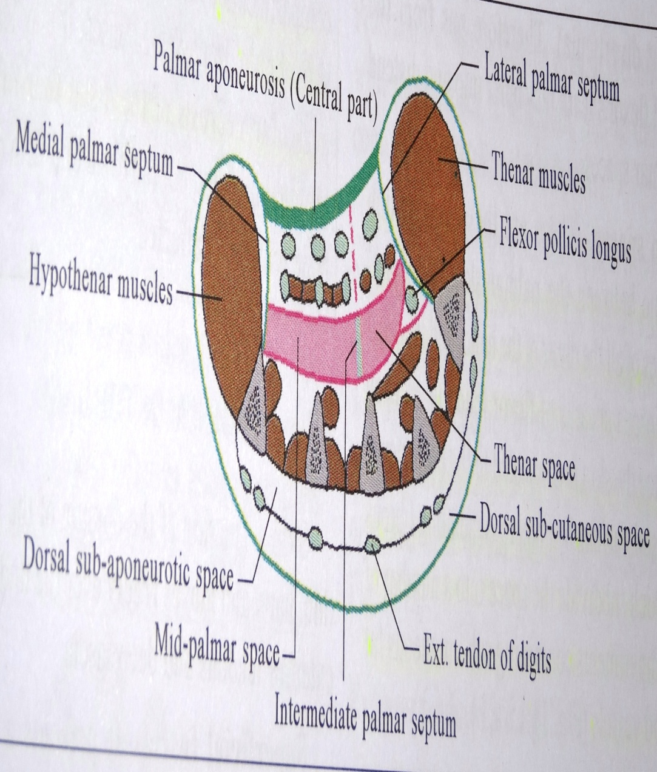
BOUNDARIES
Anteriorly;-
Skin
Palmar aponeurosis
Superficial palmar arch
Digital nerve and vessels
Ulnar bursa
FDS (3,4,5,th Fingers)
FDP (3,4,5,th Fingers)
3rd and 4th lumbricals

Slide 29
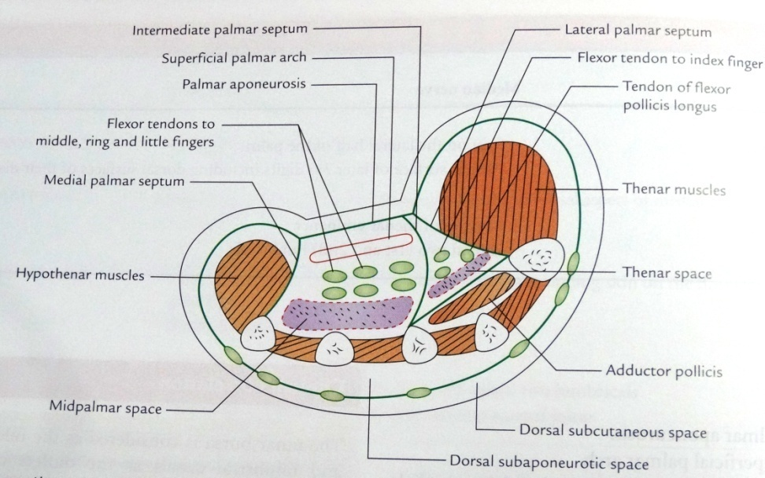
Boundaries

Slide 30
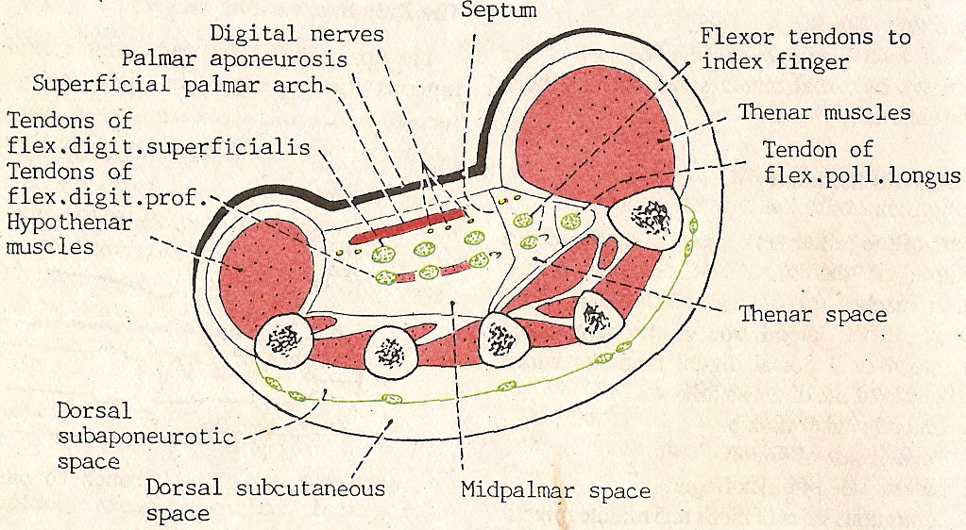

Slide 31
Posteriorly;-
3rd,4th and 5th metacarpal bone.
Palmar and dorsal interossei with fascia covering them.
Laterally;-
Intermediate palmar septum.
Medially;-
Medial palmar septum.

Slide 32
Extent --
Proximal;-
Distal margin of flexor retinaculum.
Distal;-
Distal transverse palmar crease

Slide 33
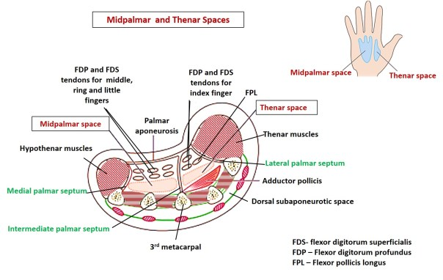

Slide 34
Midpalmar space infections
Pain, swelling, loss of palmar concavity.
Pain with movement of the third and fourth digits.
Dorsal swelling secondary to the tracking of infection dorsally along the lymphatic's.

Slide 35
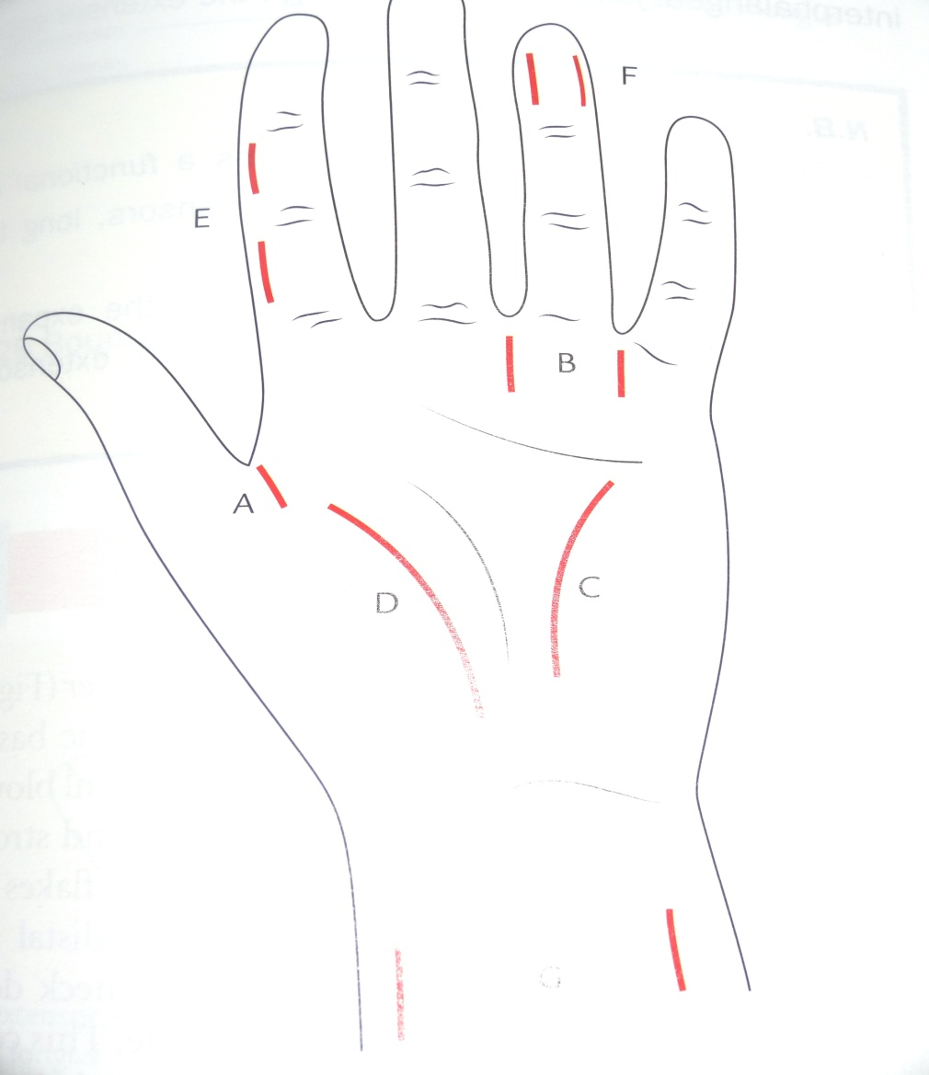

Slide 36
Thenar space
It is triangular in shape, lies on the radial side of the midpalmar space.

Slide 37
BOUNDARIES
Anterior;-
Skin
Suprficial Fascia
Palmar aponeurosis .
Superficial palmar arch.
Flexor tendon of index finger.
Tendon of flexor pollicis longus.
1st and 2nd lumbrical.

Slide 38
Posterior;- Adductor pollicis.
Lateral;- Lateral palmar septum.
Medial;- Midpalmar septum.
Proximal Extent ; Distal margin of flexor retinaculum.
Distal Extent ;- Proximal transverse crease

Slide 39
Boundaries

Slide 40
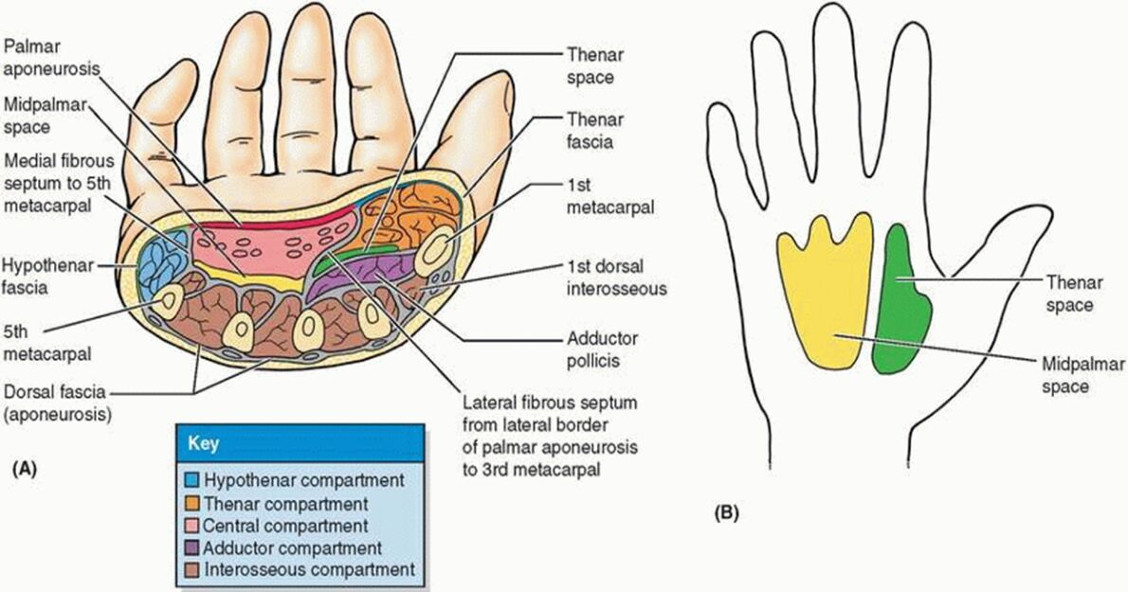

Slide 41
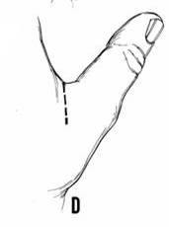
Thenar space infections
Marked swelling of the thumb-index web space.
Flexed and abducted resting posture of the thumb.
Pain with passive adduction.
It can be drained by giving an incision in the first web space.

Slide 42
Dorsal subcutaneous space
It lies deep to the skin on the dorsum of the hand.
Contains;-
Dorsal venous arch.
Dorsal digital nerves.

Slide 43
Boundaries

Slide 44
Infection of this space is uncommon.
If this space is infected then there is collection of pus which produces large swelling.
Pus can be drained by incision given at the pointing site.

Slide 46
Dorsal subaponeurotic space
It lies between the deep fascia and the dorsal surface of metacarpal bones and common aponeurosis formed by dorsal extensor tendons..
Contains;-
Extensor tendons of the hand.
Dorsal digital expansions.

Slide 47
Pus collected in the subaponeurotic space is limited proximally at the bases of metacarpal bones and distally at the metacarpophalangeal joint
On each side it is limited opposite the borders of second and fifth metacarpal bones.
To drain the pus from this space incision are made in the apneurosis between the tendon distally,other incisions given on the radial and ulnar side of extensor tendons.

Slide 48
FOREARM SPACE OF PARONA
It is situated in the lower part of the forearm.
Shape;- Rectangular.
Boundaries;-
In front – Pronator quadratous.
Long flexor tendon.
Superiorly- it extend up to the oblique origin
of FDS
Inferiorly – up to the flexor retinaculum.
Communication – with mid palmar space and thenar space.

Slide 51
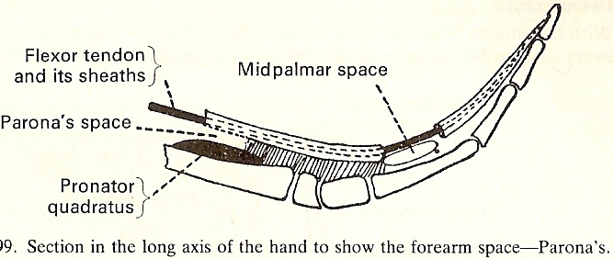

Slide 52
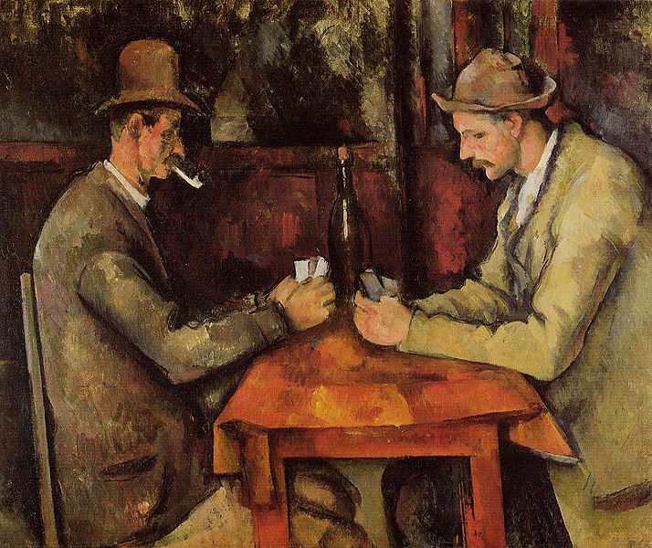
Painting by- Paul Cezane (CARD PLAYERS,1894) Rs. 1,15,00,00,000 - SOLD

Slide 53

THANK YOU

Slide 54


THANK YOU

